Slide 1
API, Virtio Messages for Virtio-ipsec-LA
Subha Venkataramanan, Srini Addepalli
subhaav@freescale.com
addepalli.srinivasa@gmail.com

Slide 2
Agenda
g-API Guidelines
Virtio-ipsec-la
Categorization
Packet Flow
g-APIs for IPsec
sio Interface
Virtio IPsec default device definition
Virtio Messages for IPsec
Relevant documents
Architecture/PoC

Slide 3
g-API Guidelines
C-functions
APIs to be defined as C callable functions
API Flags
API Naming
By defining arguments as structures, it is possible to add parameters passed easily without changing API definitions.
Arguments as structures
Allows for APIs to be extended with minimal code changes.
Synchronous or Asynchronous.
In case asynchronous mode is requested, calling application should provide the callback function and argument that can be called by the API layer later when the response is ready.
Response Required or not
In some cases, there may be additional steps that the API layer needs to do, to force a response from the underlying virtual accelerator. (e.g: Openflow)
Return Value
May provide additional error details in the case of failure
Must return success or failure
g_”function”_”type”_”object”_”action”.
Variable Naming
Linux style of naming convention to be followed
For e.g., an IPsec look aside accelerator SA add function would be named as g_ipsec_la_sa_add()
Types
Linux standard types to be used for data structures
Not Applicable for Packet processing APIs

Slide 4
Virtio-ipsec-la
NFV Software
NFVI
VNF
Look Aside Accelerator
In-line
Fast Path
Housing/Location of Accelerator
Integrated CPU(Accelerator as Hardware function, FPGA, GPU, NDU, AIOP etc.)
iNIC
Network Attached
Accelerator based on Functionality Type
Security (Crypto, IPsec, SSL, SRTP etc.)
Compression / Decompression Accelerator
OF based Packet processors for fast path and data plane
Bus Attached
L1 Accelerator (DSP, Transcode)
Type of Accelerator
Optimized Software Path
e.g. DPDK, ODP
CPU (Instruction based)
Pattern Matching
Optimized Store
Function based packet processor e.g. Secure L2/L3 Packet Processor, eNodeB Packet Processor, etc.
Memory Slots
Processor Interconnect Attached
Accelerator types based on multiple facets
Note: Classification is Freescale Contribution to ETSI IFA-001 (Status: Accepted)

Slide 5
Virtio-ipsec-la Packet Flow
IPsec Packet Processing – Look Aside Accelerator Flow
VNF
F1, F2 – functions such as Firewall, NAT etc.
F1
IPsec
F2
More than Crypto
Algorithm Processing
Protocol header processing
Encapsulation
De-capsulation
ESP, AH
Anti-replay check
Checksum computation
Ingress/Egress
Path
IPsec Path
Virtio-IPsec Frontend
Virtio-net Frontend
Virtio-net Frontend
VRING
Transport
Host Linux User
Virtio-IPsec Backend
QEMU
Host Linux Kernel
VHOST-NET
IP Tables
OVS DP
KVM
VLAN/VXLAN Driver
Hardware
NIC
IPsec Accelerator Hardware

Slide 6
g-API for IPSec
Data API
Control API
Management API
g_ipsec_la_packet_encap()
g_ipsec_la_packet_decap()
g_ipsec_la_mult_packet_encap()
g_ipsec_la_multi_packet_decap()
g_ipsec_la_capabilities_get()
g_ipsec_la_sa_add()
g_ipsec_la_sa_del()
g_ipsec_la_sa_mod()
g_ipsec_la_sa_flush()
g_ipsec_la_sa_get()
g_ipsec_la_notifications_hook_register()
g_ipsec_la_get_api_version()
g_ipsec_la_avail_devices_getinfo()
g_ipsec_la_active_devices_getinfo()
g_ipsec_la_open()
g_ipsec_la_close()
g_ipsec_la_group_create()
g_ipsec_la_group_delete()
Send a packet for encapsulation
Send a packet for decapsulation
Send multiple packets for encapsulation
Send multiple packets for decapsulation
Get the capabilities of the underlying devices
Add SA
Delete SA
Modify SA
Flush SA
Read and Traversal SA
Register hooks for optional notifications such as Sequence number overflow or lifetime in kilobytes expiry etc.
Get the API version
Get the information on available devices
Get the information on active devices
Open a device
Close a device
Create a logical group for grouping SAs
Delete a logical group

Slide 7
DPACC Requirements/IPsec API mapping
# | DPACC Requirement | Compatibility | Comments
1 | MUST be as high a performing design as possible | ✓ | No structures in the Data processing APIs
2 | MUST provide portability for the applications (Both Source and Binary) - Source code portability across CPU architectures Binary portability within a CPU architecture (vNF VM binary in case of QEMU and vNF container binary in case of Linux containers). | ✓ | APIs don’t use any particular implementation based structures and all APIs are normal C functions. All tunable parameters are queried and informed using API functions.
3 | MUST be scalability in performance and design | ✓ | Supports any number of accelerators exposed by host Linux Tunable for high capacity systems
4 | MUST be written in a portable language | ✓ | Implemented in ‘C’
5 | MUST support legacy VNFs | ✓
6 | MUST supply all code within the DPACC design to be open sourced | ✓ | In the works
7 | MUST NOT supply code in binary form with only one exception | ✓ | Code to be submitted in source form
8 | MUST NOT use non-upstreamed host kernel modules or modifications for core DPACC system | ✓ | Yes. No host Kernel Changes or Modules
9 | MUST document the API and code with Doxygen | ✓ | Will be made available when code is submitted

Slide 8
sio (virtio) Interface – Ipsec-LA Device
Registers
Number of Version Registers
Version 1
Version 2
Version n
Guest’s Preferred Version
Device Queue Information
Guest’s Selected Queues
Feature Bits
VIRTIO_IPSEC_F_SG_BUFFERS
VIRTIO_IPSEC_F_AH
VIRTIO_IPSEC_F_WESP
VIRTIO_IPSEC_F_SA_BUNDLES
VIRTIO_IPSEC_F_UDP_ENCAPSULATION
VIRTIO_IPSEC_F_SOFT_LIFETIME_BYTES_NOTIFY
VIRTIO_RING_F_INDIRECT_DESC
VIRTIO_IPSEC_F_TFC
VIRTIO_IPSEC_F_ESN
VIRTIO_IPSEC_F_ECN
VIRTIO_IPSEC_F_DF
VIRTIO_IPSEC_F_ANTI_REPLAY_CHECK
VIRTIO_IPSEC_IPV6_SUPPORT
VIRTIO_IPSEC_F_SEQNUM_OVERFLOW_NOTIFY
VIRTIO_IPSEC_F_SEQNUM_PERIODIC_NOTIFY
VIRTIO_RING_F_EVENT_IDX
Default IPsec Device
Transport mode
Tunnel mode
IPv4
ESP Protocol
IP checksum computation of tunnel packets
Queues
Control Queue
De-capsulation Qs [1..n]
Encapsulation Qs[1..n]
Notification Queue (Optional)

Slide 9
sio Interface Virtio Messages
VIRTIO_IPSEC_CTRL_GENERIC
VIRTIO_IPSEC_CTRL_SA
VIRTIO_IPSEC_CTRL_GET_CAPABILITIES
VIRTIO_IPSEC_CTRL_SET_GUEST_ENDIAN
VIRTIO_IPSEC_CTRL_ADD_GROUP Add a group
VIRTIO_IPSEC_CTRL_DELETE_GROUP Delete a group
VIRTIO_IPSEC_CTRL_ADD_OUT_SA Add an outbound SA
VIRTIO_IPSEC_CTRL_DEL_OUT_SA Delete Outbound SA
VIRTIO_IPSEC_CTRL_UPDATE_OUT_SA Update Outbound SA
VIRTIO_IPSEC_CTRL_READ_OUT_SA Read Outbound SA
VIRTIO_IPSEC_CTRL_READ_FIRST_N_OUT_SAs Read first N outbound SAs
VIRTIO_IPSEC_CTRL_READ_NEXT_N_OUT_SAs Read next N Out SAs
VIRTIO_IPSEC_CTRL_ADD_IN_SA Add an inbound SA
VIRTIO_IPSEC_CTRL_DEL_IN_SA Delete Inbound SA
VIRTIO_IPSEC_CTRL_UPDATE_IN_SA Update Inbound SA
VIRTIO_IPSEC_CTRL_READ_IN_SA Read Inbound SA
VIRTIO_IPSEC_CTRL_READ_FIRST_N_IN_SAs Read first N SAs
VIRTIO_IPSEC_CTRL_READ_NEXT_N_IN_SAs Read Next N SAs
VIRTIO_IPSEC_CTRL_FLUSH_SA Flush SAs within a group
VIRTIO_IPSEC_CTRL_FLUSH_SA_ALL Flush all SAs
Get capabilities
Set capabilities
VIRTIO_IPSEC_CTRL_SET_CAPABILITIES
VIRTIO_IPSEC_GET_HEADROOM_TAILROOM_SIZE Get the headroom, tailroom size
VIRTIO_IPSEC_DATA_GENERIC
Set the guest endian
VIRTIO_IPSEC_SEPERATE_INPUT_OUTPUT_BUFFERS
VIRTIO_IPSEC_IN_MEMORY_BUFFER_REPLACEMENT
Input provided in separate buffers and processed output expected in different buffers
Input data in the input buffers will be replaced with processed data

Slide 10
Details
Documents in git repository
https://github.com/fsl-dpacc-poc/docs.git
G-API guidelines:
api_guidelines_xx.doc
G-APIs for Virtio IPsec
Freescale-IPsec-Virtual-Accelerator-gapi-xxxxx.doc
Virtio IPsec Messages:
Freescale-IPsec-Virtual-Accelerator-xxxx.doc

Slide 11
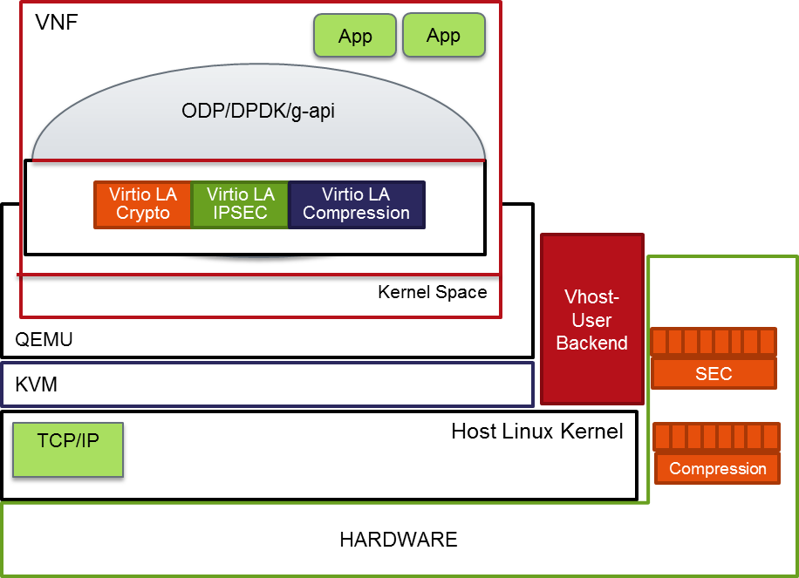
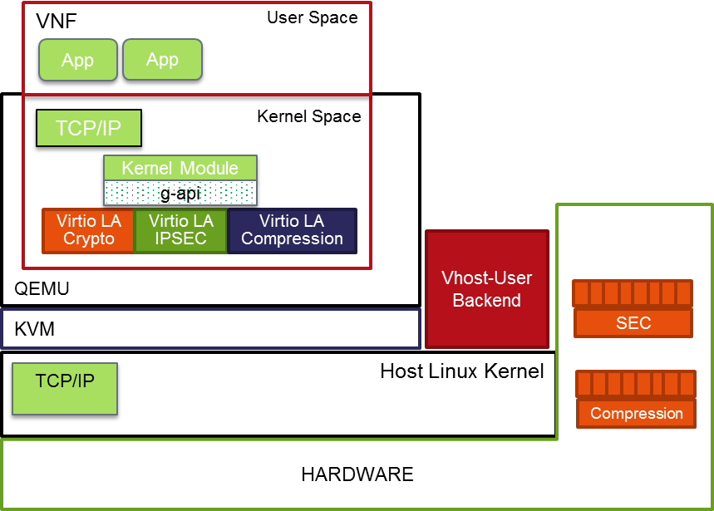
Architecture Model
VNF-Kernel Space Application
VNF User Space Application
PoC Implementation for Kernel Space IPSec to make use of g-api (Currently in focus)
PoC Implementation for User space IPsec Application to use ODP-dpdk

Slide 12
DPACC PoC (Virtio-IPSec) – Contributions welcome
VNF Side
Linux Kernel based IPSec
Freescale is working on this
User space IPSec DP
Which Kit to use
NO HW dependency
Virtio Drivier framework.
ODP over DPDK
-→ DPDK as code base to start?
→ Contributions welcome
Open Stack Support
Advertise accelerator capabilities
Libvirt changes
NOVA scheduler changes
Contributions welcome…
Backend
QEMU Changes to introduce virtio-ipsec-la device.
Various vendors can implement this.
FSL contribution on Layerscape (ARM)

Slide 13
Thank You

