Slide 1
Plugfest
Hongbo Tian
Email: hongbo.Tianhongbo@Huawei.com

Slide 2
Plugfest
At plugfest, equipment from many vendors is brought together to identify interoperability issues.
Even devices which have been certified by the same conformance certification when devices choose different subsets of optional features
It is recommended that developers take prototypes to both certification labs and plugfest
The Plugfest will give participants the chance to have their equipment tested with OPNFV. This is especially helpful for those companies wishing to enter the global market
Plugfest attendees will have the option to request from the plugfest committee a formal test report regarding their participation in terms of test report.
Also, plugfest attendees will have the opportunity to list the device on the OPNFV plugfest webpage

Slide 3
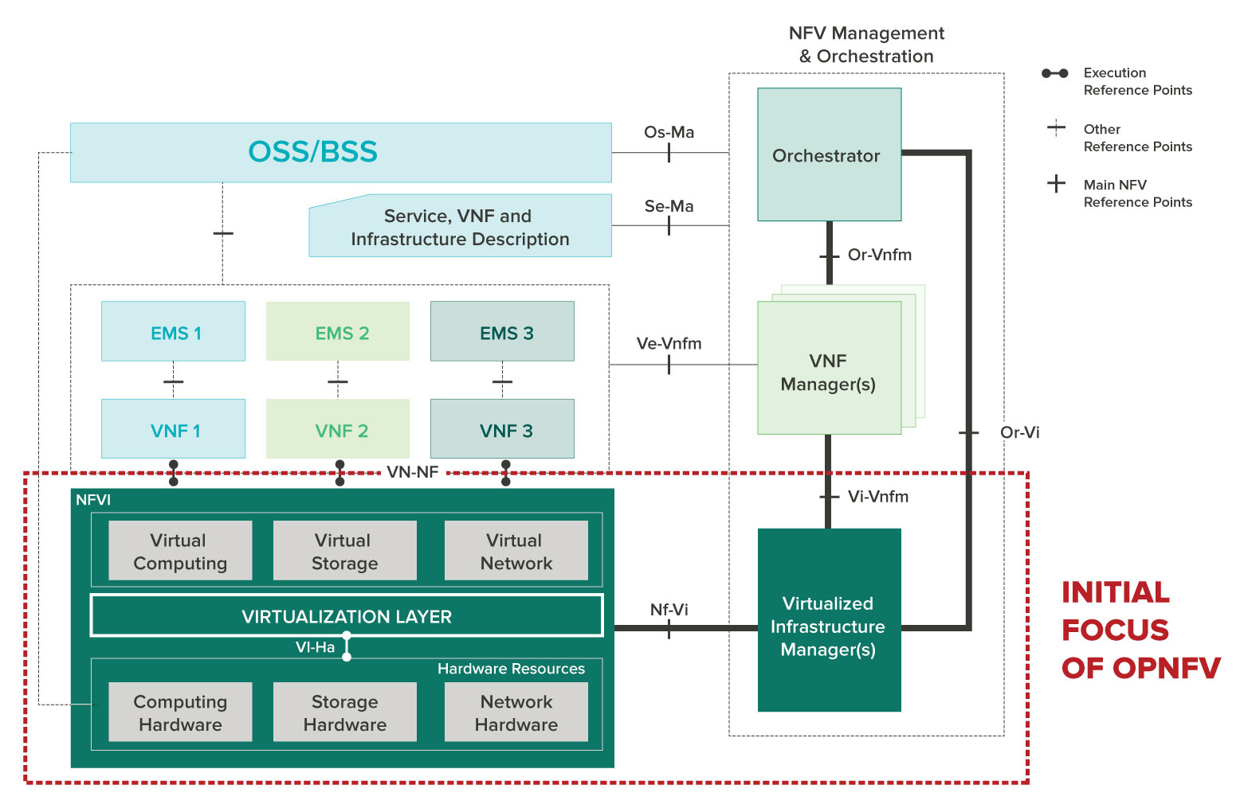
OPNFV first Plugfest
External
compatibility
Internal
compatibility
…..
…..
B release
OPNFV Plugfest is event to help vendors to understand the compatibility with B-release and to build the market and ecosystem。Test results from Plugfest can help to improve the OPNFV release.
Internal facing part of the PlugFest is for vendors to validate their internal components with the Brahmaputra release，i.e. mix and match of choices of internal components from upstream or replacement components. Internal components include(but are not limited to):
Installers, OVS and SDN controllers
External facing part of the Plugfest is for vendors to validate systems that interface with the Brahmaputra release. External systems include(but are not limited to):
Platfrom extensions to OPNFV Brahmaputra
Application(use cases)that run on top of Brahmaputra
Hardware system or components that power the Brahmaputra platform
Participation：Including hardware，software, platform and NFV vendors

Slide 4
Plugfest program
Pre-Plugfest
Plugfest confidentiality
Topics for Plugfest
Test scope
Invitation for vendors
Lab, test environments and test tools
Test case and test plan
Technical support
Plugfest
Plugfest program
Plugfest execution
Test report
All these will be listed on etherpad
Kick off meeting
Plugfest
C release
Nov
May
Aug

Slide 5
Technical group
Test projects
Functest
Yardstick
Bottlenecks
Qtip
Cperf
Operf
Storyperf
Pharos（labs）
Installers
volunteers

