Slide 1
**DRAFT**
Blueprints Alignment
(OpenStack Ceilometer)
5 March 2015
Ryota Mibu, NEC

Slide 2
BP from HA team (2015-02-27)
Add independent alarm report mechanism
Openstack need to add an independent fault alarm mechanism to facilitate the user to detect system problems. Alarm mechanism is currently provided in Ceilometer, but can not fully meet the requirements:
1. Ceilometer Alarm main objective is to single or multiple meter set thresholds to trigger heat auto scaling. For non-meter types of failures triggered alarms can not support.
2. Alarm is achieved by periodically polling meter value whether the user-defined threshold is reached, which can not meet the real-time requirements.
3. After triggering Alarm, there are two form of actions: http callback, log. Need to provide a real-time reporting method, such as SNMP interface.
https://blueprints.launchpad.net/ceilometer/+spec/add-independent-alarm-mechanism
overlap

Slide 3
BP from Doctor Team (2015-03-01)
Real-time instance monitoring and notification-based alarm management
OpenStack Ceilometer already provides some functionality to monitor and alert the user about faults in the server. It will be useful to enhance this functionality as follows:
[1] Instance State Notification: This BP proposes adding new compute notification definition regarding instance state to handle event of instance (server) from nova. It also enables to create a new meter "instance.state". To notify an instance.state change immediately, the BP creates "instance.state" by using the notification agent rather than the pollster.
[2] Event Publisher for Alarm: The proposal is to create a new event publisher which can send messages to a new alarm evaluator [3]. The publisher enables the admin to provide event driven notifications to users such that they can achieve fast auto-healing by using this immediate notification mechanism and orchestrator with auto scaling rules. Besides the existing Ceilometer usage for billing purposes, this BP enhances Ceilometer to provide additional notification capabilities to the user.
[3] Notification-driven alarm evaluator: This BP proposes a notification-driven alarm evaluator that is using event notifications received from [2]. The alarm evaluator does not execute any periodical task, but is triggered by alarm notifications. The alarm evaluator will aggregate and correlate different alarms, which will then be notified to the user in order to trigger recovery action(s) on the user-side (e.g. migrate, terminate,re-instantiate etc.).
https://blueprints.launchpad.net/ceilometer/+spec/realtime-alarm-management
overlap

Slide 4
Proposed BP Alignment regarding two submitted BPs
BP#1 Instance State Notification
BP#2 Event Publisher for Alarm
BP#3 Notification-driven alarm evaluator
BP#4 SNMP notifier to user (NBI)
BP#5 Real-time Alarm (table)
BP#6- New plugin for Detector
(other missing event/meter/notification definitions)
Doctor
Doctor
Immediate Notification with minimum impact
to current Ceilometer
Doctor
HA
HA
Immediate Notification efficiently (Enable detection depends on
alarm configuration)
HA

Slide 5
Immediate Notification
Difference between two blueprint are clarified
[Doctor]
Adding hook and new alarm evaluator to avoid polling mechanism in Ceilometer
[HA]
Adding SNMP interface to NB I/F
New real-time alarm table to efficient detection
(Common)
Extend monitoring target resources such as VM.state and Port.state

Slide 6
[Doctor] Fault Management Scenario
Applications
0. Set Alarm
User-side
Manager
Admin-side Manager
6-. Action
5. Notify Error
Virtualized Infrastructure
4. Notify all
Controller
Controller
Notifier
Controller
Resource Map
Alarm
Conf.
3. Update State
2. Find Affected
4. (alt) Notify
Monitor
Monitor
Inspector
Monitor
Failure Policy
1. Raw Failure

Slide 7
[Doctor] Implementation Plan in OpenStack
Applications
VIM User and Administrator
Virtualized Infrastructure
Queue
Alarm Set
Nova
Ceilometer
Immediate Notification
Error Injection
Zabbix
Inspector
Plugin ?

Slide 8
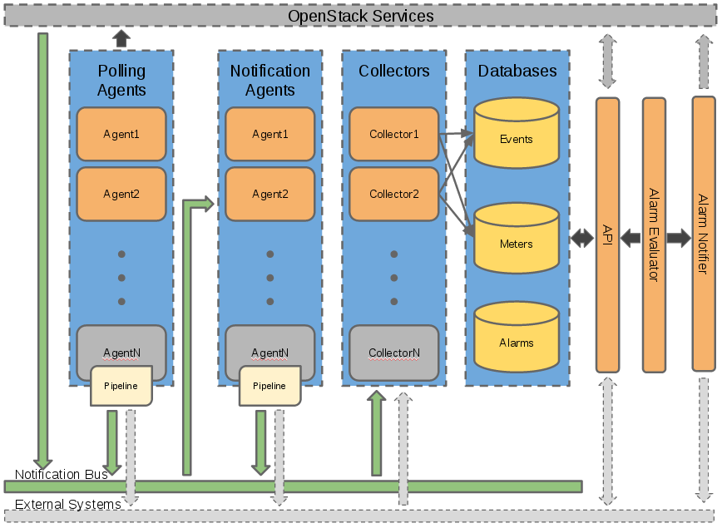
Three approaches to immediate notification for user
Approach 1. evaluate each event
eval
Approach 2. pass notification + real-time evaluator
Approach 3. pass update (including notification and polled samples) + real-time evaluator
Notification-driven Evaluator

Slide 9
Notes of Those Approaches
Approach 1.
Existing BP “Alarm type based on notification”
Add a new alarm type that will be triggered when an notification of a certain type and with some fields is received by Ceilometer.
https://blueprints.launchpad.net/ceilometer/+spec/alarm-on-notification
Patch was abandoned
Approach 2.
Hook in notification agent (“publisher” in Ceilometer terminology)
Able to capture data update only for immediate notification
Approach 3.
Hook in Collector (“dispatcher” in Ceilometer terminology)
Able to capture consistent data if the both of pollster and notification agent could update the same data

Slide 10
Ceilometer Architecture
http://docs.openstack.org/developer/ceilometer/architecture.html

