Slide 1
**DRAFT**
OpenStack Ceilometer Blueprints for Liberty
19 March 2015
Doctor Team

Slide 2
Proposed Ceilometer BPs
BP#1 Instance State Notification
BP#2 Event Publisher for Alarm
BP#3 Notification-driven alarm evaluator
(other missing event/meter/notification definitions)

Slide 3
[Doctor] Fault Management Scenario
Applications
7. Switch to SBY
“Consumer” of Fault Notification
(Tenant User and Administrator)
8. Action
6. Notification
1+2. Subscribe+ Response
Virtualized Infrastructure
5c. Notify all
Controller
Controller
Notifier
Controller
Resource Map
Alarm
Conf.
5a. Update State
5b. Find Affected
5c. (alt) Notify
Monitor
Monitor
Inspector
Monitor
Failure Policy
4. Raw failure

Slide 4
[Doctor] Initial Implementation Plan in OpenStack
Applications
“Consumer” of Fault Notification
(Tenant User and Administrator)
Northbound I/F
Virtualized Infrastructure
Complete list
of resources
Notification bus
Ceilometer
Nova
Immediate Notification
Error Injection
Zabbix
Monasca ?
Plugin ?

Slide 5
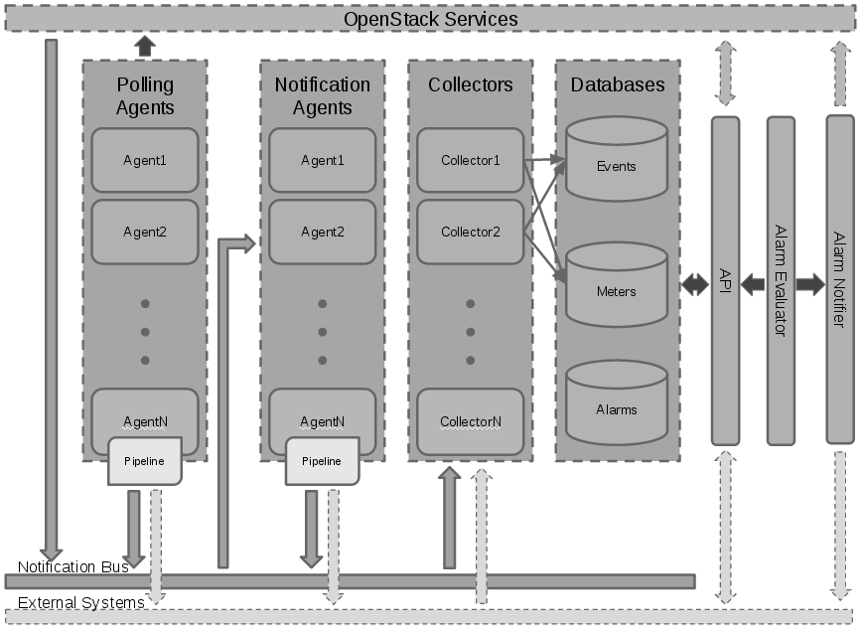
Ceilometer Architecture
event, e.g. alarm
Event-Publisher for Alarm
sample
dispatcher
resource
EXISTING (polling-based)
Notification-driven evaluator
NEW shortcut (notification-based)
notification
http://docs.openstack.org/developer/ceilometer/architecture.html

Slide 6
Ceilometer Architecture
Approach 1
eval
Approach 2
Approach 3
Notification-driven evaluator
http://docs.openstack.org/developer/ceilometer/architecture.html

Slide 7
Notes of Those Approaches
Approach 1.
Existing BP “Alarm type based on notification”
Add a new alarm type that will be triggered when an notification of a certain type and with some fields is received by Ceilometer.
https://blueprints.launchpad.net/ceilometer/+spec/alarm-on-notification
Patch was abandoned
Approach 2.
Hook in notification agent (“publisher” in Ceilometer terminology)
Able to capture data update only for immediate notification
Approach 3.
Hook in Collector (“dispatcher” in Ceilometer terminology)
Able to capture consistent data if the both of pollster and notification agent could update the same data

