Slide 1
Doctor
Fault Management
- Updates -
30 July 2015
Ryota Mibu, NEC

Slide 2
Doctor Overview
One of the OPNFV Requirement Projects (Identify requirement, Gap Analysis, Implementation Study)
Goal
Build fault management and maintenance framework for high availability of Network Services on top of virtualized infrastructure
Valuable and acceptable framework for other industries
Key requirements
Consistent Resource State Awareness
Immediate Notification
Extensible Monitoring
Fault Correlation

Slide 3
Doctor Status
Requirement study, architecture design, Gap analysis
Initial Work Done – “Stable Draft” in https://wiki.opnfv.org/doctor
Refinement activities as 2nd Cycle
Collaborative Development
Good progress in OpenStack Nova and Ceilometer
4 Blueprint (with Spec) → 2 Specs were Accepted
9 Patches → 4 Patches were Merged
Standardization Sync
On-going (by NFV member efforts, joint meeting)

Slide 4
TO-BE Functional Blocks
Applications
VIM User and Administrator
App
App
App
Virtualized Infrastructure
VIM
Virtual Compute
Virtual Storage
Virtual Network
Controller
Notifier
Virtualization Layer
Monitor
Inspector
Hardware Resources

Slide 5
Doctor: Development Status and Plans for OPNFV B Release
Notifier
Controller
Inspector
Monitor
Ceilometer
Nova
Neutron
Cinder
Monasca?
Zabbix
DPDK
To-Be Arch. Design
Gap Analysis
Blueprint
Coding
Integration
OPNFV Release
Done
Plan for B

Slide 6
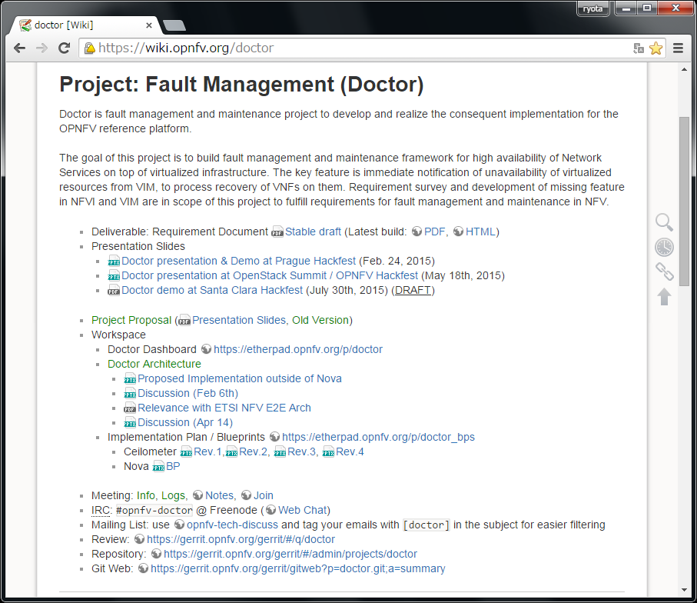
Doctor Info

