Slide 1
OPNFV Summit 2015
Doctor
Fault Management
Gerald Kunzmann, DOCOMO
Carlos Goncalves, NEC
Ryota Mibu, NEC

Slide 2
Doctor Overview
One of OPNFV Requirement Project (Identify requirement, Gap Analysis, Implementation Study)
Goal
Build fault management and maintenance framework for high availability of Network Services on top of virtualized infrastructure
Status
Initial Requirement study, architecture design, Gap analysis : Done
Collaborative Development: On-going (3 merged Blueprints)
Standardization Sync: On-going (by NFV member efforts, joint meeting)

Slide 3
Doctor Members
At project creation (Dec 2014)
NTT DOCOMO, Sprint
NEC, Nokia, Ericsson, Huawei, ClearPath Network, Cisco
Now (Oct 2015)
NTT DOCOMO, Sprint, AT&T, Telecom Italia, KDDI
NEC, Nokia, Ericsson, Huawei, ClearPath Network, Cisco Cloudbase Solutions, Spirent, Intel, ZTE
2x

Slide 4
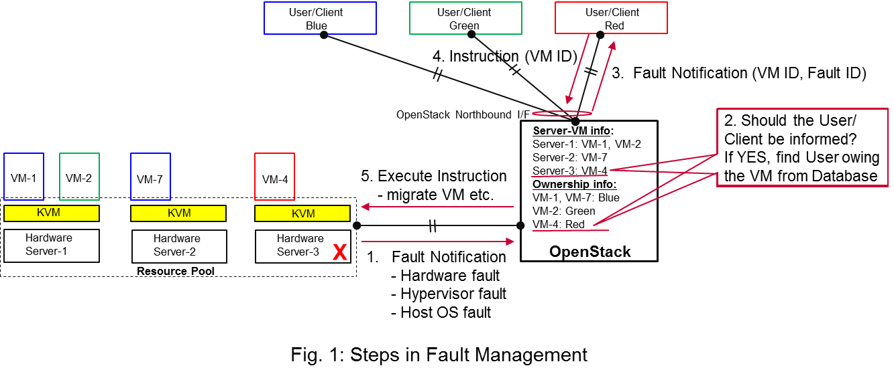
Use Case 1: Fault management

Slide 5
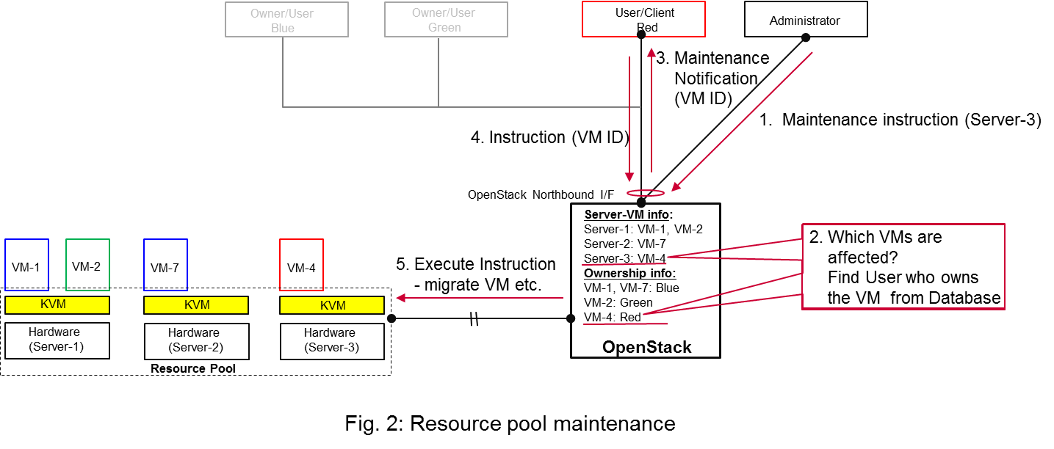
Use Case 2: Maintenance

Slide 6
Fault Management Sequence
Detection
Reaction
Applications
VIM User and Administrator
App
App
App
Virtualized Infrastructure
Virtualized Infrastructure Manager (VIM)
= OpenStack
Virtual Compute
Virtual Storage
Virtual Network
Virtualization Layer
Hardware Resources
Doctor Initial Focus

Slide 7
Key Requirements as VIM
Consistent Resource State Awareness
Immediate Notification
Extensible Monitoring
Fault Correlation

Slide 8
Doctor Architecture and Typical Scenario
Application
0. Set Alarm
Manager
6-. Action
5. Notify Error
Virtualized Infrastructure (Resource Pool)
4. Notify all
Controller
Controller
Notifier
Controller
Resource Map
Alarm
Conf.
3. Update State
2. Find Affected
Monitor
Monitor
Inspector
Monitor
Failure Policy
1. Raw Failure

Slide 9
Doctor OSS Map
Application
0. Set Alarm
Manager
6-. Action
5. Notify Error
Virtualized Infrastructure (Resource Pool)
4. Notify all
Controller
Controller
Notifier
Controller
Resource Map
Alarm
Conf.
Nova
Ceilometer
3. Update State
2. Find Affected
Monitor
Monitor
Inspector
Monitor
Failure Policy
Zabbix
1. Raw Failure
Monasca?

Slide 10
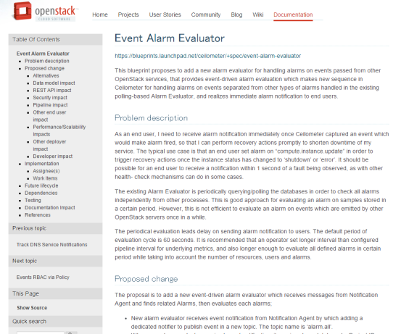
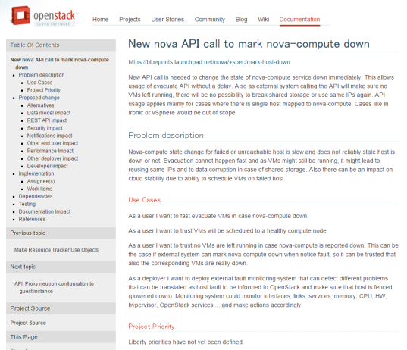
Doctor OSS Development
Application
0. Set Alarm
Manager
6-. Action
5. Notify Error
State Correction
Event Alarm
Virtualized Infrastructure (Resource Pool)
4. Notify all
Controller
Controller
Notifier
Controller
Resource Map
Alarm
Conf.
Nova
Ceilometer
3. Update State
2. Find Affected
Monitor
Monitor
Inspector
Monitor
Failure Policy
Zabbix
1. Raw Failure
Monasca?

Slide 11
Doctor BP’s Detail (TBD)

Slide 12
Doctor Southbound API
Configuration
Fault Messaging
Admin
Threshold
Enable
Conf.
Policy
Conf.
Enable
NFVI
Monitor
Inspector
Controller
Notifier
User
Monitor
Monitor
Unified Event API

Slide 13
Doctor Status
Notifier
Controller
Inspector
Monitor
Ceilometer
Nova
Neutron
Cinder
Monasca?
Zabbix
DPDK
To-Be Arch. Design
Gap Analysis
Blueprint
Coding
Integration
OPNFV Release
Dec 2015
Mar 2015
Done
Upstream
Sep 2015
Next Step
Feb 2016

Slide 14
Doctor Blueprints in Liberty Cycle
Project | Blueprint | Spec Drafter | Developer | Status
Ceilometer | Event Alarm Evaluator | Ryota Mibu (NEC) | Ryota Mibu (NEC) | Completed (Liberty)
Nova | New nova API call to mark nova-compute down | Tomi Juvonen (Nokia) | Roman Dobosz (Intel) | Completed (Liberty)
 | Support forcing service down | Tomi Juvonen (Nokia) | Carlos Goncalves (NEC) | Completed (Liberty)
 | Get valid server state | Tomi Juvonen (Nokia) |  | Waiting for spec approval
 | Add notification for service status change | Balazs Gibizer (Ericsson) | Balazs Gibizer (Ericsson) | Waiting for spec approval

