Slide 1
Update Summary of
DPACC docs
2016/3/11

Slide 2
Quick Summary
Work-in-progress docs
  Dpacc architecture:
    https://docs.google.com/document/d/1O4rtCh1vbTOO5cMwmRwfv3UJb_bVWZrqXQS_-QJAk10/edit#
    No new major issues. Plan to migrate to gerrit next week.
  OpenStack Gap Analysis:
    https://docs.google.com/document/d/1_fOinIQNcPwNODZPzGK5vRMPJQLwL7iLds4NFnjXSms/edit#
    No new input this week. Renaming issue raised online.
    Plan to bring to review after completion of Section 5 next week.
  Dpacc usecase: detailed discussion later.
New doc for API guidelines
  https://docs.google.com/document/d/1Yp5AYO8vqDRRVVBIFGa0updhDTmvyqFLl4bsZREDVaY/edit?usp=sharing
  Based on the proposal and discussion last week
  Working on addressing comments and welcome more review and feedback
  Plan to bring to review next week

Slide 3
Latest Update
DPACC API Guidelines
https://docs.google.com/document/d/1Yp5AYO8vqDRRVVBIFGa0updhDTmvyqFLl4bsZREDVaY/edit
3/10/2016

Slide 4
Update Summary
Do we need to remove the “accmodel” name ?
API - Queries
  API Naming convention (apitype_accfunc_accmodel_operation_suffix )
  API Operations Examples (apitype_accfunc_accmodel_operation_suffix )
  Return Values – Error codes
  Response Arguments
Use-cases
  Software accelerator in Host (or) Guest ?
Given the DPACC Arch Doc reference

Slide 5
API Naming convention (apitype_accfunc_accmodel_operation_suffix )
accmodel, stands for the acceleration model the accelerated application is intended to be using via the API. E.g. “la” for lookaside model, “in” for inline model and “dp” for data path offload model. Please refer to [dpacc-usecase] for the definitions of the three acceleration models of DPACC.
Keith: suggest to remove model information from api name and insert it the arguments instead.
Ola: It is ok to have the model name in the API, as the application is aware of the accelerator type.
Denis:The model information is required in the API name because the API will be different for different models. For example encap_packet for lookaside has to supply output buffers, whereas encap_packet for inline does not have to supply them.

Slide 6
API Operations Examples
(apitype_accfunc_accmodel_operation_suffix )
Keith: what is the difference between "set" and "modify"?
Rajesh:
  Set API is used to update the global configuration like Hostname,time etc.,
  get/set API's operations are used in sequence. There won't be delete API call for this set of API's, as it has always some global value.
  To configure the new record, add/modify/delete API's are used.
Denis:
  set API is used for setting global parameters of the driver or accelerator. modify api is used to change an existing IPsec SA or PDCP security context. Right now, we do not have an example for set API

Slide 7
Return Values – Error codes
The error code is a 32 bit number constructed as follows
Error codes are negative, except when return is successful when the error code is 0
The most significant 16 bits is the accelerator ID
0xFFFF accelerator ID is used for error codes common to all accelerators
Other accelerators are assigned codes as follows
  ipsec_la 0xFFFE
  pdcp_la 0xFFFD
Positive return values may be used to indicate other non-error return values such as number of packets processed in a multi_packet call. These return values are common to all accelerators
Common error codes:-
ACCELERATOR_AVAILABLE 0
ACCELERATOR_NOT_AVAILABLE 1
ACCELERATOR_API_VER_NOT_SUPPORTED 2
RESERVED_ERROR_CODE_BASE 128
GENERAL_FAILURE 65535
Accelerator specific error codes:-
G_ACC_1_ERROR_CODE_START RESERVED_ERROR_CODE_BASE+1
G_ACC_1_ERROR_HANDLE_NOT_FOUND G_ACC_1_ERROR_CODE_START
G_ACC_1_ERROR_NOT_SUPPORTED G_ACC_1_ERROR_CODE_START+2
Reserve and define the commonly used error codes. Accelerator should start from this error code base.

Slide 8
Response Arguments
struct g_ipsec_la_resp_args {
struct g_ipsec_la_resp_cbfn cb_fn;
/* Callback function if ASYNC flag is chosen */
void *cb_arg;
int32_t cb_arg_len; /* Callback argument length */
}
Keith: suggest to define response functions types and then further define the arguments for each of them.
Denis:
Instead of variable length cb_arg for the callback, we can fix them to be 1 or 2 void * args. Then the callback function type will be fixed to
cb_fn(void *arg) or
cb_fn(void *arg1, void *arg2)

Slide 9
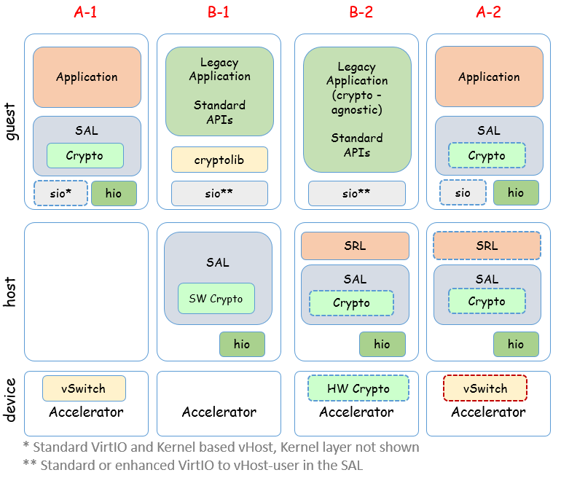
  Use-cases - Software accelerator in Host (or) Guest
If the guest does not require host support the host layer are optional. The host layer allows the guest to have better acceleration support without having to have a SAL layer in the guest.
The guest can have crypto support in software (either guest SAL as in Example A or host SAL as in Example B) or be using a external crypto hardware via the hio interface.
Example A-1 on the left includes a VM with a SAL for direct access to external device and VM to VM support only supplied by kernel based vSwitch or external device. The sio is optional for host access for management, and non-hio packets may have poor performance in some cases.
Example B-1 in the middle includes a legacy application using crypto lib via VirtIO to accelerate crypto operations in the host, where VM to VM is still missing, but can be supported by SAL to external switch accelerator. The design could also be enhanced by adding a kernel based vSwitch for VM to VM traffic.
Example B-2 in the middle includes a legacy application being agnostic to the encrypted traffic being handled in the host software or in external accelerator, which means it sends and receives packet in clear text format as the host layer or the device is encrypting or decrypting the packets unbeknownst to the guest application., An SRL (vSwitch/vRouter) is added for VM to VM communication.
Example A-2 on the right includes accelerated application using SAL in guest to access crypto accelerator directly, as well as flexible vSwitch or vRouter support in SW or HW. SAL allows for some/all crypto operations to be done in the guest or passed to the host for processing.
Reference: DPACC Architecture page 10.
https://docs.google.com/document/d/1O4rtCh1vbTOO5cMwmRwfv3UJb_bVWZrqXQS_-QJAk10/edit?pref=2&pli=1

