Slide 1
DPACC Metadata
2016/2/25

Slide 2
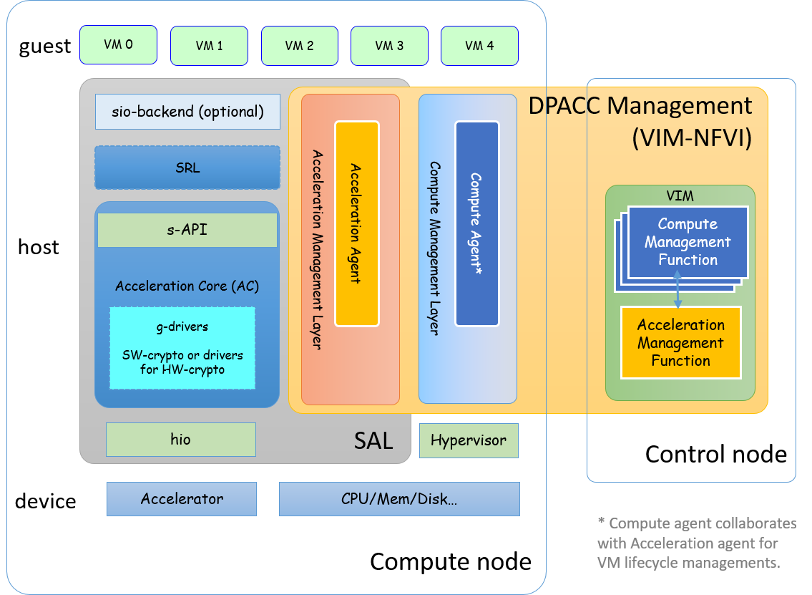
Motivation
Openstack needs to define a general metadata for acceleration resources
Acc-agent interface
s-API
Agent-VIM interface
nfvi-vim
VIM-MANO interface
vim-mano

Slide 3
Information Model Discussion
dev_id | Device ID | Mandatory | a unique device ID for each physical accelerator (either implemented via HW or SW)
mac | MAC address | Optional | MAC address for some of the HW accelerators, e.g. iNIC
numa_node | NUMA Flag | Mandatory | Whether the accelerator is NUMA attaching CPU, default to False.
device_type | HW/SW type | Mandatory | The type of HW/SW device of the accelerator (either physical device or virtual function). Typical types include: GPU, FPGA, SW, ASIC, DSP etc. SoC: a collection of accelerators each with device_id, type, etc.
acc_func | Functionality | Mandatory | The acceleration functionality the accelerator offers. Typical functionalities include: CRYPTO, IPSec, PDCP, FFT, etc.
acc_capability | Capability Capacity? | Mandatory | The acceleration capability of the given acceleration functionality. E.g. in case of crypto, the algorithms supported, the expected performance metrics, etc.
queue_num | Queue number | Optional | Number of concurrent queues/channels supported by the accelerator (either physical or virtual).
queue_type | Queue Type Name is confusing | Optional | The acceleration functionality of a loaded queue on a programmable accelerator or multi-purpose accelerator.
address | Accessible Address for HW accelerator | Mandatory | Bus address for bus attached accelerators, or assigned system address for integrated accelerator or virtual address for a virtual function. Bar address for PCI device (via IO configuration).
pf_address | Physical Address | Optional | Physical address of a HW accelerator that supports virtualization (i.e. the physical accelerator can be sliced into a number of virtual functions, which appear to be an independent physical device to its assignees), otherwise the same with Accessible Address. (combined with address, optional)
vendor_id | Vendor ID | Mandatory | Globally unique vendor ID, assigned by XXX, retrieved from the HW device driver. Default to 0 for SW acc. ?For non-PCI device
product_id | Product ID | Mandatory | Internally unique product ID, assigned by the vendor, retrieved from the HW device driver. Default to 0 for SW acc.

Slide 4
Data Model Discussion
dev_id | String | “pci_”+ PFA for pci device, .e.g. pci_0000_05_00_1 What about other types of device?
mac | String | The Hexadecimal (in hexadecimal) Representation of LAN MAC addresses have been defined in ISO/IEC 10039. E.g., 52:54:00:BA:E2:90
numa_node | Boolean | True(1) or False(0)
device_type | Enumeration | GPU, FPGA, SW, ASIC, DSP
acc_func | Enumeration | CRYPTO, IPSec, PDCP, FFT EMPTY - special value for non-initialized multi-purpose or re-programmable accelerators
acc_capability | Structure (use json) | algorithm": {"type":"aes", "pps":1024,"bps":10},"algorithm": {"type":"3DES", "pps":10240,"bps":10 }]
queue_num | INTEGER
queue_type | Enumeration | Same as acc_func
address | String | Unique PFA (PCI Function Address) , bus number ’:’ device number ’:’ function number. E.g. 0000:05:00.1 What about other types of device?
pf_address | String | Same as address
vendor_id | String | “pci_” + PCI vendor_id (32-bit Hexadecimal (in hexadecimal) Representation) as defined in http://pcidatabase.com/ ) What about other types of device?
product_id | String | “pci_” + PCI vendor_id (32-bit Hexadecimal (in hexadecimal) Representation) as defined in http://pcidatabase.com/ ) What about other types of device?

Slide 5
backup
Initial discussion table and comments taken from
gap analysis of openstack for dpacc
https://docs.google.com/document/d/1_fOinIQNcPwNODZPzGK5vRMPJQLwL7iLds4NFnjXSms/edit

Slide 6
Initial discussion table & comments so far
dev_id | VARCHAR(24) | pci_0000_05_00_1
mac | VARCHAR(32) | 0，：52:54:00:BA:E2:90
numa_node | VARCHAR(1) | 0 or 1
device_type | VARCHAR(12) | Nomad_GPU, Nomad_FPGA
acc_type | VARCHAR(8) | EMPTY、CRYPTO、VTC、DC
acc_capability | VARCHAR(60) | ["count": 2, "algorithm": {"type":"aes", "pps":1024,"bps":10},"algorithm": {"type":"3DES", "pps":10240,"bps":10 }]
queue_num | INTEGER | 1
queue_type | VARCHAR(8) | EMPTY 、SA、IPSec、GB
address | VARCHAR(12) | 0000:05:00.1
pf_address | VARCHAR(12 ) | ?
vendor_id | VARCHAR(4) | 15b3
product_id | VARCHAR(4) | 1004
Do we have a complete list of know acc_types today? If so lets define them in this doc.
Micheal has the same comment in discussion 0205, and we agreed. The definitions are to be introduced in the above table on EPA vs NOMAD, and could be included here later.
I can not determine the format of this field, is it JSON or what? I think we need to define the format of this field if not stated later.
Need to define the values for this field.
Why have this field if the one above is used. Unless the one above is just a text name, then we can remove this one or remove the one above for this field.
What is the reason for this field, is this the number of support Physical Functions or what? It looks like a text or name field.

Slide 7
ETSI NFV IFA004 Information Model
Table 4.2.2.1.2-1: Functional requirements for acceleration resources features
Numbering | Feature | Functional requirements description
ACC_RES_FEATURE.001 (device_id) | UID | Each acceleration resource shall have a unique identifier.
ACC_RES_FEATURE.002 | Version (+M) | Each acceleration resource shall specify the version of its accelerator.
ACC_RES_FEATURE.003 (acc_functionality) | Type | Each acceleration resource shall have a clear type (e.g. Crypto, FFT, IPSec, etc.)
ACC_RES_FEATURE.004 (acc_capability) | Capabilities | Each acceleration resource shall indicate its acceleration specific capabilities.
ACC_RES_FEATURE.005 (queue_number) | Number of Channels | Each acceleration resource shall indicate how many channels it supports.
ACC_RES_FEATURE.006 | Number of Contexts (?) | Each acceleration resource shall indicate how many contexts it supports.
ACC_RES_FEATURE.007 | Allows Migration (+O) | Each acceleration resource shall indicate if it supports live migration capabilities.
ACC_RES_FEATURE.008 (acc_capability) | QoS | Each acceleration resource shall indicate the quality of service level it supports.
ACC_RES_FEATURE.009 | Data Format (?) | Each acceleration resource shall indicate the data format they operate on.
ACC_RES_FEATURE.010 (acc_type) | Re-Programmability | Each acceleration resource shall indicate whether it requires a hardware image to be programmed with before it can operate.
ACC_RES_FEATURE.011 (acc_capability) | Resource Availability (needed exchange but not metadata) | Each acceleration resource shall indicate the level or amount of availability that are currently unused and can be allocated.
Notes:
Howard contact original contributor of the table (Altera) for further clarifications on ACC_RES_FEATURE.006 (Number of contexts) and ACC_RES_FEATURE.009 (Data Format).

