Slide 1
Latest Update DPACC Architecture
https://docs.google.com/document/d/1O4rtCh1vbTOO5cMwmRwfv3UJb_bVWZrqXQS_-QJAk10/edit#
2/18/2016

Slide 2
Table of Contents
1 Introduction
2 Framework
2.1 Partitioned View
2.1.1 Acceleration Layer for Guest (VM’s)
2.1.2 Acceleration Layer for Host (Hypervisor)
2.2 Usage Analysis
2.2.1 Usage: VNF Acceleration types
2.2.2 Usage: VNF Acceleration
2.3 Aggregated View
3 Related Upstream Work Plans
Suggest to remove AML module from SAL@guest.

Slide 3
Discussion Points
Suggest to remove guest AML
Suggest to differentiate two cases for SAL
Host SAL (H-SAL) and Guest SAL(G-SAL)
Suggest to mention Nomad as implementation for AML

Slide 4
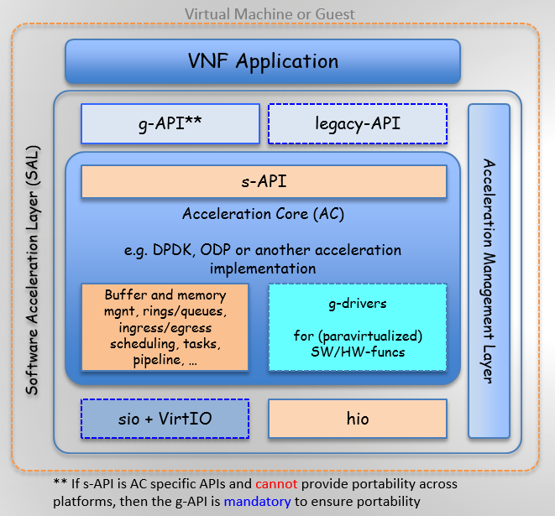
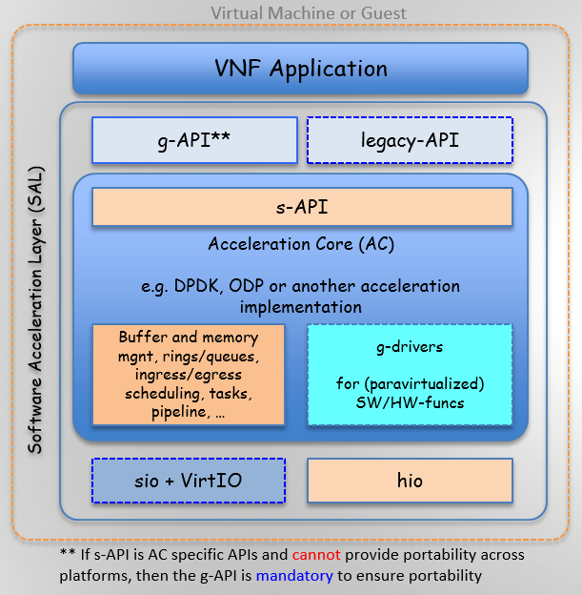
Descriptions AML: Acceleration Management Layer

Slide 5
Todos
Address remain comments
Authors to check the comments
Commenters to confirm remarks and suggestions
Submit to larger group review

