Slide 1
Latest Update DPACC Use-cases
https://docs.google.com/document/d/1eu2489SYeVL180ZzjnagrXTUM1Qh37GKs6N6rRYDVNM/edit
2/25/2016

Slide 2
Table of Contents
Update on the figures to align with dpacc arch.
Introduction
Acceleration Models: Lookaside Model, Offload Model (Inline Model), External Model (Data Path Offload Model)
Virtualized Acceleration Interfaces: Passthrough-based Acceleration & Virtio-based Acceleration
Virtio-lookaside Acceleration & virtio-inline acceleration
Targeting Applications: SmallCell Gateway. IPSec between vRAN and vEPC, VRAN
IPsec Packet Processing Acceleration
NFVI Packet Processing Acceleration
PDCP Packet Processing Acceleration
Use-cases
IPsec Look Aside Accelerator
NFVI Packet Processing Offload Accelerator
Combined NFVI Inline and IPsec LA Accelerator
NFVI and IPsec Offload Accelerator
PDCP Offload Accelerator
vRAN application description refined.

Slide 3
Update Summary
Refine vRAN application statement
???
Updated virtio-lookaside figures
Remove irrelevant technical details
Be aligned with dpacc arch

Slide 4
Targeting applications (Any update?) vRAN (LTE Stack illustration & Accelerator models)
Look aside
Look aside
Inline (offload)
Two types of look-aside accelerator identified
Added into Section 2.1 as examples;
Clarifications added in Section 4.3.
One types of offload accelerator identified
Added into Section 2.2 as examples;
Clarifications added in Section 4.3.
Notes:
Vineet: the leftmost should be changed into GTP. Which can also be accelerated via hardware offload.

Slide 5
Update Summary
Refine vRAN application statement
???
Updated virtio-lookaside figures
Remove irrelevant technical details
Be aligned with dpacc arch

Slide 6
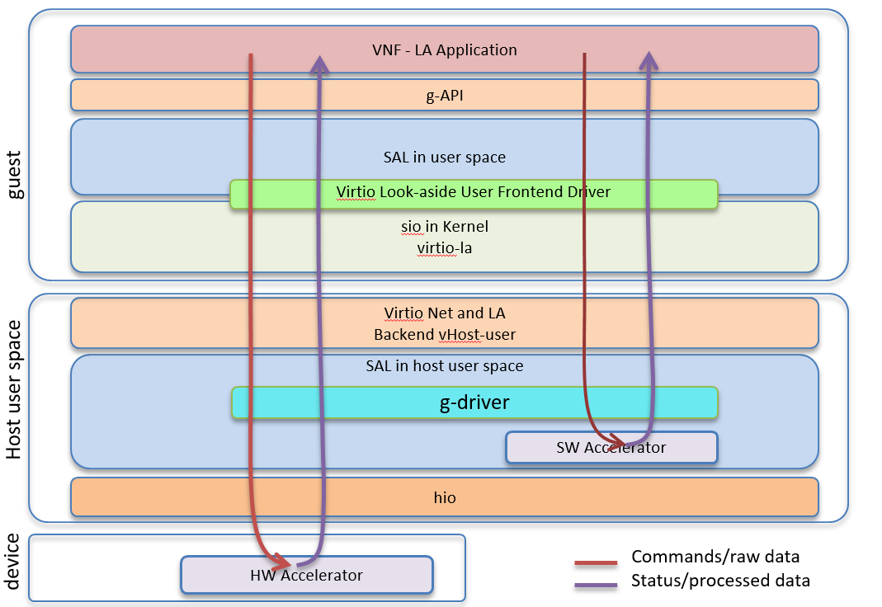
Look Aside Accelerator v1 (updated)
Virtio-Lookaside Acceleration
Notes:
This view is attempting to how the DPACC layer and configuration can be designed by the developer to give his application the best accelerated performance.
In this picture having a software acceleration layer in the host would provide the best performance and flexibility for a VNF application.

Slide 7
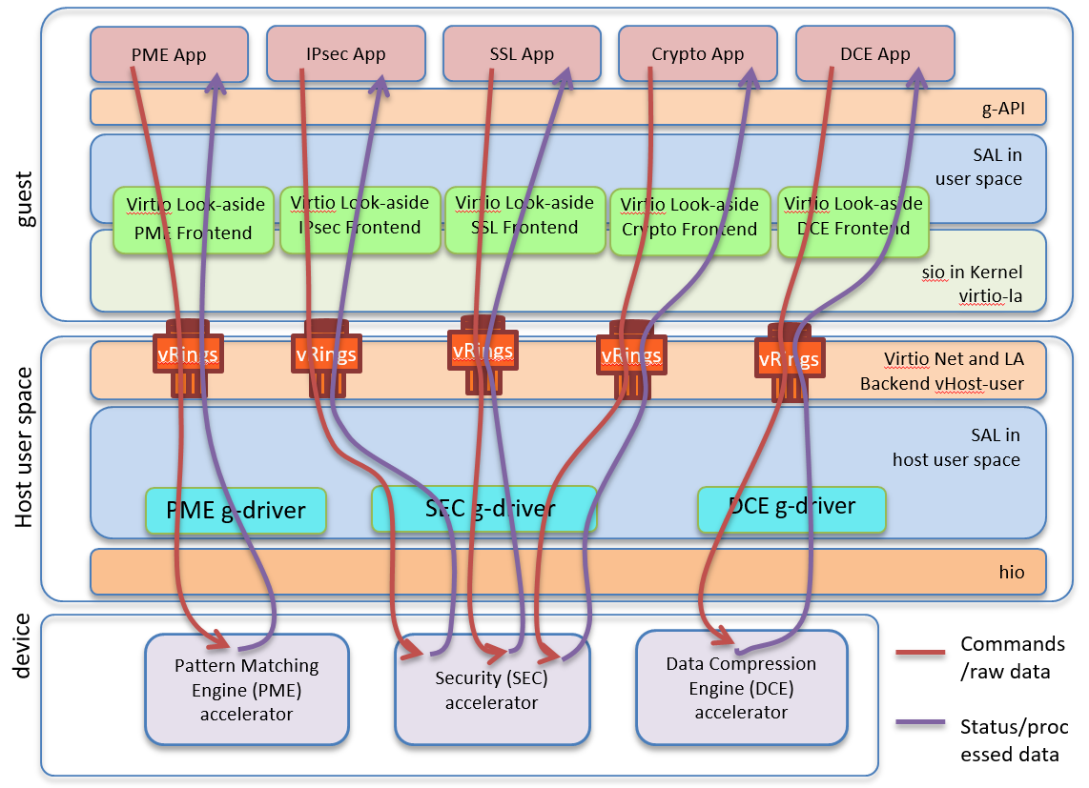
Look Aside Accelerator v2 (updated)

Slide 8
IPSec Look Aside Accelerator (to be updated)
VNF
App F1
App IPsec
Suggest to replace this box with a simple “NFVI packet processing box”, like the one used for crypto, IPSec or PME.
App F2
g-API
To be updated according to the consensus reached based on the previous general figures.
SAL
Virtio-net
Frontend
Virtio-net
Frontend
Virtio-IPsec Look-aside
Frontend
sio + Virtio
Host
kernel
sio-backend (vHost-user)
Vhost-net
IPtables FW
OVS DP
VLAN/VxLAN Driver
s-api
SAL
Acceleration Core
Clear packet
Encrypted packet
IPSec g-driver
hio
Physical ports
IPsec Accelerator HW
Figure X IPsec Packet Processing – Look Aside Accelerator Flow

Slide 9
PDCP Look Aside Accelerator (to be updated)
VNF - PDCP Application
guest
SAL
SAL
SAL
virtio-net frontend
virtio-la-pdcp frontend
virtio-net frontend
To be updated according to the consensus reached based on the previous general figures.
To be aligned with the previous IPSec figure on ingress or outgress part or other processing functions in VNF.
sio
sio
sio
virtio-la-pdcp backend + vHost-user
virtio-net backend
virtio-net backend
host
SAL
hio
SW Accelerator
hio
hio
device
HW (NIC)
HW Accelerator (Crypto)
HW (NIC)
UE
Backplane Processing RLC/MAC/PHY
Downlink
Uplink
Backhaul Processing GTPU/IPSec/QoS
EPC
Notes:
This view is attempting to how the DPACC layer and configuration can be designed by the developer to give his application the best accelerated performance.
In this picture having a software acceleration layer in the host would provide the best performance and flexibility for a VNF application.

Slide 10
Todos
Address remaining issues online
Keep on working description of existing applications/use-cases
Keep on working on other usecase figures
Call for review and feedback
Anything missing?

