Slide 1
Latest Update on Gap Analysis of Openstack for DPACC
https://docs.google.com/document/d/1_fOinIQNcPwNODZPzGK5vRMPJQLwL7iLds4NFnjXSms/edit#
2/5/2016

Slide 2
Table of Contents
1 Introduction
2 Definitions
3 Architecture
4 Gap Analysis
4.1 OpenStack Background
4.2 Accelerator Lifecycle Management
4.3 Summary
5 Work Plans
6 References
7 Editors
8 Contributors

Slide 3
Update Summary
Minor editing on Section 1-3
Merge Section 4 with Section 5
Add EPA introduction to Section 4
Section 4 Gap Analysis
4.1 Openstack Background
Basic Functions, EPA Introduction, Proposal: Dedicated Acc Management
4.2 Accelerator Life Management
Resource Discovery, Resource Selection, Resource Allocation, Resource Update, Release
4.3 Summary
Requirements, Gaps

Slide 4
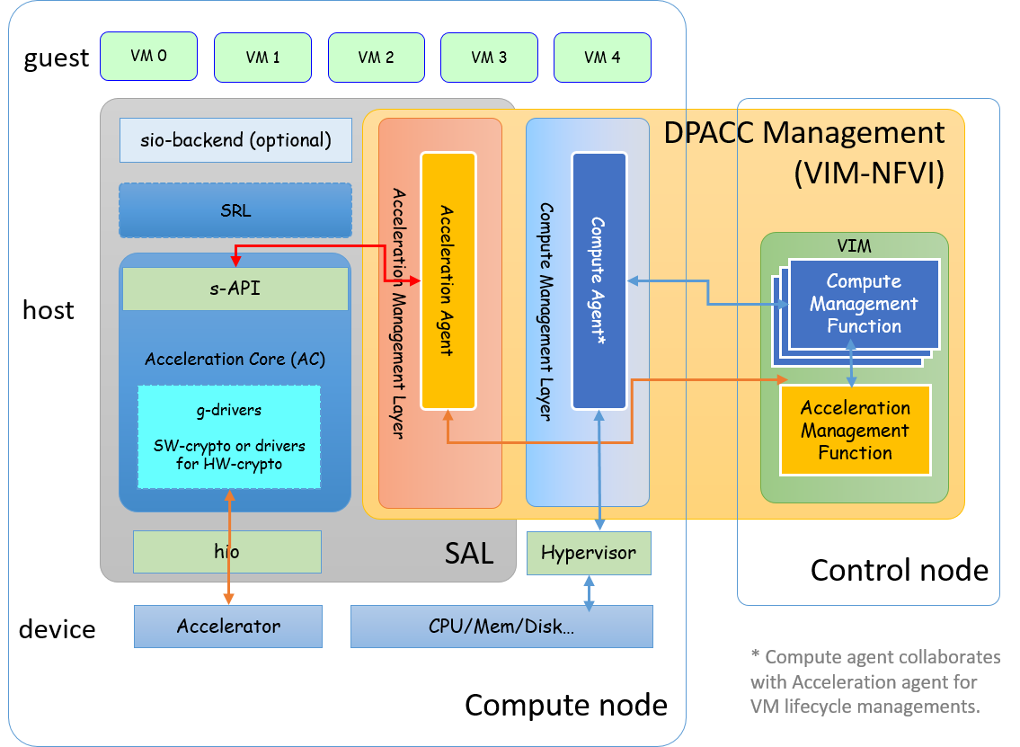
Architecture Figure 3-2
Adjust the arrow, not to go across SRL, as pointed out by Keith.

Slide 5
Section 4 Requirements
Merged with the following Section “Gap Analysis”
Requirements are grouped with the specific lifecycle management
Gaps are intended to be added accordingly

Slide 6
Gap Analysis Introduction Update
OpenStack Introduction
EPA Introduction (Quote from EPA WP)
Exposes advanced hardware features via Nova extensions for discovery, filtering and scheduling
I/O Pass-through (with or w/o SR-IOV), CPU ddio, CPU Pinning, NUMA, Huge Page support, CPU Instruction Set Architecture Extensions, vSwitch (type, capability), RT hypervisor, QAT, etc.
NOMAD：Dedicated Management Function
General resource management
networking and storage acceleration
Dynamic resource management for Programmable accelerators
FPGA, GPU, etc.
Portable hardware agnostic acceleration
abstract accelerator management, g-API

Slide 7
Discussion point 1 Nova Extension vs NOMAD
Can also be exposed as software implementation for abstract accelerator and be managed by NOMAD. (Keith)
Need another review and grouping accordingly. (Lingli)
Add a column for abastracted accelerator types to be supported by NOMAD. (Micheal)
 | NOVA | NOMAD
Use cases | Use cases/technologies which aim to best performance without dealing with portability | Best trade off between performance and portability
Type of accelerators | CPU architecture specific accelerators. No need to share them with other VMs | Portable accelerators shared between different VMs
Accelerators examples | CPU Instruction Set Extensions (Intel AES-NI, AVX2, SIMD, VT-d, VT-x, EPT, etc.), PCI passthrough | SRIOV, PCIe accelerators, SoC accelerators, APIs such as DPDK, OpenCL, ODP and OFP, but also programmable (GPU and FPGA) and remote accelerators, etc
Pros | - Code simplicity: by handling the portable accelerators in Nomad we keep the Nova code simple, with benefits to performance, security, etc. | - Resource discovery, scheduling, setup etc. - Accelerated VM's Migration - Hardware portability and independence - VMs direct access to accelerators
Cons | - Direct interaction between the compute node and the accelerators could provide slightly better performance, but at a cost of portability of the accelerators | - The accelerator allocation phase might take (an unpredictable amount of) time, as an handshake procedure has to be put in place between the components of the architecture potential scalability issues
Need clarification on this “VM direct access to accelerator. Does it not supporting Virtio interface access of accelerator from VM? (Bob)
Virtio is meant for data path access. (Howard)
There is potential scalability issues for NOMAD, as the number of compute nodes under its management increases. (Paul)
Agreed. (Howard)
Will bring workflow design to discussion later. (Lingli)

Slide 8
Discussion Point 2 Requirements for Resource Discovery
Requirement 3‑1 Acceleration agent SHOULD be able to collaborate with AC to discover local available acceleration resource, and notify VIM.
Requirement 3-2 VIM SHOULD maintain a catalog for recognizable acceleration resources and its features.
Requirement 3‑3 VIM SHOULD support notification of acceleration resource discovery to MANO under the circumstance in which MANO has requested notification of this type of event.
Requirement VIM (or AC?) SHOULD maintain the mapping (change to mapping dependency?) between abstract acceleration resource to physical acceleration resource.

Slide 9
Discussion Point 3 Acceleration resources features*
Feature | Functional requirements description
UID | Each acceleration resource shall have a unique identifier.
version | Each acceleration resource shall specify the version of its accelerator.
Type | Each acceleration resource shall have a clear type (e.g. Crypto, FFT, IPSec, etc.)
Capabilities | Each acceleration resource shall indicate its acceleration specific capabilities.
Number of Channels | Each acceleration resource shall indicate how many channels it supports.
Number of Contexts | Each acceleration resource shall indicate how many contexts it supports.
Allows Migration | Each acceleration resource shall indicate if it supports live migration capabilities.
QoS | Each acceleration resource shall indicate the quality of service level it supports.
Data Format | Each acceleration resource shall indicate the data format they operate on.
Re-Programmability | Each acceleration resource shall indicate whether it requires a hardware image to be programmed with before it can operate.
Resource Availability | Each acceleration resource shall indicate the level or amount of availability that are currently unused and can be allocated.
* aligned with ETSI NFV IFA004

Slide 10
Discussion Point 4 Gaps for Resource Discovery
Gap 3-1 Openstack needs to define a general metadata for accelerators such as GPU and FPGA.
Metadata definition example https://docs.google.com/document/d/1_fOinIQNcPwNODZPzGK5vRMPJQLwL7iLds4NFnjXSms/edit#bookmark=id.u667eke4uqo3
(Keith: too detail for inclusion in this doc)
Gap 3-2 Openstack needs to provide standard southbound APIs to get accelerator metadata.
API definition example https://docs.google.com/document/d/1_fOinIQNcPwNODZPzGK5vRMPJQLwL7iLds4NFnjXSms/edit#bookmark=id.buj26le0qu2n
(Bob: more feedback to come after team review later)

Slide 11
Discussion Point 5 (left for further discussion) Requirements for Resource Selection
Basic Requirements:
Requirement 3-4 Acceleration Agent MUST support the capability to report acceleration resource’s information.
Requirement 3-5 VIM MUST maintain an inventory for up-to-date running status for all available acceleration resource, based on aggregated information from local acceleration agents.
Requirement 3-6 VIM MUST support the capability to choose an appropriate accelerator based on the acceleration capability requirement in the virtualization resource allocation request based on the acceleration resource information aggregated and stored in the acceleration catalog and instance inventory.
Configuration for Re-programmable accelerators
Requirement 3‑7 VIM MAY support the data store of acceleration resource configuration feature.

Slide 12
Discussion Point 6 (left for further discussion) Requirements for Resource Allocation
Basic Requirements:
Requirement 3-8 Acceleration agent shall collaborate with AC in supporting the capability of triggering attaching/detaching an accelerator to a virtualization container (e.g., VM).
Requirement 3-9 VIM shall support the capability to interact with local acceleration agent on selected compute node to trigger resource allocation on selected accelerators.
Configuration for Re-programmable accelerators:
Requirement 3-10 Acceleration agent may collaborate with AC to expose its capability to configure an accelerator.
Fine-grained QoS orchestration for powerful accelerators
Requirement 3-11 Acceleration agent may collaborate with AC in exposing its the capability of virtualizing/slicing hardware accelerator.
Requirement 3-12 Acceleration agent shall collaborate with AC in collecting local accelerator performance metrics.

Slide 13
Discussion Point 7 (left for further discussion) Requirements for Resource Update
Basic Requirements:
In addition to Requirement 3-2 (catalog) and Requirement 3-5 (inventory).
Requirement 3‑13 Acceleration agent SHOULD collaborate with AC in monitoring the running status of acceleration resource and notify VIM accordingly.
Requirement 3‑14 VIM SHOULD support notification of NFVI acceleration resource modifications per MANO’s request or earlier subscription.
Scaling requirements
Requirement 3‑15 VIM MAY support the capability of modification (Increase, Decrease, Update) of NFVI acceleration resources upon request from MANO.

Slide 14
Discussion Point 8 (left for further discussion) Requirements for Resource Release
Basic requirements
Requirement 3‑16 VIM SHOULD support the capability to terminate the association of a given set of acceleration resources from a given VNF upon request from MANO.
Requirement 3‑17 VIM SHOULD support notification of acceleration resource termination under the as per MANO’s request or earlier subscription.
Fault Management requirements
Requirement 3-18 Acceleration agent should collaborate with AC in exposing and leveraging the capability of accelerator fault management.
Requirement 3-19 VIM should support the capability to collect fault information related to both physical and virtual accelerators from acceleration agents and report to MANO if needed.

Slide 15
Todos
Identify gaps for lifecycle management
Resource Selection, Allocation, Update and Release
Refine work plans
Nomad Architecture, workflows
Call for review to the doc
https://docs.google.com/document/d/1_fOinIQNcPwNODZPzGK5vRMPJQLwL7iLds4NFnjXSms/edit#
Call for participation to project
https://wiki.openstack.org/wiki/Nomad

