Slide 1
Accelerator powered IPSEC API

Slide 2
OAI Framework
VNF #1
VNF #2
VNF #3
….
OAI
DPI Agent
Crypto Agent
Forwarding Agent
OAI Manager
Accelerator Abstraction Layer
Director
DPI API
Crypto API
Forwarding API
…
AP-VNF Function Manager
DPI
Driver#1
DPI
Driver#2
Crypto
Driver
#1
Crypto
Driver
#2
Forwarding
Driver
#1
Forwarding
Driver
#2
….
OAI Hardware( Fixed or Programmable)
OAI Resource Manager
x86
ARM
FPGA
GPU
SNP
NP
ASIC
……
DPI
ACC
DPI
ACC
Crypto
ACC
Crypto
ACC
FWD
ACC
FWD
ACC
AAL：a set of open and common APIs, which shields the difference of accelerators as well as offer a uniform interface for VNFs. VNFs can involve these APIs to implement various of accelerated functions (e.g. Crypto, Compression, DPI and Forwarding)
Manager：in charge of the management and the orchestration of accelerator resources and bridging between VNFs and accelerators.
Page 2

Slide 3
AAL Architecture
VNF#1
VNF#2
VNF#3
Accelerator Abstraction layer
API
Flow Classification
Forwarding
Pattern Match
Crypto
Compression
…
Ring Manager
Queue Manager
Buffer Manager
Event Manager
Memory Manager
…
…
Arbiter
Dispatcher
Arbiter
Dispatcher
Arbiter
Dispatcher
Arbiter
Dispatcher
Driver
Crypto Driver
FWD Driver
Pattern Match Driver
Compression Driver
….
GPU
Drv
FPGA
Drv
X86
Drv
ASIC
Drv
…
FPGA
Drv
X86
Drv
NP
Drv
SNP
Drv
…
X86
Drv
ASIC
Drv
ARM
Drv
…
ASIC
Drv
ARM
Drv
…
GPU
FPGA
x86
ASIC
NP
SNP
ARM
…
Crypto ACC
Crypto ACC
FWD
ACC
Crypto ACC
FWD ACC
Pattern Match
ACC
Crypto ACC
Compression
ACC
Pattern Match
ACC
FWD ACC
FWD ACC
Pattern Match
ACC
Compression
ACC

Slide 4
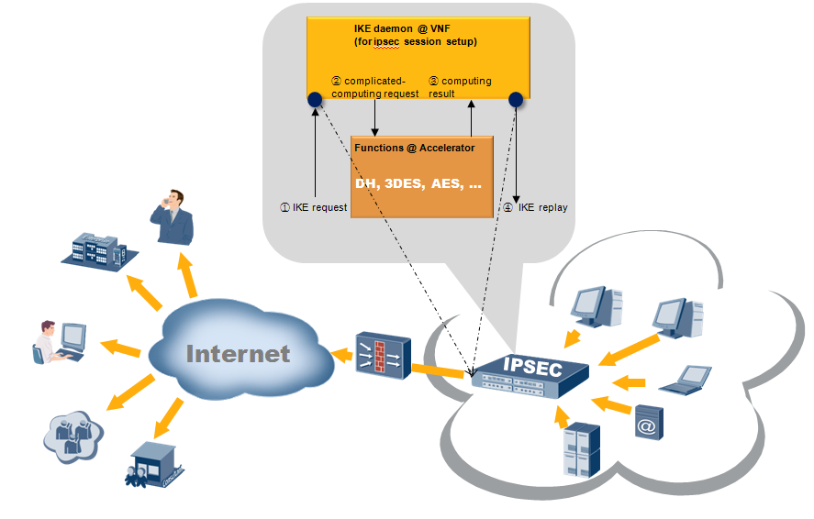
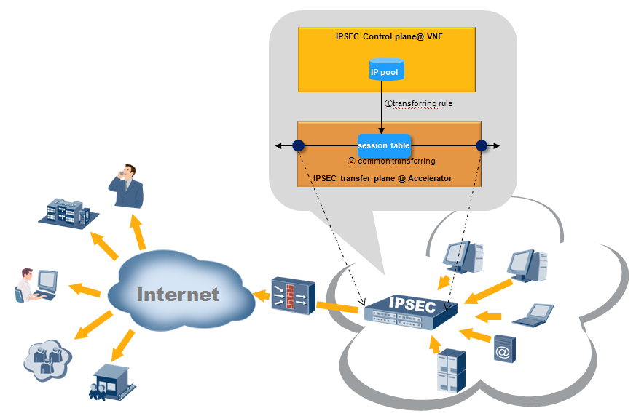
POC: accelerator-powered IPSec VPN
IKE acceleration
IPSec forwarding acceleration
It illustrates the acceleration of IKE (IPSEC session negotiation). The DH (Differ-Hellman) function, which consumes considerable CPU resources, is the most complicated computing during IKE negotiation stage. Besides, the IPSEC gateway, which is responsible for abundant and frequent session setting-up requirements, is always expected to have a high performance.
It illustrates the acceleration of IPSec forwarding. The entire forwarding-related functions, including packet encrypt/decrypt and packet RX/TX via NIC, can be offloaded accompanied with downloaded SA polices from the control-plane.

Slide 5
API infrastructure over AAL
Application Process
AAL API is for runtime accelerator (or virtual accelerator) detection, allocation, binding, initiation and access.
APP API goes for application requirement.
AAL delivers AAL API to accelerator directly. Meanwhile, it delivers APP API to Linux kernel or bound accelerator , which depends on the ‘manager’.
AAL API
APP API
AAL
AAL API:
aal_context_init()
aal_find_device()
aal_acquire_device()
aal_release_device()
aal_lock_device()
aal_unlock_device()
Linux Kernel
Accelerator

Slide 6
APP API (Crypto API as an example)
Synchronous Crypto API | parameters | Description
aal_crypto_handle_create( ) | AAL_DEVICE | Used to initialize a crypto handle. This function returns a unique handle.
aal_crypto_handle_destroy( ) | CRYPTO_HANDLE | Destroy a previously initialized handle.
aal_crypto_encode( ) | CRYPTO_HANDLE Input_buffer, input_buffer_len, Output_buffer, output_buffer_len | Consumes data from the input buffer and generates encrypted data in the output buffer.
aal_crypto_decode( ) | CRYPTO_HANDLE Input_buffer, input_buffer_len, Output_buffer, output_buffer_len | Consumes encrypted data from the input buffer and generates decrypted data in the output buffer.
Asynchronous Crypto API | parameters | Description
aal_crypto_handle_create_async( ) | AAL_DEVICE | Used to initialize an async crypto handle. This function returns a unique handle.
aal_crypto_handle_destroy_async( ) | CRYPTO_HANDLE_Async | Destroy a previously initialized handle.
aal_crypto_encode_Async( ) | CRYPTO_HANDLE_Async Input_buffer, input_buffer_len | Consumes data from the input buffer and when encryption finished, crypto driver call the Encode_callback function to utilize encrypted results.
aal_crypto_decode_Async( ) | CRYPTO_HANDLE_Async Input_buffer, input_buffer_len | Consumes encrypted data from the input buffer and when decryption finished, crypto driver call the Decode_callback function to utilize decrypted results.

Slide 7
A Minimal Program
#include <aalh>
int main(int argc, char **argv)
{
struct aal_context context;
struct aal_dev *dev_1;
struct aal_find_opt fo;
struct crypto_handle *handle_1;
BUFFER *input_buf, *output_buf;
int len_in, len_out;
aal_context_init(&context);
dev_1 = malloc(sizeof(struct aal_dev));
aal_device_init(&context, dev_1);
aal_find_opt_init(&fo);
aal_find_dev(&context, &fo, dev_1->parent.id);
aal_acquire(dev_1);
aal_lock(dev_1);
// initialization complete, from here on regular APP API can be used
handle_1 = aal_crypto_handle_create(dev_1);
…
aal_crypto_encode(handle_1, input_buf, len_in, output_buf, &len_out);
…
aal_crypto_handle_destroy(handle_1);
/* after using the accelerator, resources should be freed. */
aal_unlock(dev_1);
aal_release(dev_1);
free(dev_1);
return 0;
}

Slide 8
Thank you!

