Slide 1
DPACC Management Aspects
Howard Huang, Huawei
Peng Yuan, Huawei

Slide 2
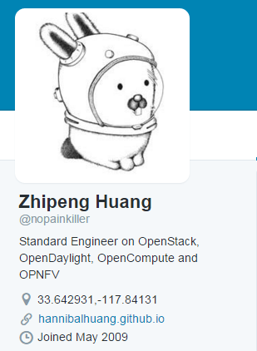
Bio
Standard Engineer
ETSI NFV
SNIA Object Drive TWG
OCI/Spec
Open Source Community Operation Manager
OpenStack (Tricircle, Kingbird, Dragonflow, …)
OPNFV (Parser, Multisite, DPACC, …)
OpenVswitch
Like Heavy Metal Music and father of twin girls !

Slide 3
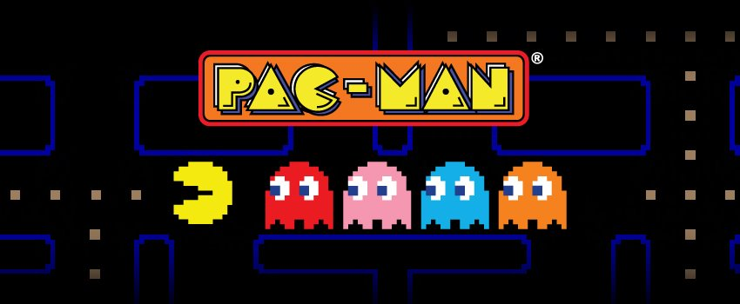
D-PACC-MAN !

Slide 4
Overview
Memory Lane
Detailed Work Proposal

Slide 5
Memory Lane : High Level Architecture
Acc DB
Inventory DB
Nova
Cinder
Neutron
Keystone
Acc DB
Acc DB
Acc DB
Catalogue DB
Inventory DB : the state datastore that maintains overall acceleration resource state
Catalogue DB : the config datastore that stores information such as version, performance, capability, compatibility and so forth.
RabbitMQ

Slide 6
Memory Lane : Distributed Acc Management
Nova
Cinder
Neutron
Cat DB
Cat DB
Cat DB
Keystone
dpacc
Inv DB
dpacc
Inv DB
dpacc
Inv DB
dpacc
Inv DB

Slide 7
Memory Lane : ETSI NFV Acceleration For DPACC
VNF
Management
VIM needs to be enhanced in three respects.
1) VI-Ha: Discovery of accelerator resource (Intel CCK, FPGA, GPU) in the Host.
2) Nf-Vi: Allocation and release of acceleration resources.
3)Or-Vi/Vi-Vnfm: External interface supporting VNFD.
"ACC":{ "acc_type":"IPSEC_3DES",
"acc_capability": {"num":"800Mbps"}
}
APP
IPSec/GB/TLS/SRTP
VNF1
Media
MANO
NFVO
SAL
VNFM
Crypto Interface
DPI Interface
Codec Interface
SR-IOV Acc Driver
VirtIO Front Driver
SW Acc Device
Or-Vi
Vi-Vnfm
SR-IOV
Virtio
VIM/OpenStack
Nova
NFVI
SAL (VirtIO Backend Driver)
Neutron
DPACC-MAN Agent
Nf-Vi
Physical Device Driver
DPACC-MAN
VI-Ha
HW Acc Devices
Intel CCK
FPGA
GPGPU

Slide 8
Detailed Work Plan : OpenStack Rock
A new project called Rock will be proposed in OpenStack to enhance Nova for accelerator management. Rock is responsible for lifecycle management of accelerators residing in a compute node or shared resource pool.
HACC-API: “Standard” API for different accelerators.

Slide 9
Detailed Work Plan : Rock Workflow
8、Rock scheduling
OpenStack
Highlights:
Accelerator QoS aware scheduling for low latency APP in NFV. Scheduler guarantees that each VNF gets its acceleration ability and Load balance of acceleration resources among different VNFs.
Standard southbound APIs for different accelerators.
MANO、 HEAT
6、create VM
Nova
Neutron
Rock
VNFD:
"ACC":{ "acc_type":"IPSEC_3DES",
"acc_capability": {"num":"800Mbps"}
}
9、Apply accelerator
7、Create VM
10、config accelerator
5、report accelerator info
OpenStack Agent
Nova Agent
Neutron Agent
Rock Agent
4、accelerator info
11、Config accelerator
HACC API
2、Load driver
3、Scan PCI for accelerator VF info
1、System booting
ACC
Host OS

Slide 11
Accelerator Management: Deployment View in Virtualizatoin (SRIOV+Virtio)
SRIOV
Virtio

Slide 12
Rock API
Orchestrator (MANO, Task Scheduling)
Portability between different accelerator platform.
Software-hardware decoupling
FPGA, GPU, Intel Cards…
ESTI NFV：
Req PER/C1: The compute domain shall support discovery of hardware (HW) /functional accelerators.
Req PER/C2: The compute domain shall support reservation of HW/functional accelerator resources.
Req PER/C3: The compute domain shall support binding/attaching to HW/functional accelerators.
Req PER/C4: The compute domain shall support unbinding/detaching from the HW/functional accelerator.
Req PER/C5: The compute domain shall support collection of the HW functional performance metrics.
Rock
Accelerator Drivers
Part 1: Overview & use cases
Part 2: VNF Interfaces
Part 3: Switching aspects
Part 4: Management aspects
Future work

Slide 13
Management: Southbound API for Accelerator Drivers
acc* acc_discovery(); | Find the accelerators in the host according to the dirvers. FPGA/GPU/Hardware Engine
void acc_get_status(acc*); | Get the acceleration description inlcuding capacity, usage, affinity, available VF/queues.
vacc* acc_create(acc*, VM*); * | Apply a VF for accelerator.
void acc_destroy(vacc*); * | Delete VF
void acc_attach (vacc*); * | Attach VF to VM.
void acc_detach(vacc); * | Detatch VF。
void acc_get_affinity(vacc*, acc_affi*); acc_affi* acc_set_affinity(vacc*); | Get the Affinity.
acc_pilicy *acc_get_policy(vacc *); acc_pilicy *acc_set_policy(vacc *); | Get the policy such as priority and preempt。
FPGA dynamic loading…
FPGA VF/queue partition … | Multiple VFs can be connected with a type of acceleration logic.
Example: Accelerator descriptions (Driver -> Rock):
acc_discovery ()
{"acc_type":"IPSEC_3DES",
"acc_capability":{
{"num":"10","unit":"G*PPS"},
{"num":"800","unit":"bps"}
}

Slide 14
Management: Northbound API for Nova/MANO
void acc_register(acc*, network*); * | Register the accelerator in a network created by Neutrion.
void acc_unregiste(acc*, network*); * | Unregister the accelerator.。
acc* acc_find_physical(acc_config*); | Find the best accelerator for the configure.
Accelerator requirement in VNF template (MANO -> Rock):
"VIU": {"init_number": 0, "cpu":4,"memory":30720,"cpu_frequency":2600, "disk":35,
"ACC":{ "acc_type":"IPSEC_3DES",
"acc_capability":{
{"num":"10","unit":"PPS"},
{"num":"800","unit":"bps"}
}
},
* For VM

