Slide 1
OPNFV Project Discussion Results on DataPlane Acceleration BreakOut
2/24/2015

Slide 2
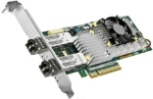
Background Hardware Dependent Data Plane VNFs
Data Plane VNFs
Service Layer
SW acc
HW acc driver
other VNFs
Packet Processing
VNFC
IPsec Gateway
VNFC
VFN manger
Independent VNF software development and upgrades on top of fully-decoupled hardware platforms.
Platform Layer
VM
VM
VIM
VM
VM
VM
VM
Simplfied deployment, flexible scheduling, on-demand scaling due to hardware virtualization.
Hypervisor
Hypervisor
not available
Hardware Layer
A combination of SW/HW accelerators has been used with SHV servers to yield comparable performance with dedicated devices.
Reduced Capex/Opex for off-the-shelf IT devices.
HW acc
“NFV Servers” based upon integrated SoC or Standard High Volume Servers+Smart NIC

Slide 3
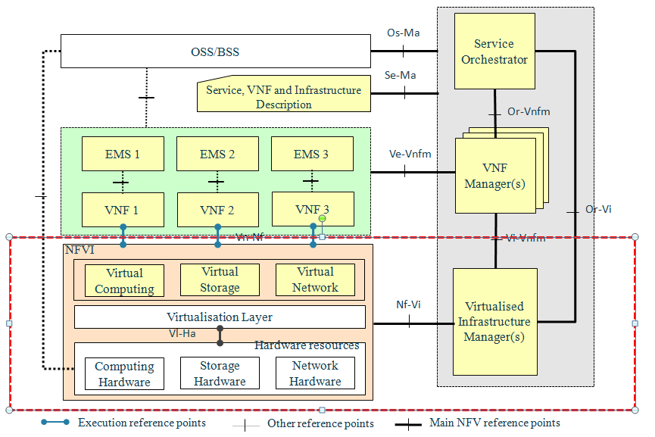
Gap Analysis Extensions to OPNFV Interfaces
4, Match VNF workloads requiring acceleration to appropriate resources
2, utilize a set of general APIs to get access to the hardware chipset
3, allocate VNFs to "capable" VMs on top of "capable" devices
1, add a specialized hardware chipset

Slide 4
Discussion Results
Noted that entire scope of orchestration/VIM/ VNF-acceleration-capability aware is challenging
Need to coordinate closely with NFV ISG IFA Stream 2
Need to coordinate with OPNFV Copper, related projects such as OpenStack Congress on capability-discovery/utilization
2 implementation arch concepts from proposal discussed but… Focus on requirements first- for 1H 2015
Need to likely spawn collaborative development (multiple) efforts to explore/assess/test/report implementations (2H15)
KickOff call Wed 25Feb 11pm CET.
Community: help us shape the project and keep aligned w/ relevant groups

Slide 5
Thank you.

