Slide 1
OPNFV Project Briefing on DataPlane Accleration
2/24/2015

Slide 2
Outline
Background
Hardware Dependent Data Plane VNFs
Vision
Enabling VNF portability for hardware acceleration
Gap Analysis
Initial Discussion
Proposal Summary

Slide 3
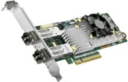
Background Hardware Dependent Data Plane VNFs
Data Plane VNFs
Service Layer
SW acc
HW acc driver
other VNFs
Packet Processing
VNFC
IPsec Gateway
VNFC
VFN manger
Independent VNF software development and upgrades on top of fully-decoupled hardware platforms.
Platform Layer
VM
VM
VIM
VM
VM
VM
VM
Simplfied deployment, flexible scheduling, on-demand scaling due to hardware virtualization.
Hypervisor
Hypervisor
not available
Hardware Layer
A combination of SW/HW accerelators has been used with SHV servers to yield comparable performance with dedicated devices.
Reduced Capex/Opex for off-the-shelf IT devices.
HW acc
“NFV Servers” based upon integrated SoC or Standard High Volume Servers+Smart NIC

Slide 4
Vision Common interfaces for DataPlane Acceleration
HW/SW acc is common in dataplane devices
Encryption, DPI, transcoding, firewall, etc.
Vision: a fully decoupled three-layer architecture
Observation: multiple choices exist for each given usecase
software-only acceleration
hardware assist accleration in various forms:
separate acc card/integrated with NIC/integrated with CPU
Concern: no common interfaces exist for acceleration
Problem: no VNF portability for data plane acceration
VNFs: rewrite their code extensively to do hardware migration
CSPs: binds VNF software with the underlying hardware devices

Slide 5
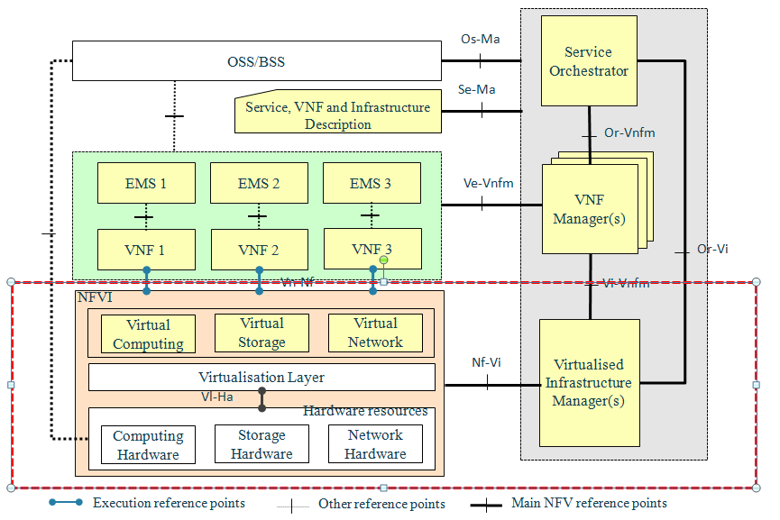
Gap Analysis Extensions to OPNFV Interfaces
4, Match VNF workloads requiring acceleration to appropriate resources
2, utilize a set of general APIs to get access to the hardware chipset
3, allocate VNFs to "capable" VMs on top of "capable" devices
1, add a specialized hardware chipset

Slide 6
Initial Discussion General Framework Design
"Pass-Through" Model
"Fully Intermediated" Model
VNF
VNF
VNF #1
Functional Abstration Layer
Functional Abstration Layer
PP APIs
Crypto APIs
Codec APIs
PP APIs
Crypto APIs
Codec APIs
PP Dirver
Crypto Driver
Codec Driver
Driver #1
Driver #2
Driver #3
Driver #4
Driver #5
Vn-Nf
Host
Driver
Host
Driver
Host Driver
Host Driver
Host Driver
Vi-Ha
NWI/HWA
#1
NWI/HWA
#2
NWI/HWA
#3
NWI/HWA
#4
NWI/HWA
#5
NWI/HWA
#1
NWI/HWA
#2
NWI/HWA
#3
NWI/HWA
#4
NWI/HWA
#5

Slide 7
Proposal Summary Output, Scope and Related Projects
Target: pass graduation review in 2015
Phase 1: (by 2015Q2) Use-cases, requirements and gap anlaysis
Phase 2: (by 2015Q4) General framework specification, running code and testing report
Scope: PoC data plane implementation in 2015
usecases: packet processing, encryption, transcoding
data plane interfaces: Vn-Nf/Vi-Ha
potential extension and integration review in 2016
Related Upstream Projects
DPDK, OpenDataPlane, OpenCL, libvirt, virtio, Openstack

Slide 8
List of committers/contributors
Committers
Contributors
Lingli Deng (China Mobile)
Ola Liljedahl (ARM)
Kin-Yip Liu (Cavium)
Xinyu Hu (Huawei)
Vincent Jardin (6WIND)
Wenjing Chu (DELL)
Saikrishna M Kotha (Xilinx)
Bin Hu (AT&T)
Subhashini Venkataraman (Freescale)
Leon Wang (Altera)
Keith Wiles (Intel)
Xiaowei Ji (ZTE)
Bob Monkman (ARM)
Peter Willis (British Telecom)
Fahd Abidi (EZCHIP)
Deepak Unnikrishnan
Julien Zhang, Hongyue Sun, Haishu Zheng (ZTE)
Srini Addepalli (Freescale)
François-Frédéric Ozog (6WIND)
Tapio Tallgren, Mikko Ruotsalainen (Nokia)
Zhipeng Huang, Arashmid Akhavain, Mike Young (Huawei)
Rabi Abdel (Altera)
Venky Venkatesan (Intel)
Alex Mui, Jesse Ai (ASTRI)
Parviz Yegani (Juniper)
Mario Cho

Slide 9
Current Status & Questions
Status Update
Approved by TSC on Feb 10th
kick off meeting scheduled this Wednesday
set work plans for documentation/implementation
keep aligned with other projects/SDOs
Questions Does OPNFV as a community provide, or each project walks its own way, in providing…
specs on output documentation for requirement projects?
mechanisms for cooperation with upstream projects?

Slide 10
Thank you.

