Slide 1
What Multisite Means for Identity Management
Howard Huang, Huawei
Multisite

Slide 2
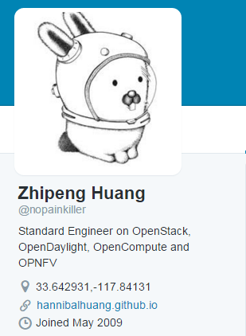
Bio
Standard Engineer
ETSI NFV
SNIA Object Drive TWG
OCI/Spec
Open Source Community Operation Manager
OpenStack (Tricircle, Kingbird, Dragonflow, …)
OPNFV (Parser, Multisite, DPACC, …)
OpenVswitch
Like Heavy Metal Music and father of twin girls !

Slide 3
Outline
Multisite Project Overview
Multisite Identity Management
The Whole Nine Yard
Upstream Bug Report

Slide 4
Multisite Project Overview
Multisite project was approved on Apr 2015, to be a requirement project that deals with OPNFV deployment across multiple sites
Weekly meeting at #opnfv-meeting very Thursday, have members from various companies to participate (Ericsson, Orange, Docomo, Metaswitch, RedHat …)
Discussed 5 use cases:
- Multisite Identity Service Management (Use Case 1)
- Multisite VNF HA Support (Use Case 2)
- Multisite VNF Geo Redundancy Support (Use Case 3)
- Multisite Centralized Services (Use Case 4&5)
Feedback BPs or bugfixes back to the upstream community based on the discussion: https://wiki.opnfv.org/multisite/bug_bp

Slide 5
Multisite Identity Service Management – Use Case Analysis
Use Case Description:
User should be able to manage virtual resources spread over multiple OpenStack regions, by using a single authentication point

Slide 7
Multisite Identity Service Management - Requirements
KeyStone service(Distributed) with Fernet token + Async replication ( star-mode).
One master KeyStone cluster with Fernet token in two sites (for site level high availability purpose), other sites will be installed with at least 2 slave nodes where the node is configured with DB async replication from the master cluster members, and one slave’s mater node in site1, another slave’s master node in site 2.
Only the master cluster nodes are allowed to write, other slave nodes waiting for replication from the master cluster ( very little delay) member. But the chanllenge of key distribution and rotation for Fernet token should be settled.
Pros.
Why cluster in the master sites? There are lots of master nodes in the cluster, in order to provide more slaves could be done async. replication in parallel.
Why two sites for the master cluster? to provide higher reliability (site level) for writing request.
Why using multi-slaves in other sites. Slave has no knowledge of other slaves, so easy to manage multi-slaves in one site than a cluster, and multi-slaves work independently but provide multi-instance redundancy(like a cluster, but independent).
Cons. The distribution/rotation of key management.

Slide 8
Multisite Identity Service Management – Requirement Recommended Deployment
Site 1
Site 2
API
Nova
Nova
Local Token Validation
Local Token Validation
KeyStone
KeyStone
DB
Cluster
Cluster
DB
Cluster
master
DB
DB
master
master
DB
DB
master
master
master
slave
slave
slave
slave
slave
slave
DB
DB
DB
DB
DB
DB
KeyStone
KeyStone
KeyStone
Local Token Validation
Local Token Validation
Local Token Validation
Nova
Nova
Nova
Site 3
Site 4
Site x

Slide 9
Multisite Identity Service Management - Prototype
Now there is something different:
We demoed the solution to see if it is logical !
https://github.com/hafe/dockers
(Shout out thanks to Hans Feldt)

Slide 11
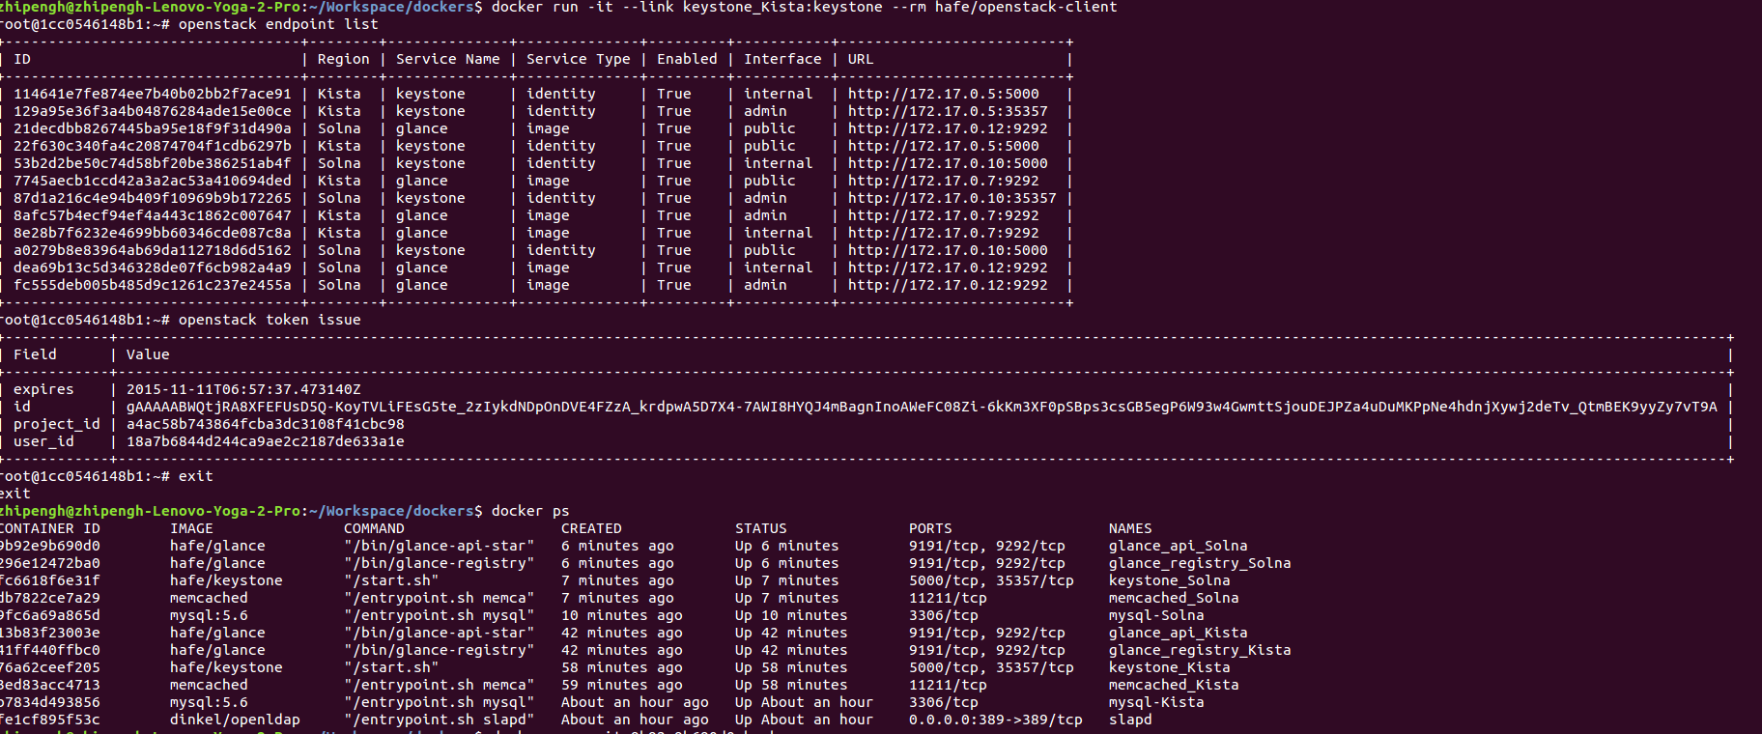
Multisite Identity Service Management – Prototype

Slide 12
Multisite Identity Service Management – Bugfix to Upstream Project
BUG:
Can't specify identity endpoint for token validation among several keystone servers in keystonemiddleware: https://bugs.launchpad.net/keystone/+bug/1488347. The method we provide works.
After discussion, community proposed using region-name to specify the keystone server for token validation. https://review.openstack.org/#/c/216579/. This one is merged

