Slide 1


A Multivendor, Interoperable NFV Solution
Bin Hu, AT&T
Dave Lenrow, HP

Slide 2







Agenda
OPNFV Vision
PoC Background
PoC #1 – OPNFV IaaS
PoC #2 – OPNFV Site Failover
Next Steps
Acknowledgement

Slide 3
OPNFV Vision

Slide 4
OPNFV Vision
Multivendor, interoperable NFV solutions
Consistency, performance and interoperability among NFVIs
Unlimited potential of new use cases, services and business

Slide 5
PoC Background

Slide 6
POC Background
The PoCs were completed prior to release of OPNFV Arno
They used the Arno upstream components (OpenStack, OpenDayLight, OVS, etc.)
They used vendor supported, generally available distributions of those upstream components, considered more deployable than the raw upstream currently
They used prototype / PoC-specific APIs and code to create some of the advanced features which don’t yet have upstream support.

Slide 7
PoC #1 – OPNFV IaaS

Slide 8




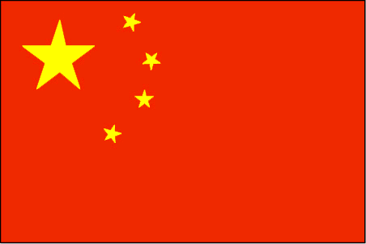



PoC #1 – OPNFV Infrastructure-as-a-Service
Interoperability aspects of OPNFV-I that are independently administered
Leverage partners’ OPNFV environments to expand service coverage
Unify services across separate domains of OPNFV environments

Slide 9
PoC #1 – OPNFV Infrastructure-as-a-Service
Objectives
  Demonstrate interoperability between OPNFV-compliant infrastructures-as-a-Service environments (“OPNFV-I”)
  Demonstrate VNF migration to separately administered OPNFV-I environments
  Demonstrate federated OPNFV-I environments enable live synchronization between the environments

Slide 10
PoC #1 – OPNFV Infrastructure-as-a-Service
User Experience | OPNFV Infrastructure and VNF
Joe Doe is a sales executive of ABC Company in S.F Joe Doe and his sales team typically connect to corporate network via VPN for company business | Mobile Secure Access VNF is running on OPNFV-I-A administered by Operator A, serving Joe Doe and his team in S.F
In order to explore a new market opportunity in China, Joe Doe and his sales team get a temporary assignment in Beijing, China Joe Doe and his sales team now in Beijing need to connect to corporate network via VPN for company business | Operator A detects that Joe Doe and his team is now accessing Mobile Secure Access VNF from Beijing, China Operator A has business relationship with Operator B that administers an OPNFV-I-B serving the area of Beijing, China Operator A decides to Scale out Mobile Secure Access VNF to OPNFV-I-B administered by Operator B in order to serve Joe Doe and his team with better QoS Scale down Mobile Secure Access VNF in its own OPNFV-I-A in order to save resources
Mobile Secure Access VNF starts live migration. Joe Doe and his team has the same UE | Controller A interacts with Controller B for live migration of Mobile Secure Access VNF. Information includes VNF and VNFD, capacity requirement, SLA, etc.

Slide 11
PoC #1 – OPNFV Infrastructure-as-a-Service
User Experience | OPNFV Infrastructure and VNF
Mobile Secure Access VNF migration is in progress. Joe Doe and his team has the same UE | Controller B gets the information from Controller A, and instantiates Mobile Secure Access VNF on OPNFV-I-B, with sufficient resources to ensure the capacity of serving Joe Doe and his sales team at QoS in SLA Controller A hands over the status information of serving Joe Doe and his team to Controller B as the starting point of Mobile Secure Access VNF on OPNFV-I-B Controller A and Controller B coordinates the access procedure so that Joe Doe and his team’s device start to use Mobile Secure Access VNF on OPNFV-I-B.
Joe Doe and his sales team now in Beijing is connecting to corporate network via VPN for company business | Mobile Secure Access VNF running on OPNFV-I-B administered by Operator B is now serving Joe Doe and his team in Beijing, China for the period of temporary job assignment there.

Slide 12
PoC #1 – OPNFV Infrastructure-as-a-Service
Implemented in PoC #1
  An IaaS environment based on OPNFV (OPNFV-I) deployed on multiple OPNFV community labs
  Federation between two separately-administered OPNFV-I environments
  VNF creation and configuration in first OPNFV-I
  VNF migration from first to second OPNFV-I

Slide 13

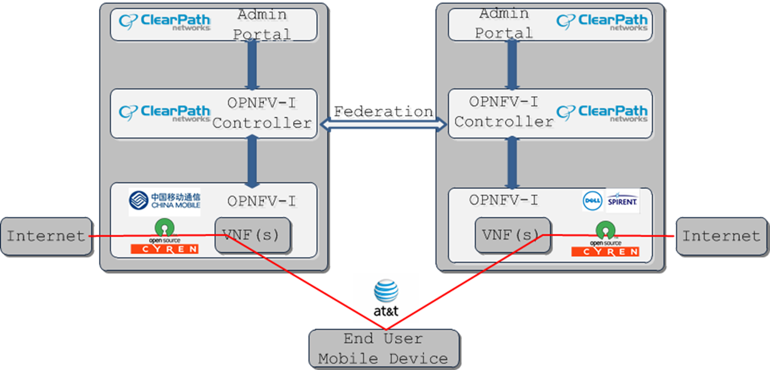

PoC #1 – OPNFV Infrastructure-as-a-Service
Federation enables VNFs to migrate with user
Data path
Data path
PoC features effective multi-company cooperation

Slide 14
PoC #2 – OPNFV Site Failover

Slide 15
Simplified Flow
Users are streaming video using two VFs running on two different VMs to create a content+adds stream.
VF instance with active subscribers fails/crashes
(active subs are temporarily redirected to an existing instance, possible over-utilization scenario)
New instance of VNF is created on a newly created VM
Subs are re-routed to new instance restoring service
Notes:
Simple story in addition or instead of super-detailed flow slide (next)

Slide 16
PoC #2 – OPNFV Site Failover
User Experience | OPNFV Infrastructure and VNF
Joe Doe is watching a movie on YouTube. Targeted ads are pushed to movie channel | Video Server VNF is running on OPNFV site A, serving 100 users including Joe Doe. Ads Server VNF is running on OPNFV site B, serving 80 users including Joe Doe.
Joe Doe continues watching the movie The ads continue to be triggered and displayed from time to time. (Failover is in progress. Joe Doe’s UE has no impact) | OPNFV Site A fails. Notification is sent to VIM VIM’s Failover Policy demands that VNF be instantiated on backup sites VIM detects that the resources on current live OPNFV site B are insufficient for the capacity originally served on site A. VIM sends the information to Orchestrator. Considering the available resources on all sites, and the Policy of balancing resource capacity, Orchestrator decides to scale out and brings OPNFV Site C live. Now VIM has sufficient resources. Orchestrator instructs VNF Manager to: Instantiate Video Server VNF on Site C, with the capacity of serving 50 users Instantiate Ads Server VNF on Site C, with the capacity of serving 40 users Scale down Ads Server VNF on site B, with the capacity of serving the rest of 40 users Instantiate Video Server VNF on Site B, with the capacity of serving 50 users Working with VNF Manager, VIM manages the OPNFV resources accordingly.
Joe Doe continues watching the movie The ads continue to be triggered and displayed from time to time. (Failover has finished without impact on UE) | Video Server VNF is running on OPNFV site B and C, serving 50 users at each site Ads Server VNF is running on OPNFV site B and C, serving 40 users at each site SDN controller handles the traffic flow, and re-routes the traffic which was dynamically provisioned by Orchestrator. Now Joe Doe’s movie is served from Site B, and ads is served from site C

Slide 17
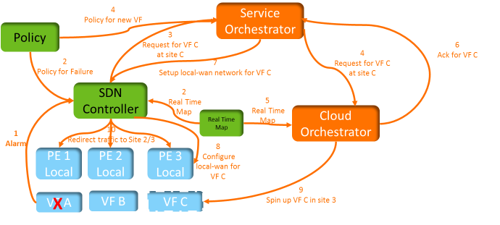


PoC #2 – OPNFV Site Failover
Policy-based, SDNC-based service orchestration for site failover
Notes:
Can’t quite get my head around numbers on arrows, thinking remove to save audience headache on talk through flow.

Slide 18
PoC #2 – OPNFV Site Failover
OSS
Layer
MANO Layer
NFVI Domain : SiteScope, NNMi, IMC
+ Other HP OSS Capabilities
HP NFV Director
VNF
Layer
VNF Manager(s)
Brocade vRouter
VNF
VNF
VNF
VNF
Brocade Vyatta Controller (ODL)
HP Helion OpenStack
NFVI
Layer
Compute Virtualization
(OpenStack Nova with hLinux Compute Nodes)
Network Virtualization
(OpenStack Neutron with Open vSwitch)
HP Converged Infrastructure Management (HP OneView)
3rd Party Servers
HP Servers
(BladeSystem / ProLiant)
HP Storage (HP VSA)
HP Networking (HP 59XX)
WAN Network

Slide 19

Network Topology
Site A
.16
.13
.6
.2
WAN facing network – Site A
Internal Facing Network – Site A
Internal Facing Network – Site A
User View
John Doe watching Youtube video while routed via site A
Jane Doe watching Youtube video while routed from site B
VR U1
VR S1
User John
13.13.13.3
10.10.10.0/24
13.13.13.0/24
20.20.20.0/24
20.20.20.7
Site C
(Standby/inactive)
Simulated Users are pre-deployed
Deploy Site A (vRouter, GRE Tunnel/routing)
  Deploy Site C as backup of Site A
Deploy Site B (vRouter, GRE Tunnel/routing)
internet
.5
.13
20.20.20.7
.2
.6
Internal Facing Network – 30.30.30.0
Internal Facing Network – Site C
Internal Facing Network – Site C
VR S3
40.40.40.0/24
20.20.20.0/24
VR Y1
20.20.20.7
Site B
.5
.2
.5
.12
WAN facing network – Site B
Internal Facing Network – Site B
Internal Facing Network – Site B
User Jane
12.12.12.2
VR U2
VR S2
12.12.12.0/24
50.50.50.0/24
20.20.20.0/24

Slide 20
Network Topology (contd.)
Site A
Site Down
.16
.13
.6
.2
WAN facing network – Site A
Internal Facing Network – Site A
Internal Facing Network – Site A
User View
Jane Doe continues watching video from site B
John Doe <continues> to watch video which is now routed via site C
VR U1
VR S1
User John
13.13.13.3
10.10.10.0/24
13.13.13.0/24
20.20.20.0/24
20.20.20.7
Site C
(Active)
Site A goes down
Activate Site C (Dynamically provisioned as a replacement of Site A)
SDN Controller routes the traffic to site C
internet
.5
.13
20.20.20.7
.2
.6
Internal Facing Network – 30.30.30.0
Internal Facing Network – Site C
Internal Facing Network – Site C
VR S3
40.40.40.0/24
20.20.20.0/24
VR Y1
20.20.20.7
Site B
.5
.2
.5
.12
WAN facing network – Site B
Internal Facing Network – Site B
Internal Facing Network – Site B
User Jane
12.12.12.2
VR U2
VR S2
12.12.12.0/24
50.50.50.0/24
20.20.20.0/24
Notes:
Lessons learned: Time to spin up new VM made failover much higher latency (seconds to minutes) than example of hot-spare failover, followed by setting up another hot-spare after healing.
Theoretically hitless, but clearly non-zero packet loss due to time to re-route. Streaming apps have high tolerance for such things ☺

Slide 21
Next Steps

Slide 22
Next Steps
Expand the PoC participation from more service providers and vendors
Migrate from pre-Arno with band-aids to fully up-streamed approach
Expand the implementation to entire PoC scope
Expand the PoC scope with more use cases
Incubate and drive new open source projects
Notes:
We didn’t scale to tens of subscribers as described in original user story

Slide 23
Thank You

