Slide 1
Service VM as a vRouter
– IPv6-enabled OPNFV
Bin Hu, AT&T
IPv6 Project Lead, OPNFV

Slide 2
Content
Key Project Facts
Project Goals and Deliverables
What Have Been Achieved
Service VM as an IPv6 vRouter
Marching to Brahmaputra
Acknowledgement

Slide 3
Key Project Facts
Project Creation Date: November 25th, 2014
Lifecycle State: Incubation
Gerrit Repo: ipv6
Project Wiki: https://wiki.opnfv.org/ipv6_opnfv_project
Project Lead: Bin Hu bh526r@att.com
Primary Contact: Bin Hu bh526r@att.com
Active contributors from AT&T, Cisco, ClearPath, Cloud Base Solutions, Huawei, Nokia, RedHat and Spirent

Slide 4
Project Goals and Deliverables
Project Goals
A meta distribution of IPv6-enabled OPNFV platform
A methodology of evolving IPv6 OPNFV
Deliverables
An integrated package consisting of basic upstream components
Auto configuration script to automate the configuration and provisioning of IPv6 features (for those that can be automated)
An Installation Guide and/or User Guide with step-by-step instructions of manual configuration of IPv6 features (for those that cannot be automated)
Test cases adapted to IPv6 specific use cases
Gap analysis and Recommendation for next steps

Slide 5
What Have Been Achieved
Gap Analysis with OpenStack Kilo
https://wiki.opnfv.org/ipv6_opnfv_project/topdown_usecase
Gap Analysis with Open Daylight Lithium SR2
https://wiki.opnfv.org/ipv6_opnfv_project/ipv6_gap_odl
Completing a Proof-of-Concept
Service VM as an IPv6 vRouter
https://wiki.opnfv.org/ipv6_opnfv_project/bottomup_exercise

Slide 6
Service VM as an IPv6 Router
Goal
Design
Underlay Network Topology
Setup Steps
Topology from Horizon UI after Setup
Gaps in ODL and Workaround

Slide 7
Goal
A VM in OpenStack+ODL environment that is capable of (1) advertising IPv6 Router Advertisements (RA) to the VMs on the internal network (2) IPv6 Forwarding (i.e., North-South traffic), i.e. capability of an IPv6 vRouter
Gap Analysis
Expand IPv6 vRouter capability to any VM
Allow for any 3rd-party solution, e.g. IPv6 vRouter VNF as an alternative of Neutron Router or ODL Router
Allow for open innovation

Slide 8
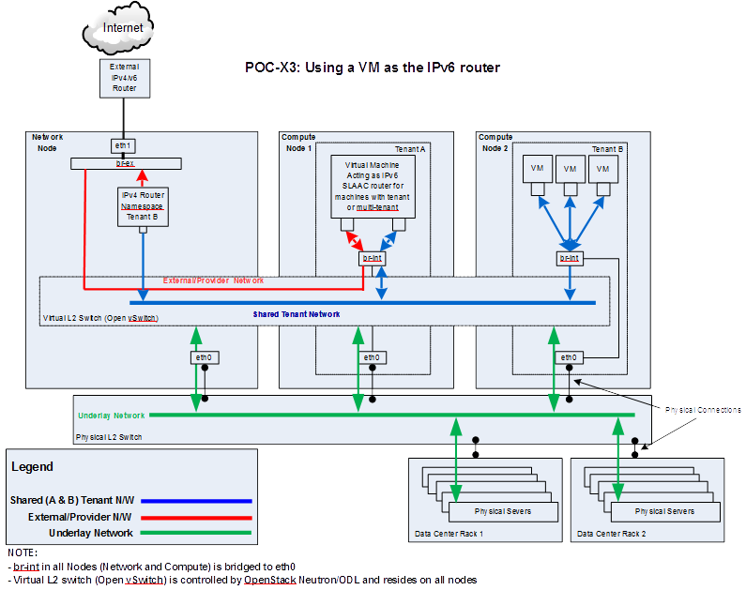
Design

Slide 9
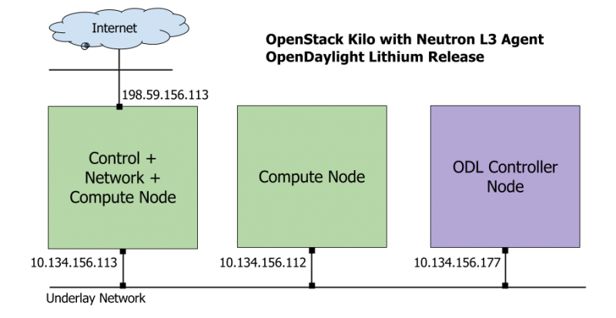
Underlay Network Topology

Slide 10
Setup Steps (1 of 2)
https://wiki.opnfv.org/ipv6_opnfv_project/bottomup_exercise
Step 0: set up infrastructure
Prepare 3 hosts with 8GB RAM and 40GB each
4GB RAM and 20GB storage minimum
Set up underlay networks and external access network
Step 1: set up ODL controller in ODL Controller Node
https://wiki.opnfv.org/ipv6_opnfv_project/bringup_odl_controller

Slide 11
Setup Steps (2 of 2)
Step 2: set up OS Controller Node
https://wiki.opnfv.org/ipv6_opnfv_project/setup_osodl_ctrlnwcom_node
Step 3: set up OS Compute Node
https://wiki.opnfv.org/ipv6_opnfv_project/setup_osodl_compute_node
Step 4: create networks, subnets, and spawn and configure VMs in integrated OS+ODL environment to complete experiment
https://wiki.opnfv.org/ipv6_opnfv_project/create_networks

Slide 12
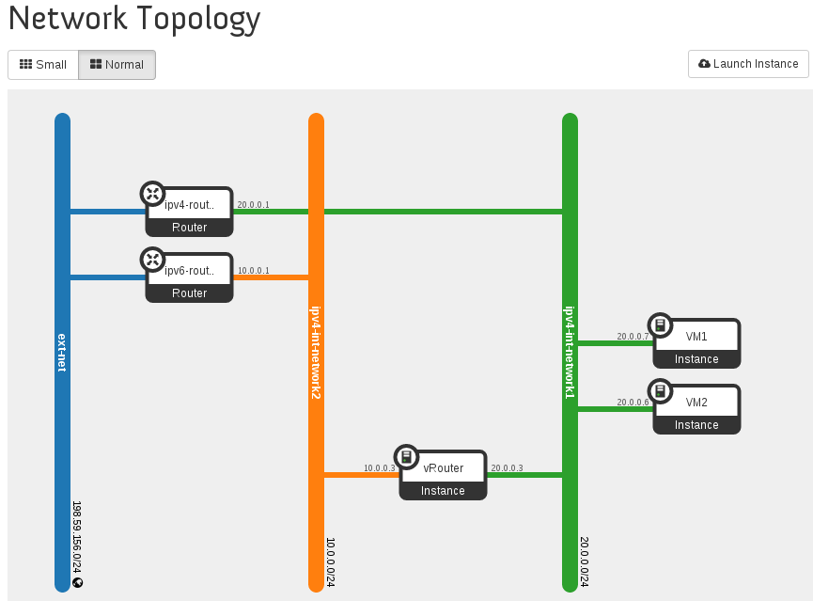
Topology from Horizon UI after Setup

Slide 13
Gaps in ODL and Workaround
Gap | Workaround
IPv6 Router is not supported in ODL and lack of IPv6 IPAM ODL net-virt provider in Lithium release only supports IPv4 Router. Support for IPv6 Router is planned using Routing Manager as part of Beryllium Release. | Use neutron-l3-agent instead of odl-l3 for L3 connectivity Use ODL for L2 switch
Security Group is not supported in ODL | Completely disable Security Group feature in Neutron Neutron ML2 Port Security Extension is not relevant any more
Shared tenant networks are not supported in ODL | Single tenant for network mapping
ODL net-virt provider doesn’t support IPv6 Java exception | Use manual configuration Expected to be fixed in Beryllium

Slide 14
Marching to Brahmaputra
To document Gap Analysis (User’s Guide)
To document setup instructions (Install Guide)
Deployment workflow:
Installer deploys core package of Brahmaputra, including testing
Disable odl-l3 and enable neutron-l3-agent (due to ODL gaps)
Our Step 4 instructions to set up IPv6 vRouter

Slide 15
Acknowledgement
All contributors of IPv6 project, particularly
Sridhar Gaddam (RedHat) for design and implementation of PoC
Mark Medina (ClearPath) for initial network architecture design
Jonne Soininen (Nokia) for SME in IPv6 area
Iben Rodriguez (Spirent) for providing VCT Lab infrastructure, and help at every step of lab setup
Cristian Valean (Cloud Base Solutions) for lab setup, access and support
Meenakshi Kaushik (Cisco) for experimenting in a single laptop
Hannes Frederic Sowa (RedHat) for SME in IPv6 in Linux kernel
Prakash Ramchandran (Huawei) for active participation and testing

Slide 16
Backup Slides

Slide 17
ODL Gap Analysis (1 of 3)
Use Case / Requirement | Lithium SR2? (Y / N) | Notes
REST API support for IPv6 subnet creation in ODL | Yes | Yes, it is possible to create IPv6 subnets in ODL using Neutron REST API. For a network which has both IPv4 and IPv6 subnets, ODL mechanism driver will send the port information which includes IPv4/v6 addresses to ODL Neutron northbound API. When port information is queried it displays IPv4 and IPv6 addresses. However, in Lithium release, ODL net-virt provider does not support IPv6 features (i.e., the actual functionality is missing and would be available only in the later releases of ODL).
When using ODL for L2 forwarding / tunneling, is it compatible with IPv6. | Yes

Slide 18
ODL Gap Analysis (2 of 3)
Use Case / Requirement | Lithium SR2? (Y / N) | Notes
IPv6 Router support in ODL 1. Communication between VMs on same compute node 2. Communication between VMs on different compute nodes (east-west) 3. External routing (north-south) | No | ODL net-virt provider in Lithium release only supports IPv4 Router. Support for IPv6 Router is planned using Routing Manager as part of Beryllium Release. In the meantime, if IPv6 Routing is necessary, we can use ODL for L2 connectivity and Neutron L3 agent for IPv4/v6 routing. Note: In Lithium SR1 release, we have the following issue, which is fixed upstream and back-ported to stable/lithium (expected in SR2 release).
IPAM: Support for IPv6 Address assignment modes. 1. SLAAC 2. DHCPv6 Stateless 3. DHCPv6 Stateful | No | Although it is possible to create different types of IPv6 subnets in ODL, ODL_L3 would have to implement the IPv6 Router that can send out Router Advertisements based on the IPv6 addressing mode. Router Advertisement is also necessary for VMs to configure the default route This could be part of Routing Manager in Beryllium release.

Slide 19
ODL Gap Analysis (3 of 3)
Use Case / Requirement | Lithium SR2? (Y / N) | Notes
Full support for IPv6 matching (i.e., IPv6, ICMPv6, TCP, UDP) in security groups. Ability to control and manage all IPv6 security group capabilities via Neutron/Nova API (REST and CLI) as well as via Horizon. | No | Security Groups for IPv6 are currently not supported.
Shared Networks support | No | ODL currently assumes a single tenant to network mapping and does not support shared networks among tenants.
IPv6 external L2 VLAN directly attached to a VM. | To-Do
ODL on an IPv6 only Infrastructure. | To-Do | Deploying OpenStack with ODL on an IPv6 only infrastructure where the APIendpoints are all IPv6 addresses.

Slide 20
Gaps in ODL and Workaround
IPv6 Router is not supported in ODL
Workaround is to use neutron-l3-agent instead of odl-l3, and use ODL as L2 switch
Security Group is not supported in ODL
Workaround is to completely disable Security Group feature in Neutron
Neutron ML2 Port Security Extension is not relevant any more
Shared tenant networks are not supported in ODL
Workaround is to use single tenant to network mapping
ODL net-virt provider doesn’t support IPv6
Workaround is to use manual configuration
Expected to be fixed in Beryllium

Slide 21
Lessons Learned of Setup in a Single Laptop Environment
RAM Size – 32GB RAM preferred in a single laptop
8GB RAM and 40GB storage for each node
4GB RAM and 20GB storage minimum for each node
Tricks of Network Setup in Virtual Box
Internal Network, Host-Only, Bridged, NAT, NAT Network
32-bit / 64-bit, Windows / Linux
External, routable IP address for a laptop to different locations

