Slide 1
Setup of a Service VM as an IPv6 vRouter
Bin Hu, AT&T
Meenakshi Kaushik, Cisco
Sridhar Gaddam, RedHat

Slide 2
Content
Goal
Design
Underlay Network Topology
Setup Steps
Topology from Horizon UI after Setup
Gaps in ODL and Workaround
Lessons Learned of Setup in a Single Laptop Environment
Marching to Brahmaputra
Acknowledgement

Slide 3
Goal
A VM in OpenStack+ODL environment that is capable of (1) advertising IPv6 Router Advertisements (RA) to the VMs on the internal network (2) IPv6 Forwarding (i.e., North-South traffic), i.e. capability of an IPv6 vRouter
Gap Analysis
Expand IPv6 vRouter capability to any VM
Allow for any 3rd-party solution, e.g. IPv6 vRouter VNF as an alternative of Neutron Router or ODL Router
Allow for open innovation

Slide 4
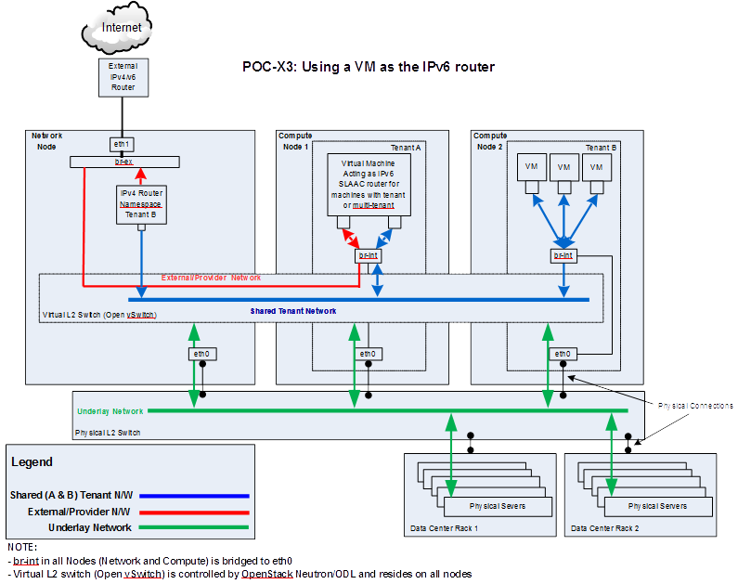
Design

Slide 5
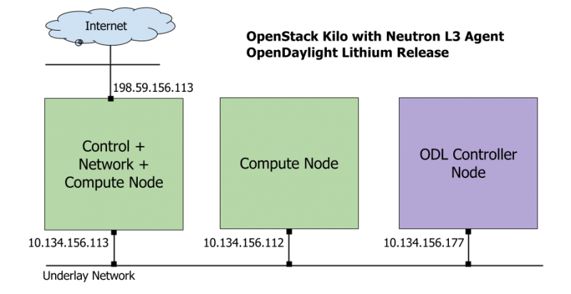
Underlay Network Topology

Slide 6
Setup Steps (1 of 2)
https://wiki.opnfv.org/ipv6_opnfv_project/bottomup_exercise
Step 0: set up infrastructure
Prepare 3 hosts with 8GB RAM and 40GB each
4GB RAM and 20GB storage minimum
Set up underlay networks and external access network
Step 1: set up ODL controller in ODL Controller Node
https://wiki.opnfv.org/ipv6_opnfv_project/bringup_odl_controller

Slide 7
Setup Steps (2 of 2)
Step 2: set up OS Controller Node
https://wiki.opnfv.org/ipv6_opnfv_project/setup_osodl_ctrlnwcom_node
Step 3: set up OS Compute Node
https://wiki.opnfv.org/ipv6_opnfv_project/setup_osodl_compute_node
Step 4: create networks, subnets, and spawn and configure VMs in integrated OS+ODL environment to complete experiment
https://wiki.opnfv.org/ipv6_opnfv_project/create_networks

Slide 8
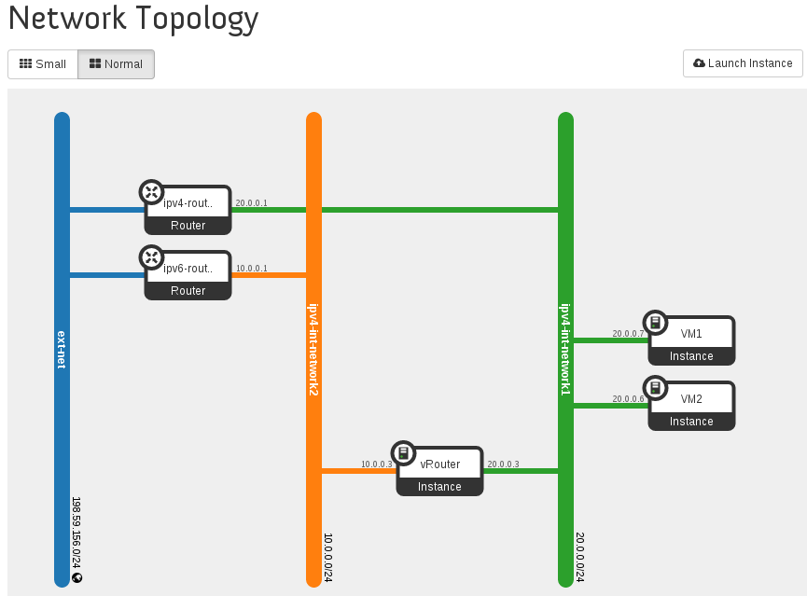
Topology from Horizon UI after Setup

Slide 9
Gaps in ODL and Workaround
Gap | Workaround
IPv6 Router is not supported in ODL and lack of IPv6 IPAM ODL net-virt provider in Lithium release only supports IPv4 Router. Support for IPv6 Router is planned using Routing Manager as part of Beryllium Release. | Use neutron-l3-agent instead of odl-l3 for L3 connectivity Use ODL for L2 switch
Security Group is not supported in ODL | Completely disable Security Group feature in Neutron Neutron ML2 Port Security Extension is not relevant any more
Shared tenant networks are not supported in ODL | Single tenant for network mapping
ODL net-virt provider doesn’t support IPv6 Java exception | Use manual configuration Expected to be fixed in Beryllium

Slide 10
Lessons Learned of Setup in a Single Laptop Environment
RAM Size – 32GB RAM preferred in a single laptop
8GB RAM and 40GB storage for each node
4GB RAM and 20GB storage minimum for each node
Tricks of Network Setup in Virtual Box
Internal Network, Host-Only, Bridged, NAT, NAT Network
32-bit / 64-bit, Windows / Linux
External, routable IP address for a laptop to different locations

Slide 11
Marching to Brahmaputra
To document Gap Analysis (User’s Guide)
To document setup instructions (Install Guide)
Deployment workflow:
Installer deploys core package of Brahmaputra, including testing
Disable odl-l3 and enable neutron-l3-agent (due to ODL gaps)
Our Step 4 instructions to set up IPv6 vRouter

Slide 12
Acknowledgement
All additional contributors of IPv6 project, particularly
Mark Medina (ClearPath) for initial network design
Jonne Soininen (Nokia) for SME in IPv6 area
Iben Rodriguez (Spirent) for providing VCT Lab infrastructure, and help at every step of lab setup
Cristian Valean (Cloud Base Solutions) for lab setup, access and support
Hannes Frederic Sowa (Redhat) for SME in IPv6 in Linux kernel
Prakash Ramchandran (Huawei) for active participation and testing

Slide 13
Backup Slides

Slide 14
ODL Gap Analysis (1 of 3)
Use Case / Requirement | Lithium SR2? (Y / N) | Notes
REST API support for IPv6 subnet creation in ODL | Yes | Yes, it is possible to create IPv6 subnets in ODL using Neutron REST API. For a network which has both IPv4 and IPv6 subnets, ODL mechanism driver will send the port information which includes IPv4/v6 addresses to ODL Neutron northbound API. When port information is queried it displays IPv4 and IPv6 addresses. However, in Lithium release, ODL net-virt provider does not support IPv6 features (i.e., the actual functionality is missing and would be available only in the later releases of ODL).
When using ODL for L2 forwarding / tunneling, is it compatible with IPv6. | Yes

Slide 15
ODL Gap Analysis (2 of 3)
Use Case / Requirement | Lithium SR2? (Y / N) | Notes
IPv6 Router support in ODL 1. Communication between VMs on same compute node 2. Communication between VMs on different compute nodes (east-west) 3. External routing (north-south) | No | ODL net-virt provider in Lithium release only supports IPv4 Router. Support for IPv6 Router is planned using Routing Manager as part of Beryllium Release. In the meantime, if IPv6 Routing is necessary, we can use ODL for L2 connectivity and Neutron L3 agent for IPv4/v6 routing. Note: In Lithium SR1 release, we have the following issue, which is fixed upstream and back-ported to stable/lithium (expected in SR2 release).
IPAM: Support for IPv6 Address assignment modes. 1. SLAAC 2. DHCPv6 Stateless 3. DHCPv6 Stateful | No | Although it is possible to create different types of IPv6 subnets in ODL, ODL_L3 would have to implement the IPv6 Router that can send out Router Advertisements based on the IPv6 addressing mode. Router Advertisement is also necessary for VMs to configure the default route This could be part of Routing Manager in Beryllium release.

Slide 16
ODL Gap Analysis (3 of 3)
Use Case / Requirement | Lithium SR2? (Y / N) | Notes
Full support for IPv6 matching (i.e., IPv6, ICMPv6, TCP, UDP) in security groups. Ability to control and manage all IPv6 security group capabilities via Neutron/Nova API (REST and CLI) as well as via Horizon. | No | Security Groups for IPv6 are currently not supported.
Shared Networks support | No | ODL currently assumes a single tenant to network mapping and does not support shared networks among tenants.
IPv6 external L2 VLAN directly attached to a VM. | To-Do
ODL on an IPv6 only Infrastructure. | To-Do | Deploying OpenStack with ODL on an IPv6 only infrastructure where the APIendpoints are all IPv6 addresses.

Slide 17
Gaps in ODL and Workaround
IPv6 Router is not supported in ODL
Workaround is to use neutron-l3-agent instead of odl-l3, and use ODL as L2 switch
Security Group is not supported in ODL
Workaround is to completely disable Security Group feature in Neutron
Neutron ML2 Port Security Extension is not relevant any more
Shared tenant networks are not supported in ODL
Workaround is to use single tenant to network mapping
ODL net-virt provider doesn’t support IPv6
Workaround is to use manual configuration
Expected to be fixed in Beryllium

