Slide 1
Congress Blueprint --policy abstraction
Yali Zhang

Slide 2
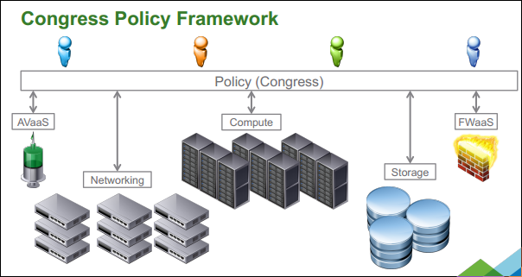
What is Congress?
Congress is a core OpenStack project to provide policy as a services across any collection of cloud services (e.g. application, compute, network and storage) in order to offer governance and compliance for dynamic infrastructures.
Wiki: https://wiki.openstack.org/wiki/Congress

Slide 3
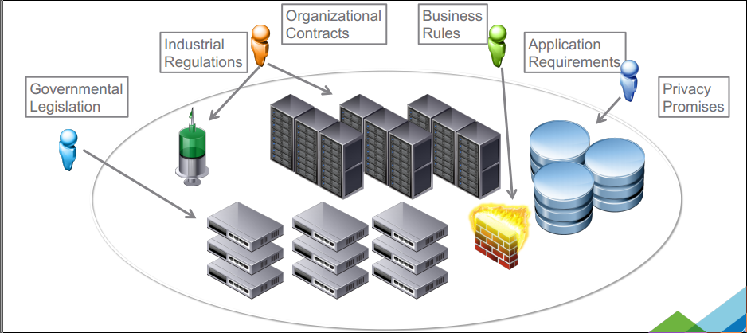
Why Congress?
Different policy implementation:
Nova: SolverSchedular
Neutron: group policy or configuration
Swift: Swift policy engine
……
Disadvantages:
Complex configuration
Tremendous conflict probability
Incompetent for across components services
……
What is the Solution?

Slide 4
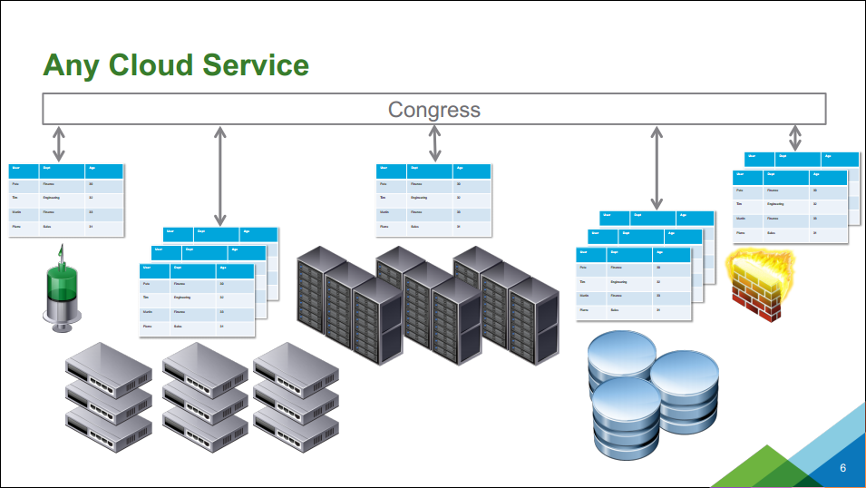
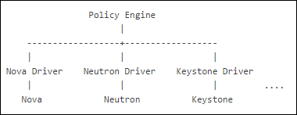
Mechanism of Congress
Retrieve data from underlying components by different drivers
Express violation state with these data tables
Functionality of Congress
Allow cloud administrators and tenants to use a high-level, general purpose, declarative language to describe business logic. Datalog has been adopted as the policy expression language.
Offer a pluggable architecture that connects to any collection of cloud services
Enforce policy
Proactive: preventing violations before they occur
Reactive: correcting violations after they occur
Monitoring: give administrators insight into policy and its violations.

Slide 5
Typical Example
Requirement: Every network attached to a VM must be owned by someone in the same group as the VM owner.
error(name2):-
nova:servers(device_id, name2, c2, d2, tenant_id2, f2, g2, h2),
neutronv2:ports(a, tenant_id, c, network_id, e, f, g, h, device_id, g),
neutronv2:networks(network_id, tenant_id3, c3, d3, e3, f3),
not same_group(tenant_id, tenant_id3)
same_group(x,y) :- group(x,g),group(y,g)
Datalog is not intuitive, even difficult. When translate the real intent into Datalog, the logic may be complex. And users must explicitly know the elements in underlying data tables, and how to connect them.

Slide 6
A Blueprint of Congress —— policy abstraction
Motivation: Datalog is complex language which is not intuitive to express users’ real intent. And there isn’t a unified policy model in Congress, so this blueprint aims to express a simple and intuitive way to deploy policies.
error(vm) :-
nova:virtual_machine(vm)
nova:network(vm, network)
nova:owner(vm, vm_owner)
neutron:owner(network, network_owner)
not same_group(vm_owner, network_owner)
Entities+ attributions
Conditions=error state
Datalog consists of three parts.
Objects which can be fetched from underlying services
Objects’ attributions which are the elements to structure violations
Prohibition state which expressed by objects’ attributions

Slide 7
Policy in Congress can be abstracted into object, violation-condition, action and data.
Object: an object or several related objects which are concerned by policy
Violation-condition: the state of objects’ attributes or the relationship between several entities which can produce violation
Action: the action needs to take for this policy, such as, monitoring, proactive or some specific reactive actions
Data: the information gotten or needed when execute the action
Expression in Horizon

Slide 8
Details of abstraction elements
Objects
The related objects users care about which be jointed by some fields.
e.g. Users care about the relation between servers and networks, they just need to choose these two objects without worrying about how to connect them (port). UI will predefine this relationship.
Violation-condition
Error state expressed by Datalog can be apart into two types.
Restriction attributions’ value or statistic value (arithmetic or string manipulation)
Restriction whether some attributions in some specific tables (data table manipulation)

Slide 9
Expansion of policy abstraction
Define new objects and relationship, violation condition
admin
Use new objects and relationship, violation condition
Database
user
policy engine
nova
neutron
swift
New service
drivers
nova
neutron
swift
New service

