Slide 1
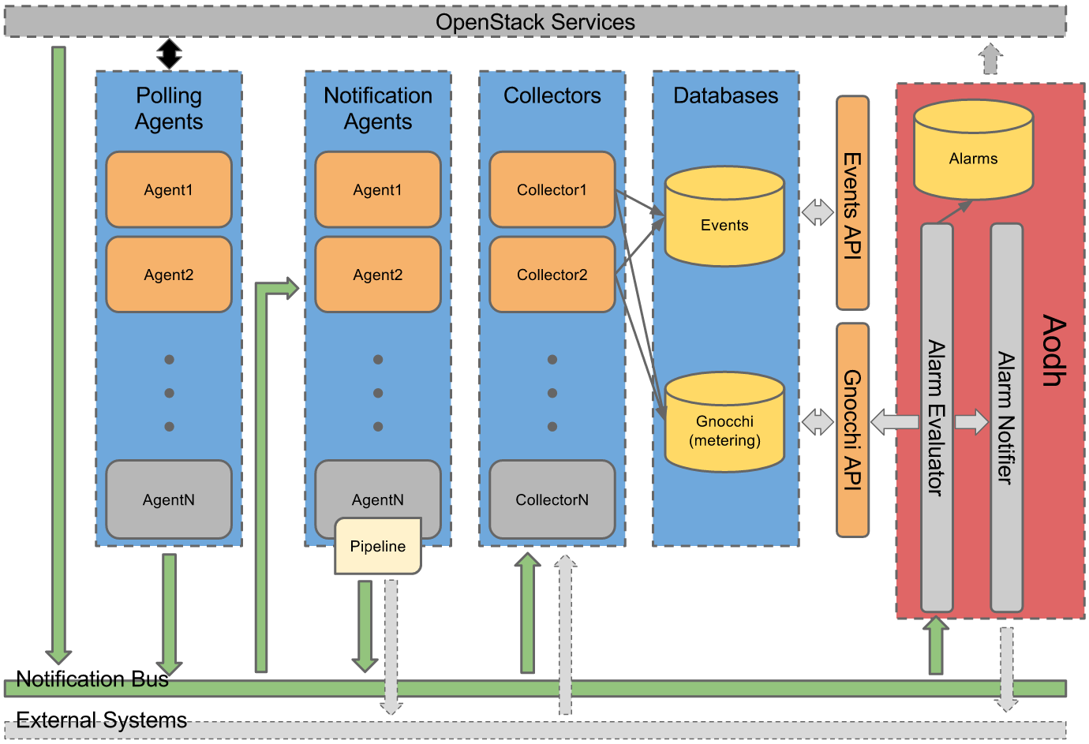
Ceilometer + Gnocchi + Aodh Architecture
Ceilometer (data collection): to efficiently collect, normalise and transform data produced by OpenStack services
Polling agent: daemon designed to poll OpenStack services and build Meters
Notification agent: daemon designed to listen to notifications on message queue, convert them to Events and Samples, and apply pipeline actions
Collector: daemon designed to gather and record event and metering data created by notification and polling agents
Gnocchi (metric storage): to provide a time-series resource indexing, metric storage service
Aodh (alarming): to enable the ability to trigger actions based on defined rules against sample or event data collected by Ceilometer

Slide 2
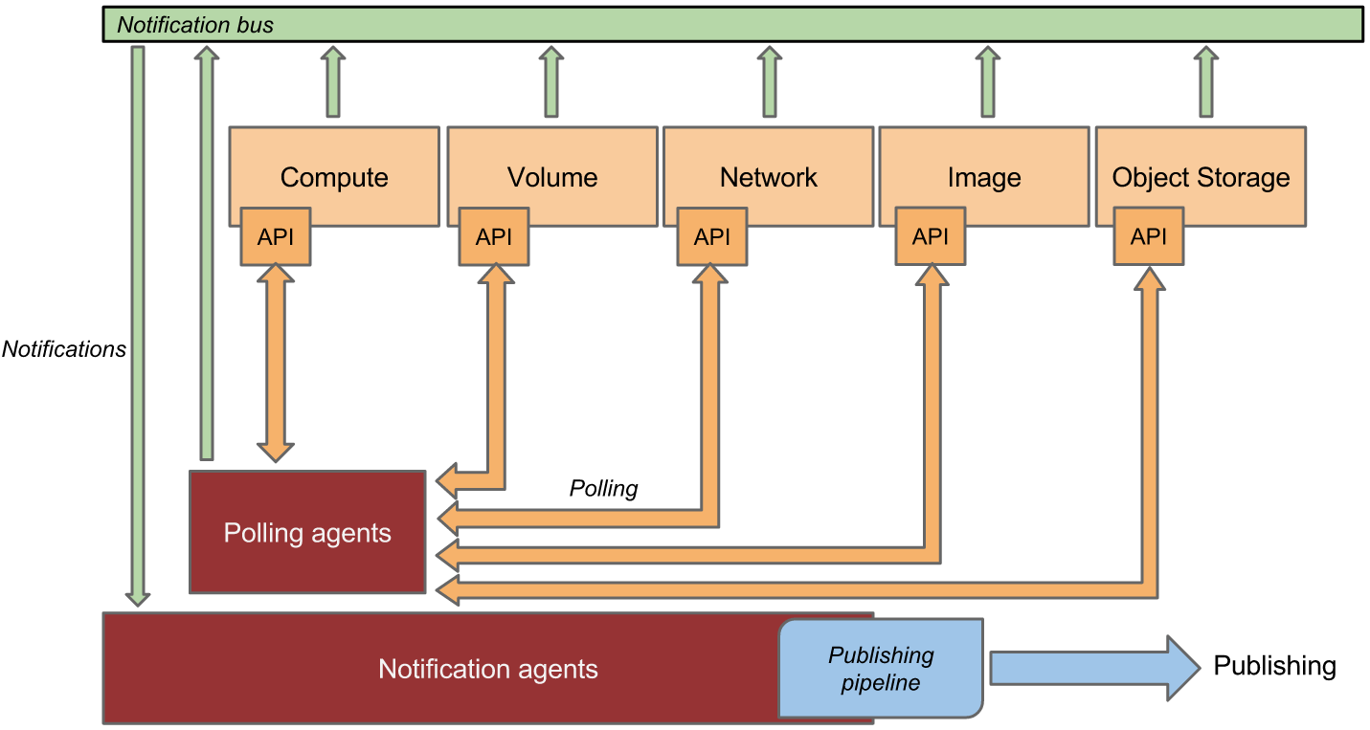
Gathering the data
Bus listener agent (Notification agent): takes events generated on the notification bus and transforms them into Ceilometer samples
Monitors the message queues for notifications
Polling agent: polls some API or other tool to collect information at a regular interval
Polling agents can be configured either to poll local hypervisor or remote APIs (public REST APIs exposed by services and host-level SNMP/IPMI daemons)

Slide 3
Notification agents: Listening for data
Notification daemon (agent-notification) which monitors the message bus for data being provided by other OpenStack components, as well as Ceilometer internal communication
Loads one or more listener plugins
Sample-oriented plugins provide a method to list the event types they’re interested in and a callback for processing messages accordingly

Slide 4
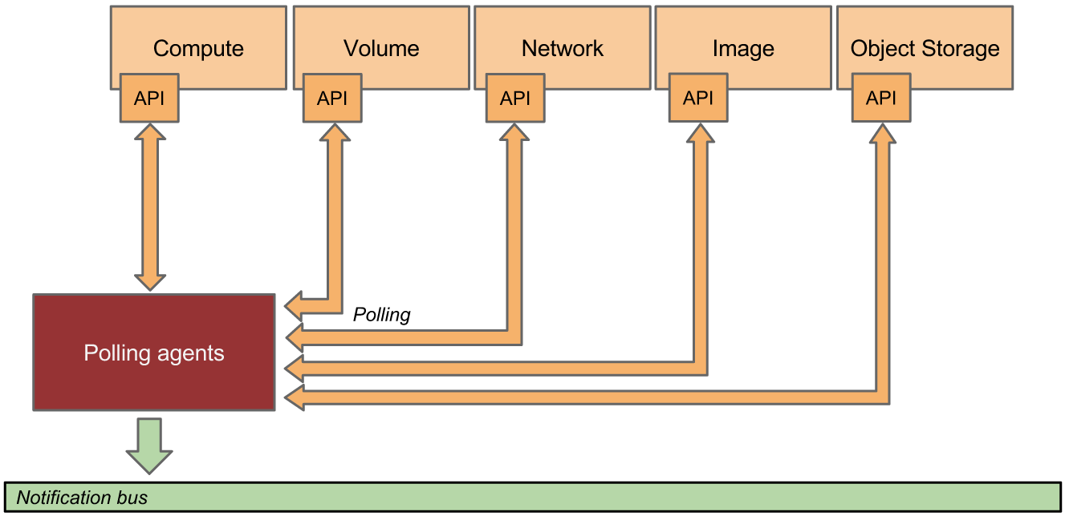
Polling agents: Asking for data
compute-agent: polling for compute resources is handled by the compute-agent running on the compute node (where communication with the hypervisor is more efficient)
central-agent: polling via service APIs for non-compute resources is handled by the central-agent running on a cloud controller node
A single agent can fulfill both roles in an all-in-one deployment. Conversely, multiple instances of an agent may be deployed, in which case the workload is shared.
The polling agent daemon is configured to run one or more pollster plugins using either the ceilometer.poll.compute and/or ceilometer.poll.central namespaces

Slide 5
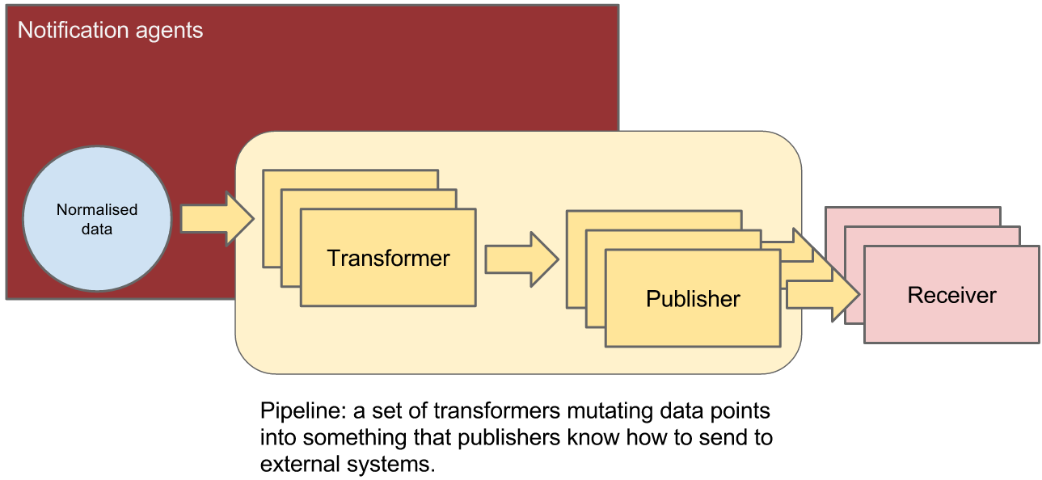
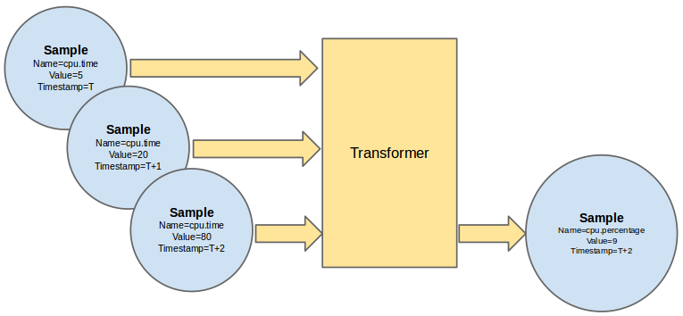
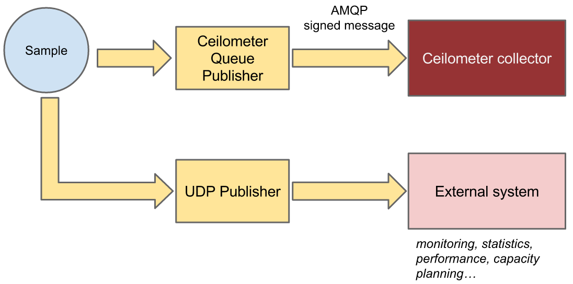
Processing the data
Ceilometer offers the ability to take data gathered by the agents, manipulate it, and publish it in various combinations via multiple pipelines. This functionality is handled by the notification agents
Pipeline Manager
Transforming the data
Publishing the data

Slide 6
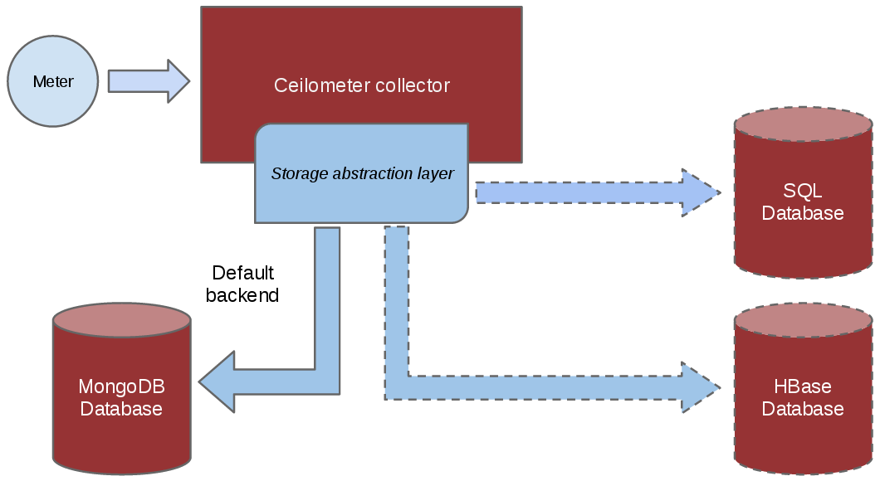
Storing the data
The collector daemon gathers the processed event and metering data captured by the notification and polling agents. It validates the incoming data and (if the signature is valid) then writes the messages to a declared target: database, file, or http.
A plugin model has been put in place to allow for various types of database backends to be used

Slide 7
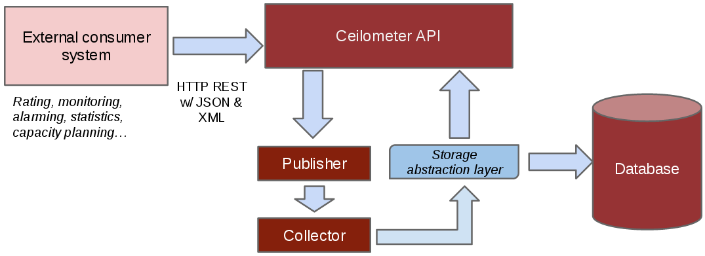
Accessing the data
Access the collected data via the API rather than by accessing the underlying database directly.
Deployers can define custom sources through a configuration file, and then create agents to collect samples for new meters using those sources. This means that you can collect data for applications running on top of OpenStack, such as a PaaS or SaaS layer, and use the same tools for metering your entire cloud.
End users can also send their own application specific data into the database through the REST API for a various set of use cases

