Slide 1
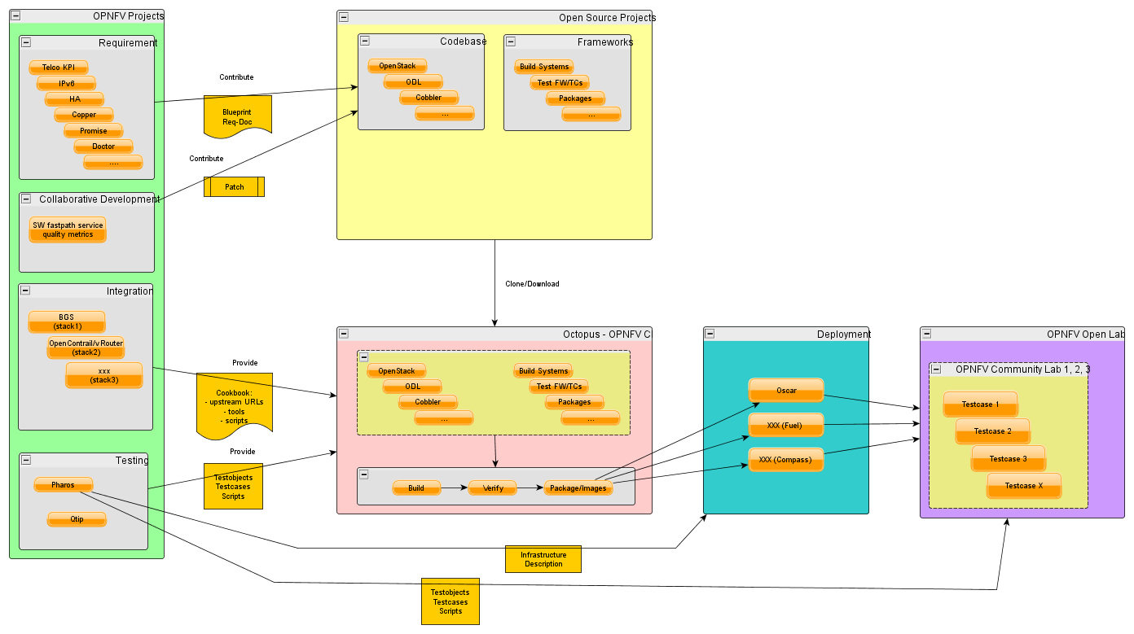
Octopus Project Embedding

Slide 2
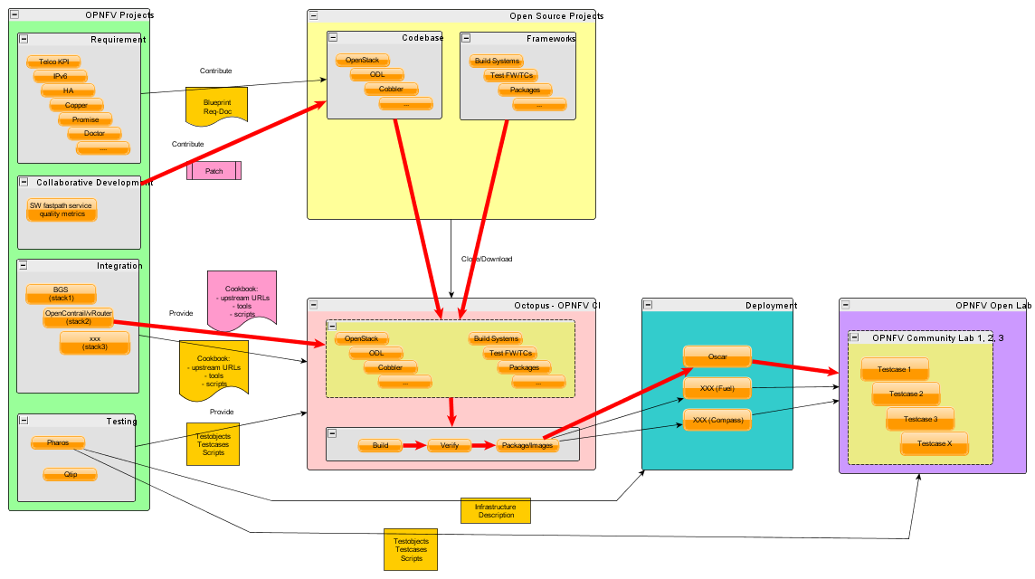
Workflow Collaborative Development

Slide 3
Questions
User-Branch?

Slide 4
Questions
Create binaries in upstream environment?

Slide 5
Questions
Create binaries in upstream environment?
Binaries / Packages or Sources?

Slide 6
Questions
Tools must be pre-installed on OPNFV CI Servers

Slide 7
Questions
How much verification?

Slide 8
Questions
Should the way of deployment be part of cookbook?

Slide 9
Questions
Every patch can be run in all testcases?

Slide 10
Questions
Create binaries in upstream environment?
User-Branch?
Tools must be pre-installed on OPNFV CI Servers
Every patch can be run in all testcases?
Binaries / Packages or Sources?
Should the way of deployment be part of cookbook?
How much verification?

