Slide 1
Virtualized Infrastructure Deployment Policies (Copper)
19 February 2015
Bryan Sullivan, AT&T

Slide 2
What is Policy?
My definition: the ability to manage a system’s state per rules
NFVI operation per policy OPNFV is the goal of the policy-related projects
Copper: ensuring resources are deployed / things are configured per a plan
Doctor: ensuring faults are handled effectively
Promise: ensuring resources can be reserved for future use
Policy depends upon several basic capabilities
Intent expression: relevant/effective for the unique scope of policy managers
State awareness: current, requested, expected, past
Ability to act: proactively, reactively, interactively

Slide 3
All Policy is Local
Orchestration
User
Policy balances top-down intent with bottom-up state
Intent is refined and delegated as it gets closer to policy enforcement points
Intent has to be expressed in terms relevant to the parties
User to Service Provider
Service Provider to Cloud Provider
Cloud Provider to Infrastructure Controller
Service
Service Provider
Network
Cloud
Cloud Provider

Slide 4
It’s big
This is a big, big, BIG subject
Copper focuses on NFV Infrastructure (NFVI) management goals
Initial focus is on policies for Virtual Infrastructure Management (VIM) of compute, storage, and network resources, using existing Open Source projects
help ensure that virtualized infrastructure deployments comply with goals of the VNF designer/user, e.g. re affinity and partitioning (e.g. per regulation, control/user plane separation, cost…)

Slide 5
Copper Approach
A requirements-developing project assessing off the shelf basic VIM support for policy management
Use existing open source projects e.g.
OpenStack Congress
OpenDaylight Group-Based Policy (GBP)
Assess current policy support
Identify key gaps given policy use cases
Initiate upstream projects to address the gaps

Slide 6
Use Cases
Workload Placement: affinity, anti-affinity, geo-diversity
Load Balancing
Service Failover
Link Mirroring

Slide 7
Initial Assessment Focus: OpenStack Congress
Congress is a “policy-as-a-service” project
Congress policies define which states of the cloud are in compliance or not
Cloud state is the collection of data provided by cloud services
Congress uses a table-based approach to monitor and assess state, e.g.
Nova: servers, flavors, hosts, floating IPs
Neutron: networks, subnets, ports, routers, security groups
Keystone: users, roles, tenants
Cinder: volumes, snapshots, services
Ceilometer: meters, alarms, events, statistics

Slide 8
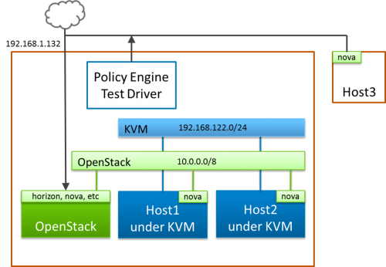
So far…
Installed devstack and congress in a lightweight environment (“Academy”)
Hacking on a web-based tool to explore Congress features
Using Congress APIs directly vs the python-based congress client
Preparing to develop policy rules that exercise the Copper use cases
Ubuntu 14.04
Congress

Slide 9
Demo
If this doesn’t work, or you’re asleep by now, I’ll post a video later

Slide 10
After Congress, we will focus on
Intent-focused projects, e.g.
OpenStack Group-Based Policy
OpenDaylight Group-Based Policy
Mechanisms for event-based state awareness
Policy expression languages for various domains and abstraction levels
Policy as part of VNF package or other metadata
Layered approach to managing policy via diverse infrastructure managers

Slide 11
Come join us!
If you are interested in open source solutions for NFVI policy management…
If you want to help set goals for this project, whatever your role…
If you are involved in a related project and want to promote synergy with it…
If you just want to learn more and get actively engaged in whatever way…
https://wiki.opnfv.org/copper

