Slide 1
OPNFV
Test Dashboard
10/09/2015
M.Richomme, Orange

Slide 2
Introduction
Test projects are producing results (hopefully)
Results have different forms (html, json, logs, …)
Some results are stored, some not
Results are not post processed for the moment (great community testbed federation not leveraged yet)
Soon same test shall be automatically run on different hardware, with different installers and different

Slide 3
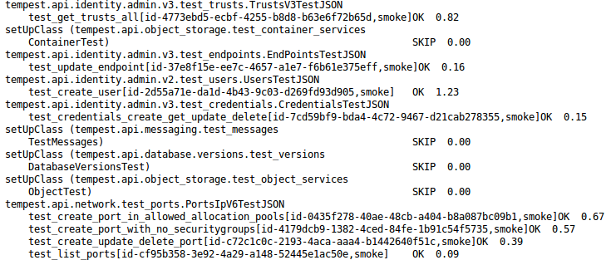
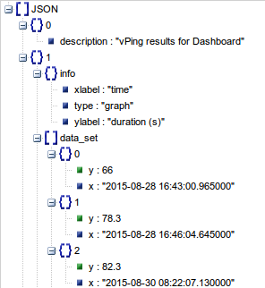
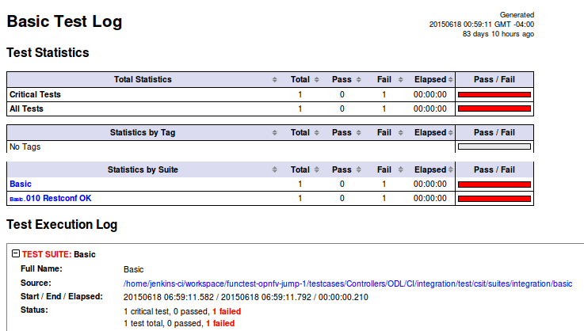
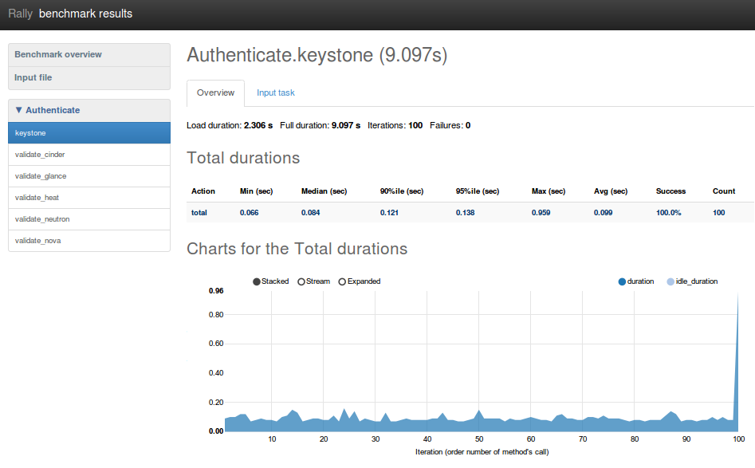
Introduction

Slide 4
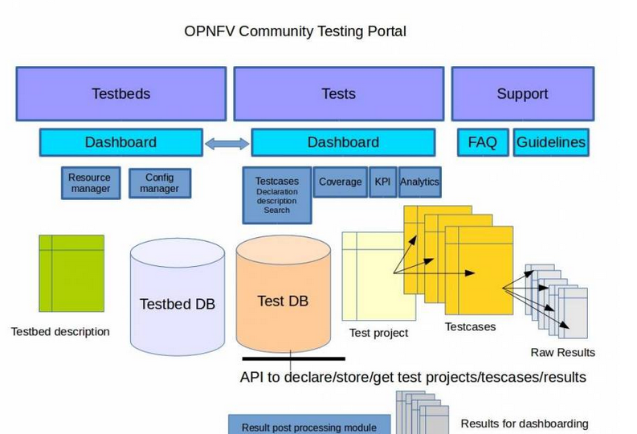
Need to collect and process results

Slide 5
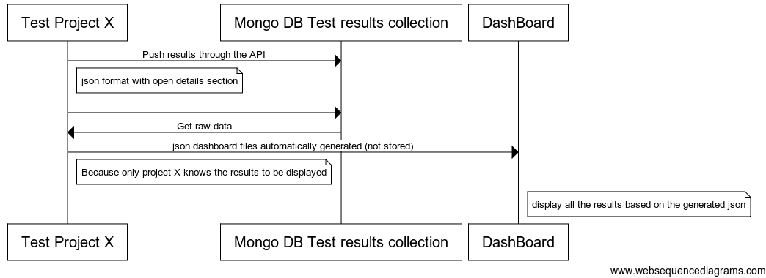
Call flow

Slide 6
Demo

Slide 7
Next steps
Consolidate API
Work on data model (version, installer ….are missing)
More unit tests
Add unit tests in CI
Add API auto doc (pyswagger)
Move to LF DB
Functest
Push results for the other testcases (Tempest, Rally, ODL, ..)
Develop and Commit Test2Dashboard scripts and generate all the required json files for dashboard
Test with other test projects (Yardstick, Qtip, …)
Proof of Concept of the Dashboard
Secure DB (backup/Restore mechanisms)

Slide 8
Thanks

