Slide 1
Doctor Overview
Goal
Build fault management and maintenance framework
Approach
Identify requirement
Gap Analysis
Implementation work in Upstream (OpenStack)
Integration and testing
Status
Initial Requirement study, architecture design, Gap analysis : Done
Collaborative Development: On-going (3 merged Blueprints in OpenStack Liberty)
Standardization Sync: On-going (by NFV member efforts, joint meeting)

Slide 2
Key Requirements as VIM
Consistent Resource State Awareness
Immediate Notification
Extensible Monitoring
Fault Correlation

Slide 3
Doctor Demo Overview
Quick Recovery
Switch ACT-SBY
Application
Manager
Video Player
Streaming Server
ACT
SBY
Virtualized Infrastructure
Virtualized Infrastructure Manager (VIM)
= OpenStack
VM-1 Down
Virtual Compute
Virtual Storage
Virtual Network
Reaction
Detection without Doctor (few minutes)
Detection with Doctor (1 second)
Virtualization Layer
Hardware Resources
Host-A Down

Slide 4
Fault Management Sequence
App Manager
+ Viewer
Application
0. Set Alarm
Streaming Server
Manager
6-. Action
5. Notify Error
4. Notify all
Liberty
Virtualized Infrastructure (Resource Pool)
Controller
Controller
Notifier
Controller
Resource Map
Alarm
Conf.
Nova
Ceilometer
3. Update State
2. Find Affected
Monitor
Monitor
Inspector
Monitor
1. Raw Failure
Failure Policy
Log Monitor
State Reflector

Slide 5
Service Healing Process
Alarm Notification
Host
Host
Control
VM
VM
VM
App Manager
Streaming Server
Streaming Server
vNIC
vNIC
vSwitch
vSwitch
Data Flow (Before)
NIC
NIC
Video Player
Data Flow (After)
Switch

Slide 6
Doctor Features in OpenStack Liberty Release
Project | Blueprint | Spec Drafter | Developer
Ceilometer | Event Alarm Evaluator | Ryota Mibu (NEC) | Ryota Mibu (NEC)
Nova | New nova API call to mark nova-compute down | Tomi Juvonen (Nokia) | Roman Dobosz (Intel)
 | Support forcing service down | Tomi Juvonen (Nokia) | Carlos Goncalves (NEC)

Slide 7
Doctor BP Detail: Nova – Mark Nova-Compute Down
External Monitoring Service
Monitoring
Client
NEW API
to update nova-compute
service state
Host / Machine
Force-down API
nova api
VM
service state
nova compute
queue
nova conductor
nova DB
Hypervisor
vSwitch
EXISTING (periodic update)
nova scheduler
BMC

Slide 8
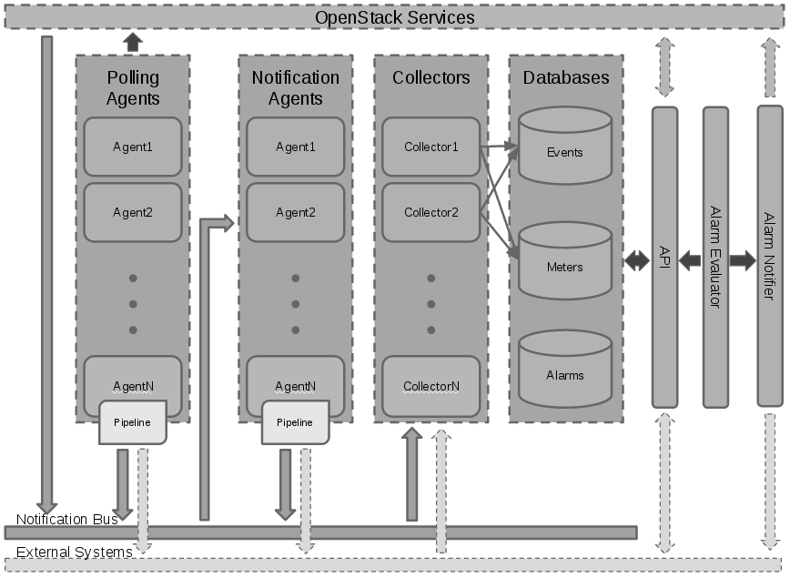
Doctor BP Detail: Ceilometer - Event Alarm
Nova
Neutron
Cinder
Manager
event
stats
sample
EXISTING (polling-based)
Notification-driven alarm evaluator
notification
NEW Shortcut (notification-based)
Audit Service

