Slide 1
Policy Architecture Discussion
18 May 2015
Bryan Sullivan, AT&T

Slide 2
Why this discussion
Policy is a big subject, larger than
Any one infrastructure manager
Any one purpose
Any one project
We are very motivated to jump right in and fix things – good
Our solutions may turn out to be multi-purpose – even better
But if they don’t…

Slide 3
OPNFV Policy-Related Projects
Project | Focus | High-Level Requirements | Upstream Projects
Doctor | Fault management and maintenance | Immediate detection of physical resource outage, affected VMs, take remediation actions including Notification | Ceilometer, Nova, Monasca
Copper | VI deployment policies | Ensure resources comply with generic and VNF-specific expectations | Congress, Group-Based Policy ODL: Group-Based Policy, Network Intent
Promise | Resource Management | Resource reservation for future use by a VNF, Capacity Management and Notification | StormForge, Blazar
Prediction | Data collection for future failure prediction | Data collector, failure predictor, and failure management module | Ceilometer Monasca

Slide 4
OPNFV Policy-Related Projects
Project | Focus | High-Level Requirements | Upstream Projects
Availability | Carrier Grade NFV HA scenarios, framework, requirements and schemas | Providing carried-grade high availability for VNFs and the OPNFV platform | Monasca Ceilometer
Resource Scheduler | Expands data available to resource schedulers | Define resource goals, constraints, and policies; collect info to enable enhanced scheduling | Nova, Neutron, Cinder, Ceilometer
VNFFG | VNF Forwarding Graphs | OpenStack based and OpenFlow compliant VNFFG | Liberty release blueprints

Slide 5
All Policy is Local
Orchestration
User
Policy balances top-down intent with bottom-up state
Intent is refined and delegated as it gets closer to policy enforcement points
Intent has to be expressed in terms relevant to the parties
User to Service Provider
Service Provider to Cloud Provider
Cloud Provider to Infrastructure Controller
Service
Service Provider
Network
Cloud
Cloud Provider

Slide 6
Some Architectural Aspects/Goals to Be Considered
Two main focuses: lifecycle event handling, and adherence to generic policies
Policy distribution directly to VIMs and through VNF/service orchestration
Policies are applied statically/locally, or thru tight closed-loop systems if needed
Policies are localized as they are distributed/delegated
Generic and VNF/service-related events may be handled by distinct closed-loop systems
Policy-related event reporting may be administered or invoked via subscription
"open-loop" systems support audits, manual intervention, policy optimization

Slide 7
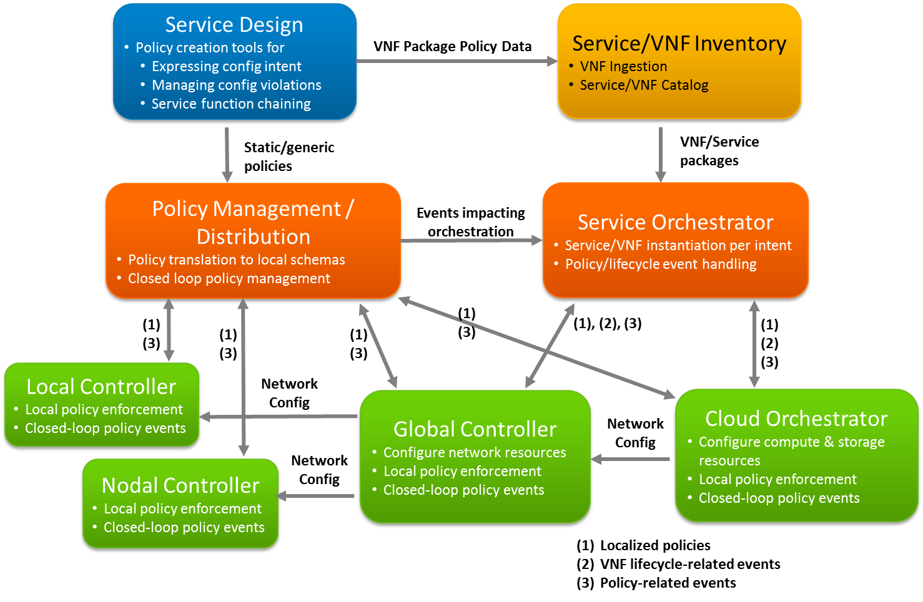
Example Architectural Approach

Slide 8
Come join us!
If you are interested in open source solutions for NFVI policy management…
If you want to help set goals for these projects, whatever your role…
If you are involved in a related project and want to promote synergy with it…
If you just want to learn more and get actively engaged in whatever way…
https://wiki.opnfv.org/

