Slide 1
Policy Architecture Discussion
18 May 2015
Bryan Sullivan, AT&T

Slide 2
Why this discussion (we need to talk…)
Policy is a big subject, larger than
Any one infrastructure manager
Any one purpose
Any one project
We are very motivated to jump right in and fix things – good
Our solutions may turn out to be multi-purpose – even better
But if they don’t…

Slide 3
OPNFV Policy-Related Projects
Project | Focus | High-Level Requirements | Upstream Projects
Doctor | Fault management and maintenance | Immediate detection of physical resource outage, affected VMs, take remediation actions including Notification | Ceilometer, Nova, Monasca
Copper | VI deployment policies | Ensure resources comply with generic and VNF-specific expectations | Congress, Group-Based Policy ODL: Group-Based Policy, Network Intent
Promise | Resource Management | Resource reservation for future use by a VNF, Capacity Management and Notification | StormForge, Blazar
Prediction | Data collection for future failure prediction | Data collector, failure predictor, and failure management module | Ceilometer Monasca
Resource Scheduler | Expands data available to resource schedulers | Define resource goals, constraints, and policies; collect info to enable enhanced scheduling | Nova, Neutron, Cinder, Ceilometer
VNFFG | VNF Forwarding Graphs | OpenStack based and OpenFlow compliant VNFFG | Liberty release blueprints

Slide 4
All Policy is Local
Orchestration
User
Policy balances top-down intent with bottom-up state
Intent is refined and delegated as it gets closer to policy enforcement points
Intent has to be expressed in terms relevant to the parties
User to Service Provider
Service Provider to Cloud Provider
Cloud Provider to Infrastructure Controller
Service
Service Provider
Network
Cloud
Cloud Provider

Slide 5
Policy Architecture / Capability Goals
Expressions of intent
Variable scope for policies: generic, group-based, app-specific
Events to be watched for: actions, states
Speed of event discovery
Actions to take: require, allow, deny, respond, log
Distributed policy enforcement
Policies are handled locally if possible
Closed-loop policy systems are as “tight-looped” as possible
Adaptation to local expressions and APIs
Minimum number of expression transformations

Slide 6
Some Architectural Aspects to Be Considered
Two high-level goals: deployment per intent, and adherence to generic policies
Policies are distributed directly to VIM elements and through VNF/service orchestration
Policies are applied statically and locally If possible, and initially thru tight closed-loop systems if needed
Policies are localized as they are distributed/delegated
Closed-loop policy and VNF-lifecycle event handling are somewhat distinct
"open-loop" systems are also needed e.g. for audits and manual interventions, and machine-learning policy optimizations (future)

Slide 7
Some Issues to be Investigated
Capabilities (e.g. APIs) of components to
handle events locally
enable closed-loop policy handling components to subscribe/optimize policy-related events that are of interest
For global controllers and cloud orchestrators
Support for event correlation across network and cloud resources
Event/response flows applicable to various policy use cases
Specific policy use cases which can/should be
Locally handled by NFVI components
Handled by VNF-relevant or VNF-independent closed-loop systems

Slide 8
Some General Policy Architecture Capabilities
Polled monitoring: exposure of state via request-response APIs
Notifications: exposure of state via pub-sub APIs
Realtime/near-realtime notifications
Delegated policy: monitoring, violation reporting, and enforcement
Violation reporting
Reactive enforcement
Proactive enforcement
Compliance auditing

Slide 9
Policy Architecture Example
The following example "relationship diagram" illustrates an NFVI platform:
With components focused on policy management, services, and infrastructure
Leveraging multiple components of the same "type" (e.g. SDN Controller)
Organized around components that address specific purposes
A global SDN controller and cloud orchestrator acting as directed by a service orchestrator in the provisioning of VNFs per intent
Various components at a local and global level handling policy-related events:
Directly, per their capabilities and the implications of specific events, and/or
Feeding events back through a closed-loop policy system that responds as needed, directly or through the service orchestrator

Slide 10
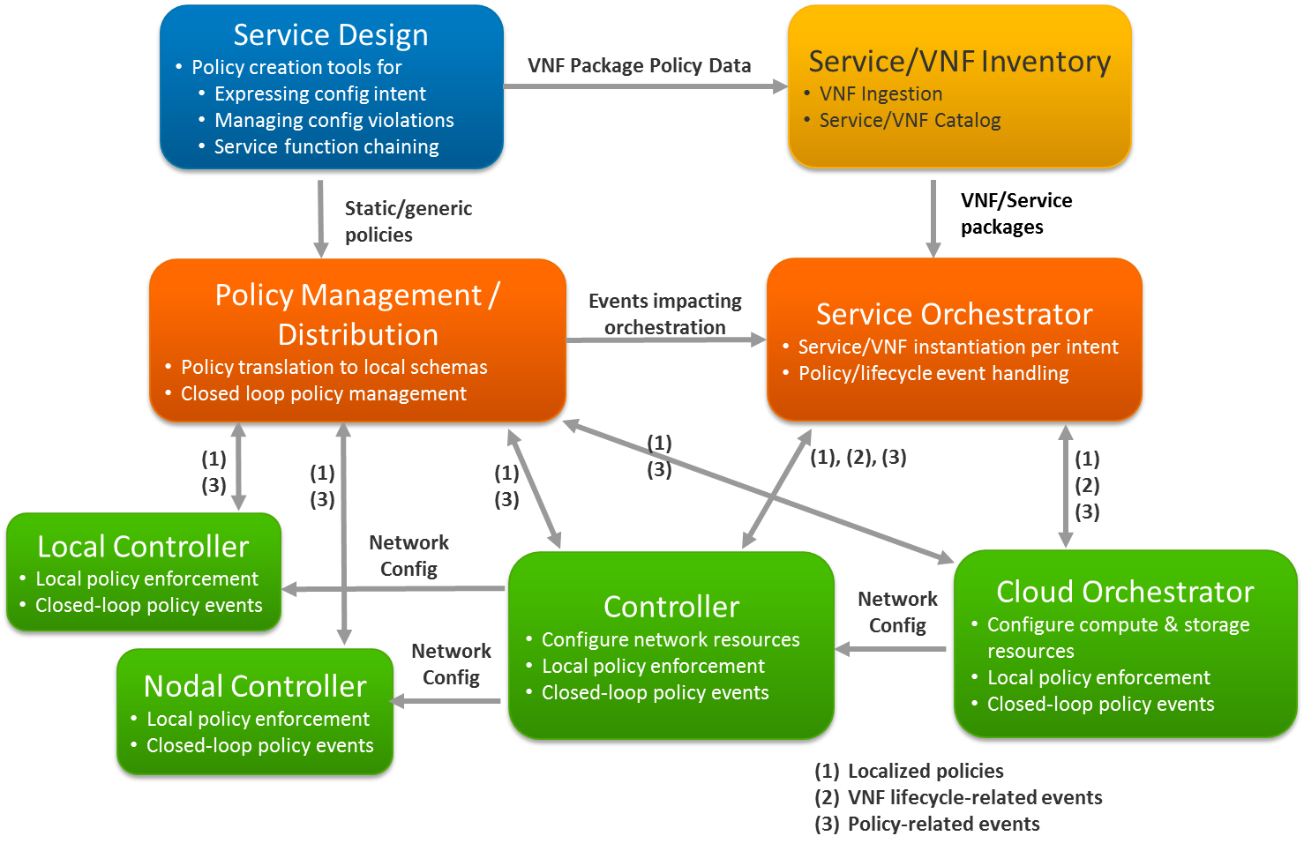

Slide 11
Come join us!
If you are interested in open source solutions for NFVI policy management…
If you want to help set goals for these projects, whatever your role…
If you are involved in a related project and want to promote synergy with it…
If you just want to learn more and get actively engaged in whatever way…
https://wiki.opnfv.org/

