Slide 1
2015 OPNFV Summit Awards
November 12, 2015

Slide 2
Director’s Awards
Open Source Coach & Cheerleader
Dave Neary, Red Hat

Slide 3
Director’s Awards
“We’re just a bunch of cry babies”
Frank Brockners, Cisco

Slide 4
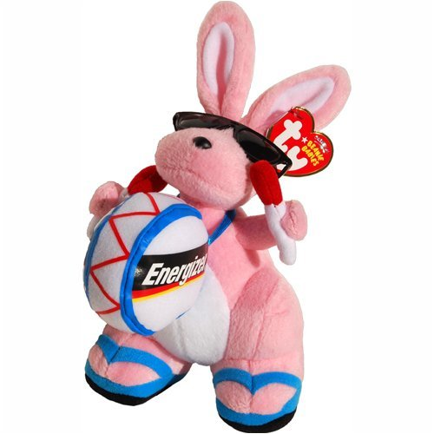
Director’s Awards
Community Energizer Bunny
Iben Rodriquez, Spirent

Slide 5
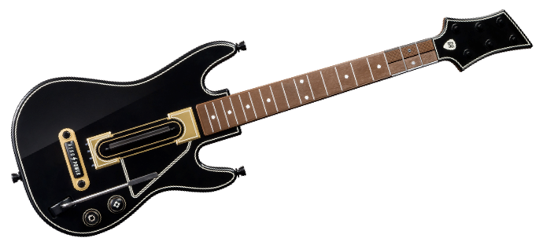
Director’s Awards
Rock’n Tester
Jose Lausch, Ericsson

Slide 6
Director’s Awards
Star Coder
Guoku Bai, Huawei

Slide 7
Director’s Awards
The Integrator
Jun (Matthew) Li, Huawei

Slide 8
Director’s Awards
Indispensible Tester
Mei Mei, Huawei

Slide 9
Director’s Awards
Trailblazing Doctor
Ryota Mibu, NEC

Slide 10
Director’s Awards
Labs Builder
Trevor Cooper, Intel

Slide 11
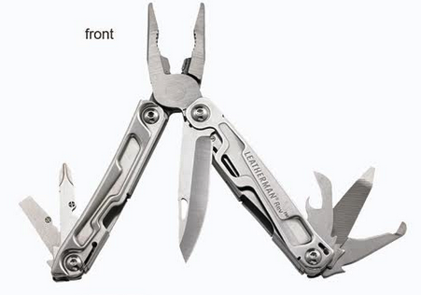
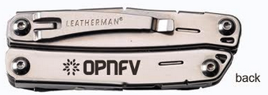
Quarterly Awards

Slide 12
Q3’2015 Award Winners & Nominees
Code Development: Ashlee Young & Jonas Bjurel (A Tie) Other nominees: Daniel Farrell, Guoku Bai, Peter Lee, Szilárd Cserey
^{Collaboration: Bin Hu} Other nominees: Dan Smith, Fatih Degirmenci, Frank Brockners, Ildiko Vancsa, Lingli Deng, Mark Beriel, Ryota Mibu, Tim Rozet
^{Documentation: Gerald Kunzman} ^{Other nominee: Bin Hu}
Integration: Fatih Degirmenci (Repeat Winner) Other nominees: Matthew Li, Tim Rozet, Shuai Chen
Testing: Morgan Richomme (Repeat Winner) Other nominees: Ana Cunha, Hongbo Tian, Jose Lausuch, Maryam Tahhan, Mei Mei, ^{Trevor Cooper, Qi Liang}

Slide 13
2015 OPNFV Annual Awards Nominees
^{Bin Hu (AT&T)}
^{Dave Neary (Red Hat)}
^{Fatih Degirmenci (Ericsson)}
^{Frank Brockners (Cisco)}
^{Iben Rodriquez (Spirent)}
^{Jose Lausuch (Ericsson)}
^{Peter Lee (ClearPath Networks)}
^{Ryota Mibu(NEC)}
^{Tim Rozet (Red Hat)}
^{Tommy Lindgren (Ericsson)}
^{Ulrich Kleber (Huawei)}

Slide 14
2015 OPNFV Annual Awards Runner-Ups
Annual Award plaque + $500 Amazon Gift Certificate
Fatih Degirmenci (Ericsson) Tim Rozet (Red Hat)

Slide 15
2015 OPNFV Annual Awards Winner
Annual Award plaque + $1000 Amazon Gift Certificate
Bin Hu (AT&T)

