Slide 1
OPNFV TOOLS
WORK IN PROGRESS!!!

Slide 2
Agenda
Setting the Context
What do we expect from you
Part I – OPNFV Tools at a Glance
Part II - OPNFV Developer Workflow Quick Look
Part III - Hands on

Slide 3
Setting the Context
This presentation is about
Which OPNFV tools we have
Frequently used terms
Typical OPNFV developer workflow
How the tools fit in our workflow
This presentation will not talk about
Technical details of the tools
Relations with/workflow towards upstream projects

Slide 4
What do we expect
Ask questions...
even though we can't guarantee we answer for all of them on the spot – we guarantee to come back with answers though!
Give feedback...
so we can define/adjust the WOW which suits us as community and enables the smooth flow rather than becoming a blocker!
Don't just watch it like a demo...
instead, follow the steps and try them on your computer while we are doing hands on.

Slide 5
OPNFV Tools at a Glance
Jira
Git
Gerrit
Jenkins
Artifact Repository
Wiki/Etherpad/Mailing List

Slide 6
Issue tracking tool
proprietary
provided by Atlassian
has a simple UI and relatively simple usage comparing with other similar tools
Typical workflow
Create issue
Link with other issues if/as relevant
Assign
Work
Resolve
Close
Further reading/references
https://confluence.atlassian.com/display/JIRA/JIRA+Documentation

Slide 7
Issue Types – other types exist!
Epic
Story
Subtask
Bug
Issue Linking – other relations exist!
Blocks/Blocked by
Depends/Depended on by
Relates to
Labeling
Attach labels for marking issues for milestones

Slide 8
Distributed version control system
open source.
created by Linus Torvalds.
easy to learn and fast.
Typical workflow
Clone the repo
Do your work
Pull/fetch & rebase/merge
Add & commit
Amend
Push
Further reading/references
http://git-scm.com/book/en/v2

Slide 9
Getting ready to work
clone a repository from remote
everyone keeps full history of repo -> possible to work offline.
What is ”remote”
git doesn’t have central server like subversion
aliases for all the repository that are remote to you
What is ”clone”
copy of remote repository
How to see what remotes you have
git remote –v
What is ”origin”
alias for original repository where you got your clone – set by git

Slide 10
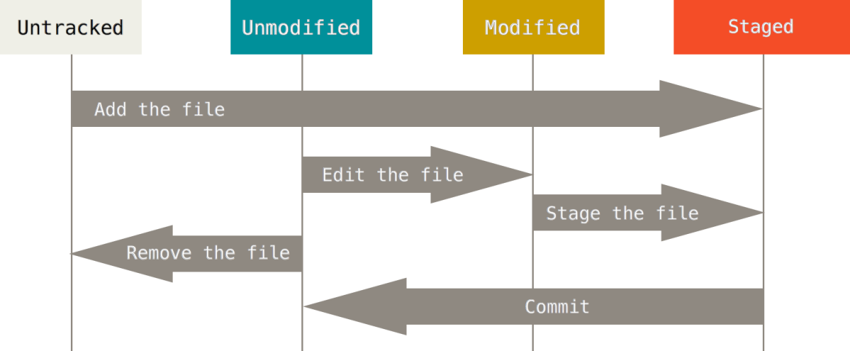
Start working
changing the state of files
modify existing files
add new files
remove existing files
File states in git repository
tracked: files that were in last snapshot – git tracks changes on them
untracked: everything else – git doesn’t track them until you want otherwise

Slide 11
When you are done with your work
Look what changes you have done
Stage your changes
How to see what changes I made
git status
What is ”staging”
prepare the conditions for committing your changes.
git add <path to file>
git add –A = git add . && git add –u
git add –A -> stage all
git add . -> stage new and modified but not deleted
git add –u -> stage modified and deleted

Slide 12
Commit your changes
git commit
So you think you are good to go, but wait, there is this whitespace here
Amend your commit then
git commit --amend
Make sure to pull latest changes from remote and rebase your changes on top of it
git pull --rebase
Share your work with others by pushing to origin
git push

Slide 13
Other frequently used commands/terms
fetch
merge
log
stash
branch
tag
...
Get help
git <command> --help

Slide 14
Code review tool.
open source
created by Google
fork of Rietveld
Typical workflow
If you are the committer
Push your changes to Gerrit
Add reviewers
Wait for reviews
If you are a reviewer
Do the review
Provide feedback and vote
Further reading/references
https://gerrit-documentation.storage.googleapis.com/Documentation/2.11/index.html

Slide 15
Change
Pushing a commit with a new Change-Id
Changes could contain multiple patchsets
Patchset
Modify an existing change without pushing a new change
How Gerrit knows different patchsets are related
Change-Id
Do not add Change-Id or modify existing one manually!
Reviewing, commenting, voting
-2, -1, +1, +2, verified
-2 is blocker and sticky until the reviewer changes it
+2 means change could be submitted

Slide 16
Continuous Integration Tool
open source
created by Kohsuke Kawaguchi
fork of Hudson
Typical workflow
Create jobs
Enable triggers
Check the console log
Further reading/references
https://wiki.jenkins-ci.org/display/JENKINS/Meet+Jenkins

Slide 17
Jobs/Projects
runnable tasks that are controlled/monitored by Jenkins
Build
result of one run of a project
Build Results
successful, stable, unstable, broken/failed, completed
Slave
computers to build projects on
Trigger
when a job should be triggered

Slide 18
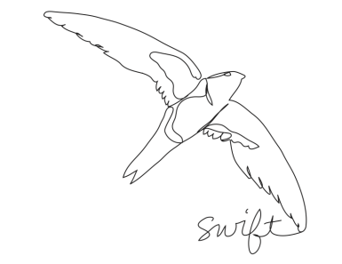
Object/blob storage
open source
provided by OpenStack
used as artifact repository
Typical workflow
Upload artifacts
Download artifacts
Further reading/references
http://docs.openstack.org/developer/swift/

Slide 19
Wiki/Etherpad/Mailing List
PLEASE UPDATE AS YOU SEE FIT

Slide 20
Questions &
Short Break

Slide 21
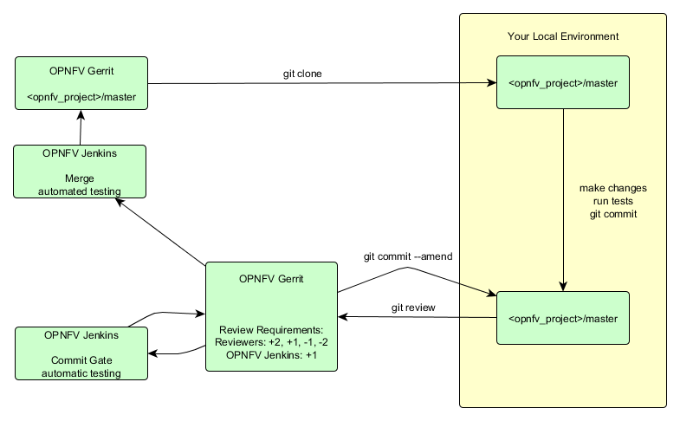
OPNFV Developer Workflow
Highly influenced by/stolen from OpenStack and modified for OPNFV.

Slide 22
Hands on Session

Slide 23
Thank you!

