Slide 1
Contrail Virtual Networking
Quick Tutorial
OpenContrail
quick Tutorial
Notes:
We live in a connected world and the foundation for these connections is the network.
Broadband Internet traffic is doubling each and every year (according to IDC) [or] Internet traffic worldwide will grow three-fold by the year 2017. (Internet Trends, Mary Meeker (KCPB)
Today we have 2.5 billion Internet users in the world – roughly one-third of the Earth’s population. In the next decade, the number of Internet users will double to 5 billion (Mary Meeker, KPCB)
That means that two-thirds of the world will be connected by 2023.
When you add in the big trends of cloud, mobility, video and security, the combined rate of acceleration is placing unprecedented demands on the network.
[Optional stats/factoids]
100 hours of video uploaded every single minute to YouTube (YouTube)
Mobile video traffic exceeded 50 percent for the first time in 2012. (Cisco VNI)
Mobile network connection speeds more than doubled in 2012. (Cisco VNI)
In 2012, a fourth-generation (4G) connection generated 19 times more traffic on average than a non-4G connection. Although 4G connections represent only 0.9 percent of mobile connections today, they already account for 14 percent of mobile data traffic. (Cisco VNI)
[NOTE: Consider finding alternate source for above stats to avoid siting Cisco]
As you just described (refer to pain points from previous slide), you are living in this world and feeling the pressure every day.
Pradeep Sindhu founded Juniper 17 years ago on the belief that we should solve technology problems that matter most to our customers and that make a difference in the world. He recognized the importance of the network and the impact it would have on our world.
Our mission is simple, but powerful; to connect everything and empower everyone.
In today’s connected world, this mission is more relevant than ever.
Here at Juniper we are focused on helping alleviate those pain points through our portfolio of high performance networking products.
[T] And we do this by listening to our customers and helping them address their challenges and capitalize on their opportunities.

Slide 2


Network/Cloud Technology interchange
Cloud Benefits
Software-defined networking
Network scale
Security
Resilience
Networking
Network Technology
Overlay networking (MPLS/VXLAN)
Control plane (BGP)
Network load balancing (ECMP)
Technology interchange benefits cloud and networks
Cloud Technology
Common x86 platform
Shared service infrastructure
Service automation
Cloud
Network Benefits
Service agility
Self-service
On-demand
Elastic scaling

Slide 3
Contrail Virtual Networking
Quick Tutorial
How Contrail Works
Notes:
We live in a connected world and the foundation for these connections is the network.
Broadband Internet traffic is doubling each and every year (according to IDC) [or] Internet traffic worldwide will grow three-fold by the year 2017. (Internet Trends, Mary Meeker (KCPB)
Today we have 2.5 billion Internet users in the world – roughly one-third of the Earth’s population. In the next decade, the number of Internet users will double to 5 billion (Mary Meeker, KPCB)
That means that two-thirds of the world will be connected by 2023.
When you add in the big trends of cloud, mobility, video and security, the combined rate of acceleration is placing unprecedented demands on the network.
[Optional stats/factoids]
100 hours of video uploaded every single minute to YouTube (YouTube)
Mobile video traffic exceeded 50 percent for the first time in 2012. (Cisco VNI)
Mobile network connection speeds more than doubled in 2012. (Cisco VNI)
In 2012, a fourth-generation (4G) connection generated 19 times more traffic on average than a non-4G connection. Although 4G connections represent only 0.9 percent of mobile connections today, they already account for 14 percent of mobile data traffic. (Cisco VNI)
[NOTE: Consider finding alternate source for above stats to avoid siting Cisco]
As you just described (refer to pain points from previous slide), you are living in this world and feeling the pressure every day.
Pradeep Sindhu founded Juniper 17 years ago on the belief that we should solve technology problems that matter most to our customers and that make a difference in the world. He recognized the importance of the network and the impact it would have on our world.
Our mission is simple, but powerful; to connect everything and empower everyone.
In today’s connected world, this mission is more relevant than ever.
Here at Juniper we are focused on helping alleviate those pain points through our portfolio of high performance networking products.
[T] And we do this by listening to our customers and helping them address their challenges and capitalize on their opportunities.

Slide 4







contrail - based on mpls VPN technology
L3 VPNs for Inter-Site Connectivity
Traffic segmentation in the WAN
MPLS over MPLS label encapsulation tunnels
BGP route signaling
Contrail Virtual Networks in Datacenters
Traffic segmentation in the LAN
MPLS over GRE or VXLAN label encapsulation tunnels
XMPP (with BGP payload) route signaling
OpenStack Cloud Manager
Route
Reflector
Contrail
Controller
BGP
XMPP (BGP)
Customer Site
CE Router
PE Router
Customer VRF
Encapsulation Tunnel
Protocols,
Architecture
VM
Hypervisor with vRouter
Server
Tenant VRF
Encapsulation Tunnel
Provider Network
Datacenter

Slide 5
OpenStack
Network Management System (NMS)
DMI
Config
Node
Analytics
Node
Route
Reflector
IBGP
Route
Reflector
Control
Node
IBGP
Control
Node
IBGP
SDN System
XMPP
PE
P
P
PE
CE
MPLS over MPLS
CE
Underlay
Switch
Underlay
Switch
MPLS L3VPN / E-VPN
VM
vRouter
BGP
vRouter
VM
Contrail
MPLS over GRE or VXLAN
Gateway

Slide 6

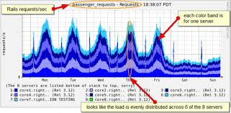


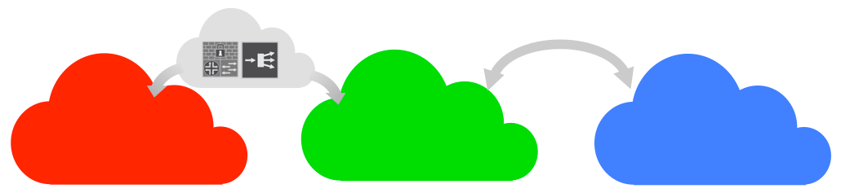



Contrail Abstraction Architecture
Analytics
Distributed collection
Global view
Consolidation
Aggregation
Orchestration, Automation
Open source and partner ecosystem of orchestrators
API and SDK for integration with OSS / BSS
OSS
Policies and requests
State and status
Control Plane - Physical, Virtual
Open, standards-based, federated controller
Scalable and resilient
Configuration model
Automation
Control Plane
Control Plane
Control Plane
Virtual Network Overlay
Overlay encapsulation implemented in hypervisor
Multi-tenancy for private and virtual public clouds
Gateway functions - connect to virtual to physical network
Service chaining (physical and virtual)
Physical Network
Interoperability with traditional network devices
Any-to-any non-blocking low-latency fabric: Q-Fabric or Clos

Slide 7


Contrail Components
Accepts and converts orchestrator requests for VM creation, translates requests, and assigns network
OPENCONTRAIL CONTROLLER
Configuration
Control
Collector
Real-time analytics engine collects, stores and analyzes network elements
Interacts with network elements for VM network provisioning and ensures uptime
VM
VM
VM
VM
VM
VM
VM
VM
vRouter
vRouter
Physical Host
with Hypervisor
Physical Host
with Hypervisor
Physical Network
(no changes)
vRouter: Virtualized routing element handles localized control plane and forwarding plane work on the compute node
Gateway
Gateway: MX Series (or other router) or EX9200 serve as gateway eliminating need for SW gateway & improving scale & performance
WAN, Internet

Slide 8

Scale Out, Highly Available Architecture
REST
HTTP
REST
Logically Centralized
(Physically Distributed)
Horizontally Scalable
Highly Available
(Active-Active)
Federated
Web UI
Nodes
Configuration
Nodes
Analytics
Nodes
IF-MAP
BGP
Database
Nodes
BGP
Control
Nodes
XMPP
BGP, Netconf
vRouters
Gateways
https://github.com/Juniper/contrail-controller/wiki/Roles-Daemons-Ports

Slide 9

Compute Node – Hypervisor/Container with vRouter
CONTRAIL CONTROLLER
JUNOSV CONTRAIL CONTROLLER
vRouter is replaces the Linux Bridge or OVS module in Hypervisor Kernel
vRouter performs bridging (E-VPN) and routing (L3VPN)
vRouter performs networking services like Security Policies, NAT, Multicast, Mirroring, and Load Balancing
No need for Service Nodes or L2/L3 Gateways for Routing, Broadcast/Multicast, NAT
Routes are automatically leaked into the VRF based on Policies
Support for Multiple Interfaces on the Virtual Machines
Support for Multiple Interfaces from Compute Node to the Switching Fabric
Compute Node
Virtual
Machine
(Tenant A)
Virtual
Machine
(Tenant B)
Virtual
Machine
(Tenant B)
vRouter Agent
Config
Tap Interfaces (vif)
VRFs
Policy Table
vRouter Forwarding Plane
Routing
Instance
(Network X)
Routing
Instance
(Network Y)
Routing
Instance
(Network Z)
pkt0
FIB
FIB
FIB
Flow Table
Flow Table
Flow Table
User
Kernel
Eth1
EthN
Eth0
Overlay tunnels
MPLS over GRE or VXLAN
XMPP
Top of Rack Switch
XMPP

Slide 10
Contrail – control node
Configuration Node
Configuration Node
Control Plane Nodes federate using BGP
Each vRouter uses XMPP to connect with multiple Control Plane nodes for redundancy
All Control Plane Nodes are active active
Each Control Plane Node connects to multiple configuration nodes for redundancy
BGP is used to connect with Physical Gateway Routers or Services Nodes
IF-MAP
Control Node Peers
Control Node
"BGP module"
IF-MAP Client
IBGP
Proxies
(ARP, DHCP, ..)
XMPP
XMPP
BGP
Compute Node
Compute Node
Service Node
Gateway Routers
Notes:
Each vrouter agent connects to at least two control nodes. Both control nodes are active. The vrouter receives all state (routes, routing instance configuration, etc.) from both control nodes. The vrouter agent receives and stores both copies of the control state, one copy from each controller. The state received from the two controllers is guaranteed to be eventually consistent but may be transiently inconsistent. It makes a local decision about which copy of the control state to use. This is similar to how a BGP PE router receives multiple copies of the same route (one from each IBGP neighbor) and makes a local best route selection.
If a controller fails, the vrouter agent will notice that the connection to that controller is lost. The vrouter agent will flush all state from the failed controller. It already has a redundant copy of all the state from the other controller. The vrouter can locally and immediately switch over without any need for resynchronization. The vrouter agent will contact the service discovery server again to re-establish a connection with a new controller node to replace the failed controller node.

Slide 11
configuration node
Orchestrator
(OpenStack)
API Server provides Northbound REST Interface – Orchestration System provisions using this API service
DHT/NoSQL Database is used for Persistence and High Availability of Configuration
Schema Transformer “compiles” the high level data model to low level model for vRouter, Service Nodes, and Gateway Routers
IF-MAP is used to represent the data-model – Control Nodes subscribe to the subset of configuration
REST
Configuration Node
REST API Server
DHT DB
Message Bus
Schema Transformer
IF-MAP
server
Distributed Synchronization
IF-MAP
Control
Node
Control
Node

Slide 12
Interaction with OpenStack
OpenStack
Horizon
Scripts
1
Create an Instance (Image, Network, …)
5
Create VM
Interface
Configuration Node
6
Publish VM
i/f on IF-MAP
Nova API
Neutron Driver
3
VM Network Properties
Neutron Plugin
Control
Node
Nova Scheduler
7
VM Interface config over XMPP
Compute Node
Nova Compute
Virtual Router
Compute Driver
Contrail Agent
2
Schedule an Instance on the Compute Node
Virtual-IF
Driver
4
Add Port
vRouter (kernel)

Slide 13
Compute Node – DNS Resolution
Compute Node
Compute Node
Virtual
Machine
(IP-VM1)
Virtual
Machine
(IP-VM2)
Tap Interfaces (vif)
Tap Interfaces (vif)
vRouter Forwarder
vRouter Forwarder
Routing
Instance
VIRTUAL
Routing
Instance
PHYSICAL
OpenStack
FIB
FIB
OpenContrail
Flow Table
Flow Table
DNS – IP for VM2
Eth1 (IP-H1)
Eth1 (IP-H2)
Overlay tunnels
MPLS over GRE or VXLAN

Slide 14
Compute Node – proxy ARP
Compute Node
Compute Node
Virtual
Machine
(IP-VM1)
Virtual
Machine
(IP-VM2)
Tap Interfaces (vif)
Tap Interfaces (vif)
ARP [Who is IP-VM2]
vRouter Forwarder
vRouter Forwarder
Routing
Instance
VIRTUAL
Routing
Instance
PHYSICAL
FIB
FIB
Flow Table
Flow Table
Eth1 (IP-H1)
Eth1 (IP-H2)
Overlay tunnels
MPLS over GRE or VXLAN

Slide 15
Compute Node – Forwarding/Tunneling
Compute Node
Compute Node
Virtual
Machine
(IP-VM1)
Virtual
Machine
(IP-VM2)
Payload
IP-VM2
Tap Interfaces (vif)
Tap Interfaces (vif)
vRouter Forwarder
Payload
IP-VM2
vRouter Forwarder
VIRTUAL
Routing
Instance
Routing
Instance
Payload
IP-H2
PHYSICAL
FIB
FIB
Virtual-IP2
Flow Table
MPLS / VNI
Flow Table
MPLS / VNI
IP-VM2
IP-H2
Payload
Eth1 (IP-H1)
Eth1 (IP-H2)
Overlay tunnels
MPLS over GRE or VXLAN

Slide 16




FEATURE: DISTRIBUTED SECURITY POLICY
Contrail Security Policy
(Firewall-like e.g. allow only HTTP traffic)
Contrail Policy with a Firewall Service
VIRTUAL NETWORK GREEN
VIRTUAL NETWORK BLUE
VIRTUAL NETWORK YELLOW
LOGICAL
(Centralized Policy Defn)
G1
G2
G3
Non-HTTP traffic
B1
B2
B3
Y1
Y2
Y3
Intra-network traffic
Inter-network traffic traversing a service
VM and virtualized Network function pool
G1
B3
G2
PHYSICAL
(Distrib. Policy Enforcement)
Y1
G3
B1
IP fabric
(switch underlay)
B2
Y3
Y2
Host + Hypervisor
Host + Hypervisor
…
…
Notes:
The idea is that there is a logical or Policy definition layer and a separate physical or policy enforcement layer, and things look and feel different in these two layers. In the policy defnition layer, operator can specify policies like create 3 virtual networks Green, Blue and Yellow, such that any traffic from Blue virtual network to yellow virtual network will have to go through a scale-out Firewall service, and only allow port 80 traffic from green to Blue virtual network.

Slide 17
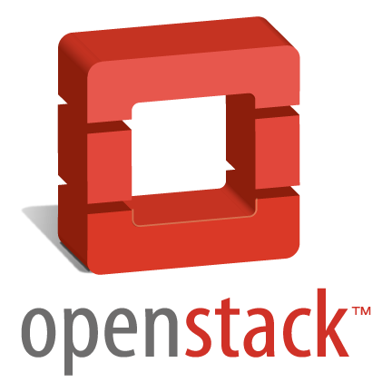
FEDERATED DOMAINS
UNIFIED CONTROL PLANE ACROSS PHYSICAL/VIRTUAL NETWORKS
Cloud Management
Orchestration, OSS/BSS
OpenContrail
WAN Control/Mgmt
NMS
Config Node
Route Reflector
BGP
Route Reflector
BGP
Control Node
BGP
Control Node
…
…
BGP
XMPP
x86 Host + Hypervisor
x86 Host + Hypervisor
PE
PE
PE
vRouter
Underlay Switches
vRouter
Public Network
MPLSoGRE, MPLSoUDP, VXLAN
IP / MPLS VPN
CLOUD DC

Slide 18


FEATURE: SERVICE CHAINING
SVC 1 VM
SVC 2 VM
Seamless insertion of Juniper & unmodified 3rd Party services using existing L3VPN connections
Allows multiple Services in a chain
Allows multiple service chains between virtual networks
Supports L3 services without the use of a gateway
Virtual Network
Red
Virtual Network
Green
LOGICAL
L3
L4
L5
L6
R1
R2
G1
G2
L1
L2
L7
L8
Locally significant MPLS Labels
X86 Servers
RI for non-svc-chain traffic
SVC 1 VM
Routing Instances
SVC 2 VM
R1
R2
G1
G2
Interf = VIF 1
Label = L1
VIF 2
L2
L3
L4
L5
L6
Interface = VIF 3 Label = L7
VIF 4
L8
PHYSICAL
Srvr IP = S1
Server IP = S2
Srvr IP = S3
Srvr IP = S4
Dst | Next Hop
G1 | S2 → L3
G2 | S2 → L3
R1 | VIF 1
R2 | VIF 2
Dst | Next Hop
R1 | S1 → L1
R2 | S1 → L2
Dst | Next Hop
G1 | S3 → L5
G2 | S3 → L5
Dst | Next Hop
R1 | S2 → L4
R2 | S2 → L4
Dst | Next Hop
G1 | S4 → L7
G2 | S4 → L8
Dst | Next Hop
R1 | S3 → L6
R2 | S3 → L6
G1 | VIF 3
G2 | VIF 4
IP Fabric
For more details, see - https://datatracker.ietf.org/doc/draft-fm-bess-service-chaining/

Slide 19





Service Virtualization and Chaining
NFV: Virtual Network Functions
Best in breed, from multiple vendors, including Juniper (e.g. vSRX)
SDN: Service Chaining
OpenContrail: Dynamically program network to create service chains
Chain of virtual services – independent scaling
Chain of virtual services
DPI
DPI
DPI
DPI
DPI
DPI
DPI
Anchor Router (Classifier)
DPI
Firewall
Cache
IDP
NAT
Decide which traffic goes into chain
Load balance between service layers
Stateful services require consistent forward/reverse paths
https://datatracker.ietf.org/doc/draft-fm-bess-service-chaining/

Slide 20
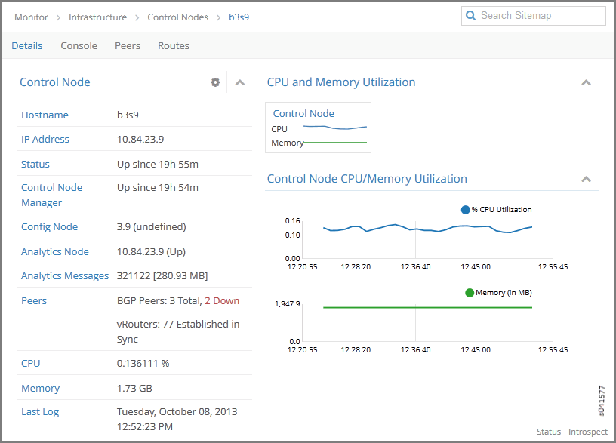
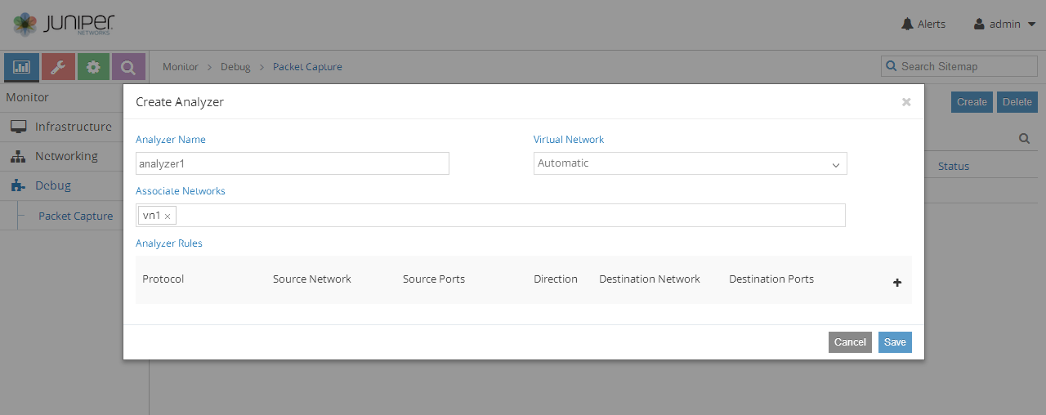
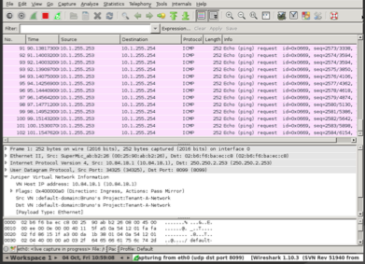
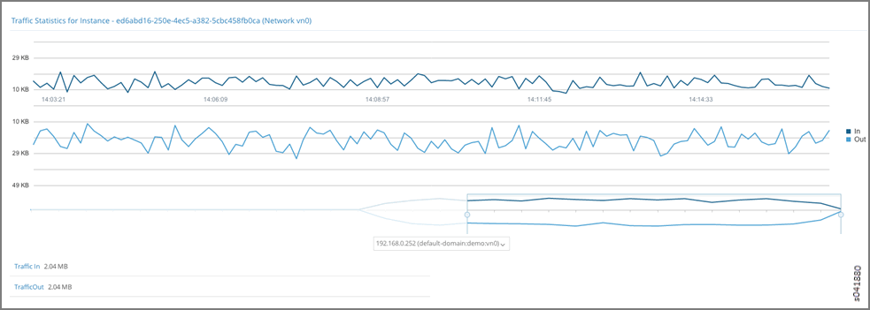
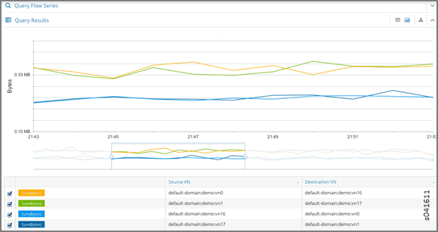
FEATURE: ANALYTICS
Notes:
Monitor Control Nodes
Monitor traffic stats per instance
Attach PCAP across VN’s – drill further in Wireshark
Execute SQL-like query for individual flows

Slide 21
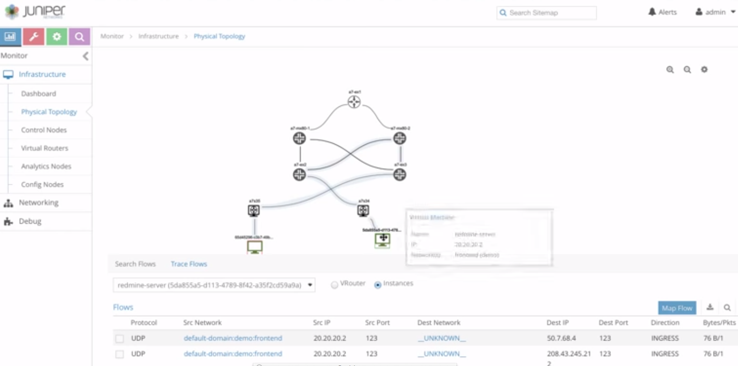
FEATURE: UNDERLAY-OVERLAY CORRELATION
Visual representation of topology (discovered using LLDP)
What underlay path are taken by flows (active or historical)
Delails of VMs, vRouters, and underlay components
Details of active flows
Ability to show historical flows as well

Slide 22




CONTRAIL - KEY FEATURES
Security Policy Enf., Distributed FW
Routing & Switching
(IPv4, v6)
IPAM, DNS, DHCP
SNAT, FIP, QoS
Load Balancing
3rd Party Netw. Svc.
Gateway Services (L2, L3 GW)
Rich Analytics, Overlay-Underlay Correlation
Service Chaining
High Availability
API Services

Slide 23
OpenContrail in OPNFV
OpenContrail is upstream to OPNFV
Working with installers for B release
  Fuel
  JOID
  Apex
  Compass4nfv
OpenContrail Sandbox on opencontrail.org
6 server POD almost ready for CI/test in NJ OpenLab

Slide 24


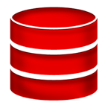





OPENContrail OPENSOURCE APPROACH
(For more info visit www.opencontrail.org)
OpenContrail Advisory Board (OCAB)
Industry veterans and key project users/adopters
Governance, Evangelism, Roadmap, Operational efficiency
x
x
Customers
Open Source (Users, Devs)
OpenContrail Developer Community
Majority Juniper, Some External developers
Proposing features & Contribute Code
Participate in Code review process
Bugs,
Design Blueprints
Launchpad
Features & Bug fixes
Continuous Integration/Development
Single Github Source Code Repository
Community Release
Community Support
(Email, IRC, Forums)
OpenContrail Community Release
Juniper Contrail Releases
Hardened for Production
Licensed Software
24x7 JTAC & Engineering
Bug Fix Release
Notes:
Contrail as I mentioned is open sourced under Apache v2 license … There is a single source code repo on github with open bug database on Launchpad …
There are community releases – but Juniper monetizes through support …
Overseeing all of
More info @ opencontrail.org

Slide 25
VNF Validation program for OpenContrail
Launching in response to customer and VNF vendor interest
Certification Tier | Basics | Functional Validation | Performance Benchmarks | Customizing and API Integration
Silver | ✓
Gold | ✓ | ✓
Platinum | ✓ | ✓ | ✓ | ✓

Slide 26
CONTRAIL DEMO VIDEOS
PRODUCT CAPABILTIIES - DEMO VIDEOS
Bare Metal Integration through multi-vendor TOR integration → https://www.youtube.com/watch?v=PjkNt0yV3H0
IPv6 DVR (Distributed Virtual Router) → https://www.youtube.com/watch?v=RLO0uIXbDxo
OpenStack Neutron at Scale → https://www.youtube.com/watch?v=xN0rXHD_dqk
P + V Service Chaining → https://www.youtube.com/watch?v=a9HqC9x6KTg
Multi-hypervisor, Docker Integration → https://www.youtube.com/watch?v=x2n5Q_ycx6o
vRouter DPDK Demo → https://www.youtube.com/watch?v=ZGiQJrKoDQM
Physical + Overlay Correlation → https://www.youtube.com/watch?v=B8aHoY—1Zs
USE CASE - DEMO VIDEOS
DDoS Protection (Contrail + DDoS Secure) → http://www.youtube.com/watch?v=TnvCea4fil4
NFV through Contrail (this is the Internet / Firewall NFV aka. vCPE) → http://www.youtube.com/watch?v=_64no8P2vUw
Contrail - Elastic cloud - IT as a Service → http://www.youtube.com/watch?v=9g3EWV8X64s
SSLVPN on Contrail → http://www.youtube.com/watch?v=vfZfdH4kkV4
Caching as a Service (Junos Content Encore on Contrail → https://www.youtube.com/watch?v=-_NtC34wcRw
Hybrid Cloud → https://www.youtube.com/watch?v=uC7nMW5PXdg
Demo – Today. 1:25

Slide 27
Thank You

