Slide 1
Promise overview
Key requirement
Guarantee that at start time of a reservation, all reserved resources of that reservation are ready to be used/allocated
As-Is: Without reservation, when trying to allocate resources required for a (complex/composed) network service (NS), it may happen that during the individual allocation requests (for compute/storage/network) an error occurs, as not sufficient resources with the requested characteristics are available, and the overall instanstiation of the service may fail.
Use cases / scenarios (see also ETSI NFV IFA010)
Scheduled event: e.g. rock concert or football match with expected peak traffic
Detailed capabilities: VIM holds detailed information about managed NFVI resources and their availability, whereas the NFVO only holds abstracted information.
5G services: many virtualized service that have to share limited resources
Disaster: valuable limited time after e.g. tsunami warning
Multi-tenant deployment: avoid resource management race conditions
Notes:
IFA010:
A.2.2.1 Use case for securing resources for several tenants
NFV and the management and orchestration framework enable tenants to request and make use of virtualised resources provided by the platform. VIM manages the NFVI and offers to consumers (tenants) operations for managing virtualised resources. In NFV deployments, several tenants can coexist, and in this scenario resource management race conditions can happen, ending in resource service denegation. In carrier telco environments, with stringent SLAs, reliability and performance requirements, resource service denegation can become an issue.
The NFVO plays a key role in the NFV-MANO, as central point for orchestrating the resource consumption by VNFs and Network Services and granting the lifecycle operations. The NFVO cannot guarantee resource availability during the granting of a VNF lifecycle request if the resources needed to accommodate such lifecycle operation have not been secured (i.e., reserved) by the VIM, entity responsible for the NFVI resources management.
A.2.2.2 Use case for securing resources with detailed capabilities
The VIM, as end point for managing and controlling the NFVI resource holds more detailed information about the managed resources and their availability. At the NFVO, visibility of specific resources is not the same as the VIM. The NFVO holds information about the availability, reserved and allocated NFVI resources as abstracted by the VIM.
Examples of more detailed information are specific acceleration capabilities, CPU-pinning, etc. This information is visible at the VIM level in order to execute the right allocation of virtualised resources according to the resource capability requirements. If such capabilities are needed, and the NFVO has no visibility on the particular resources accommodating such capabilities, granting the VNF lifecycle operations can lead to undesired resource service denegation, in particular those that follow with subsequent virtualised resource management requests for detailed capabilities.
A.2.2.3 Use case for securing resources during Network Service instantiation
A Network Service (NS) can be composed of a number of VNFs, virtual links to interconnect them, etc. In order to realize a NS, it is possible that a great quantity of NFVI resources will be needed. Thus, the instantiation of an NS will be possible as long as all the resources can be secured to be available at the time of the instantiation of the NS.
The instantiation of an NS can involve several transactions, with possibly a number of different VIMs managing the required NFVI resources, and VNFMs managing the lifecycle of the VNFs to instantiate. During the instantiation process, if resources cannot be secured to be available by the VIM(s) for the Network Service, the overall instantiation can fail. This can lead to inefficient processing and arrangement of Network Services instantiation.
A.2.2.4 Use case for securing resources during Network Service scaling
A Network Service can be composed of a number of VNFs, virtual links to interconnect them, etc. In order to realize an NS, as well as for scaling purposes, it is possible that a great quantity of NFVI resources will be needed. Moreover, under certain scenarios, such as sport events or natural disasters, operators require that Network Services can scale to accommodate the extra traffic to handle. Such NS scaling requires adding extra resources to be used by the VNFs part of the NS, or news ones to be instantiated. By reserving resources in advance against the VIM managing the resources, it is ensured that NS can scale properly.
A.2.2.5 Use case for securing resources related to a scheduled event
Network Services or certain capacity may only be needed for a specified duration. For instance, the duration of a scheduled sport event is usually known in advance, i.e., with an expectation to be ended at some point in time.
To support the event, the operator may need to add extra Network Service capacity or instantiate a new Network Service. In this scenario, the service provider wishes to secure the instantiation of new VNF instances, or the expansion of existing instances for the Network Service by reserving underlying NFVI resources.
The present use case exemplifies the need for the NFVO and VIM to handle reservation time information.
As part of the NS instantiation/expansion, the NFVO requests to the appropriate VIM(s) the reservation of virtualised resources needed by the VNF instances. In addition, the NFVO provides information about the expected timespan where the virtualised resources will be used, i.e., it provides start and end time information. The time information may either be the same or have certain deviation from the scheduled event timing to allow for certain backup time. This information about start and end time helps the VIM to determine the best scheduling of resources and their availability in the NFVI-PoP(s). This is particularly applicable when scheduling resources for multiple future events, i.e. the VIM will know about reservations that have been scheduled but whose reserved resources are not being used yet or reservations that have been scheduled, but whose reserved resources will be freed prior to another reservation.

Slide 2
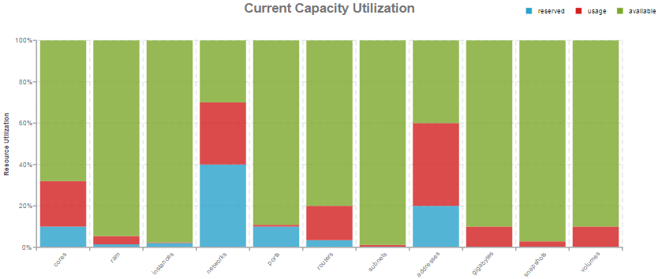
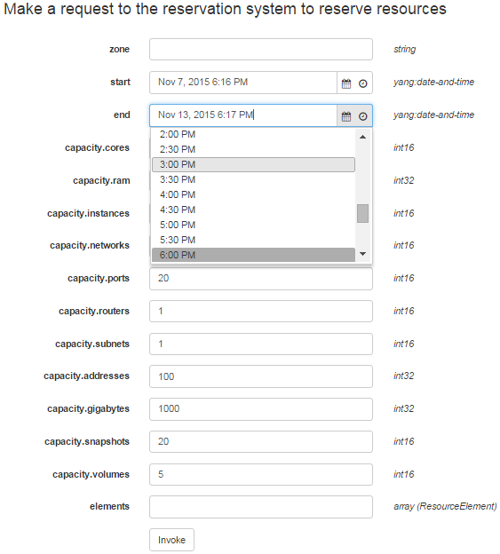
Implementation Overview
Intent-driven N/B Interfaces
create/update/cancel/query reservation
increase/decrease/query capacity
create/destroy instance
Supported Interfaces
CLI, REST/JSON, WEBSOCKET, BROWSER
Model-driven Implementation
YANG (data model schemas)
YAML (control logic definitions)
JSON (configuration data)
JSX* (visualization schemas)

Slide 3
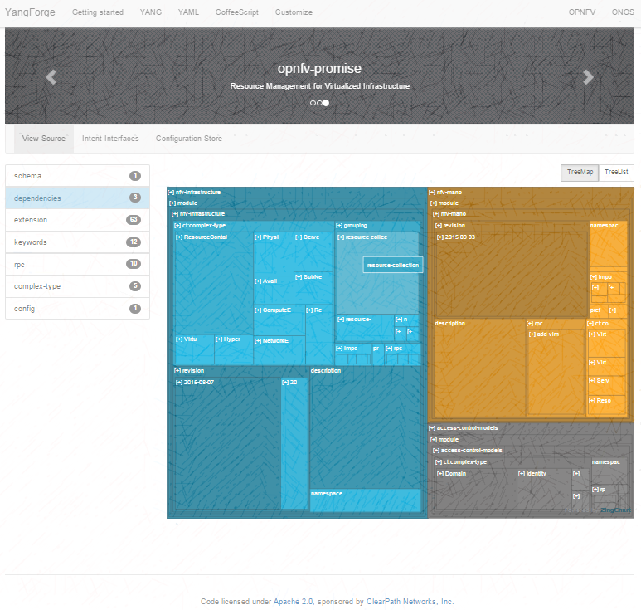
Promise Live Demonstration
Create Reservation
Query Capacity
Create Instance
Visualizations
… and More!
OPNFV Project Theater
Thursday 2:25 - 2:45pm
Promise - Planning the Future
Peter Lee, ClearPath Networks
Gerald Kunzmann, DOCOMO

