Slide 1
QTIP
Version 0.2
^{4th} August 2015

Slide 2
What is QTIP?
A benchmarking suite to test NFVI components that are important for NFV applications
Bottoms up benchmarking
Use available benchmarking suites and integrate them in a framework for automated testing and collection of results
Testing computing, networking and storage performance of NFVI systems

Slide 3
Why test?
CPU and memory performance benchmarks important for switching and routing tasks within NFV applications
Encryption performance dependant on CPU capabilities
While benchmarking computing, tests to evaluate cpu, cache, memory …etc. performance

Slide 4
What to Test?
The configuration of the system being tested would be the variable when doing benchmarks
Benchmarks would help to distinguish between the performance of different computing components within NFVI system through
Example: benchmarking on a baremetal machine vs on a VM vs on a Docker container to evaluate overheads of virtualization
Benchmarking suite to be flexible to allow many different scenarios to be tested
Benchmarks of NFVI configured with a different component combination would help analyze performance of isolated components through comparison.
For example comparing CPU benchmarks across two baremetal servers configured with all the same components except for the CPU would help isolate the performance of the CPU

Slide 5
Sample QTIP benchmark case
Benchmarking integer, floating point, memory and cache bandwidth on bare metal server as well as on a VM
OpenSource benchmarking suites such as unix-byte benchmark and Phornonix benchmark used to run the benchmarks.
User connects to the jump server
On the jump server, QTIP scripts runs benchmarks through ansible
QTIP scripts set up the required environment (e.g Openstack heat to setup VM)
Configures the environment (downloads needed tools) to conduct tests and generate results
Ansible Collects the results on the jump server

Slide 6
Dell OPNFV lab
Bash Scripts+ Ansible to configure the environment
VM
OPNFV Arno (OpenStack)
Jump Server
KVM
QTIP
Server
Server
Server

Slide 7
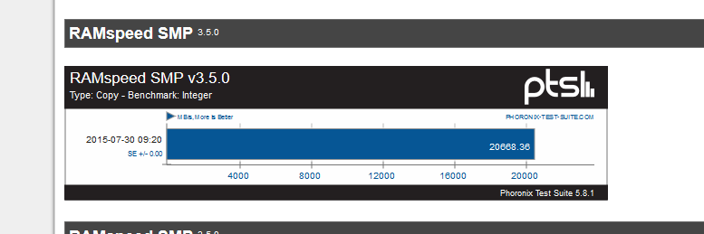
Results
The results show that RAM benchmark performed better for the baremetal server as compared to a VM
Baremetal
VM

Slide 8
Questions and Future work
Which components to test within NFVI?
Which benchmarks to run?
Increase number of benchmarks by including OpenSSL speed (only tests the encryption throughput capacity for an isolated machine)
What network benchmarks to run?
Overlap with Yardstick?
Improving the benchmark automation framework

Slide 9
What components to test within NFVI?
We have identified CPU, cache and memory as important components for NFVI applications that are important to VNF applications such as routers and switches
What other NFVI components are important for VNF applications?

Slide 10
Which benchmarks to run?
We have identified opensource benchmarks such as dhrystone, whetstone for CPU performance benchmarks?
Are there other benchmarks that can be used to test CPU performance within NFVI?
Similarly we have used memory and cache bandwidth benchmarks using RAMspeed and cachebench
Are there other benchmarks that can be used to test memory and cache performance?

Slide 11
What network benchmarks to run?
Network benchmarks related to Interconnected devices are pursued by both Yard Stick and Vswtich perf ( Exclusively to vswitches)
What Network benchmarks can QTIP cover as part of OPNFV, other than throughput, latency and packet loss
L3Forward/ Router benchmarks are not covered by other projects. We can contribute here

Slide 12
Overlap with Yardstick?
Yardstick also aims to test compute, network and performance capabilities of NFV infrastructure
How does QTIP differ?
QTIP aims to use opensource tools to benchmark platforms as compared to stress test Infrastructure, which seems to be the objective of Yardstick

Slide 13
Future Work
Aim to add new benchmarks such as OpenSSL, Dijkstra Algorithm performance to test CPU Computing performance.
These benchmarks are utilized by network functions such as routers and cryptos and would provide good benchmarks for NFVI components
Incorporating network benchmarks
Defining more case scenarios to test.
Identify characteristics of QTIP framework to make it flexible so that it is easier for users to customize test cases using the provided opensource benchmark suites

