Slide 1
Qtip
Revised project scope
July 2015

Slide 2
QTIP overview
QTIP aims to develop a framework for bottoms up testing of NFVI platforms
QTIP aims to test:
Computing Performance of NFVI systems
Networking Performance of NFVI systems
Storage Performance within NFVI systems

Slide 3
QTIP also aims to develop a framework
To automate the execution of benchmark tests
Collect the results of tests in a consistent manner to allow comparative analysis of results

Slide 4
Qtip performance benchmarking reference
Qtip console
vTester 1
VNFC UT 1
VNFC UT N
vTesterN
Remote hosts
virtualization
virtualization
Servers
Networked Storage
Local storage
Performance characterization
Bottom-up – white box
Reuse framework / tools
Configuration automation or glue using Ansible/ssh
Supports hardware + software,
Supports open source + commercial
Network
Tester 1
Tester N

Slide 5
Qtip components
Qtip console: a VM/host that hosts Ansible and Qtip test tools/confs
Baremetal configuration: (pre-installation state)
Bios
Host OS
OPNFV install – BGS/CI
Orchestration: Heat template
Post-Heat-orchestration test configuration & run: Ansible
Post-run data collection and post processing
Post-run cleanup
Rally integration - potential

Slide 6
Test tools (generating & measuring)
Hardware test equipment
Spirent, IXIA
Use existing configuration tools and wrap it in Ansible
Networked, or direct
Software commercial testers
Spirent, IXIA
Use existing configuration tools and wrap it in Ansible
Open source tools
Reuse and package: networking, computing, storage benchmark tools
New: dpdk based generator and capturer
Traffic profiles
See sample profiles from at&t/china mobile/cablelabs

Slide 7
SUTs (representative SUT)
The SUT set is used to represent common components (as in NFVC)
E.g. L2, L3, L4-7/HTTP, SSL, DPI, media encoding/decoding, …
E.g. storage: read/write, iops, file, DB, noSQL, big data
Select open source SUTs

Slide 8
Test Examples

Slide 9
SSL Test
Encryption and decryption involved in SSL connections are CPU intensive processes and could provide an indication of CPU capability.
Measure:
1. The number of RSA signatures a machine can handle
2. Crypto algorithm performance These measurements can evaluate CPU performance

Slide 10
Tool: OpenSSL speed
OpenSSL speed can measure the number of RSA signatures a machine can sign
OpenSSL speed can measure how many bytes per second can be processed by a specified crypto algorithm on a machine

Slide 11
SSL performance Test
Measure 1. Number of RSA signatures that can be performed by a guest machine 2. Crypto algorithm performance of guest machine
Would evaluate performance of Guest Virtual CPU which would test the performance of hypervisor as well as the underlying server CPU
Tool: OpenSSL speed to measure number of RSA handshakes as well as crypto algorithm performance
OpenSSL speed test
System Under Test
virtualization
Server

Slide 12
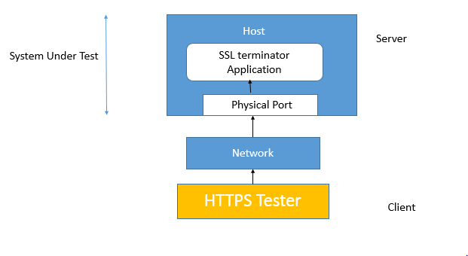
SSL traffic Test: Host Test
An external Tester tool such as Spirent Avalanche can be used to generate HTTPS traffic. The Tester tool can be used to vary a, The number of HTTPS session requests b, The File size of the HTTPS payload
Ngix or Stunnel to run as SSL terminators on host to measure SSL performance
To evaluate RSA handshake performance, reduce payload size to 0
To evaluate Crypto throughput performance, use a large payload file

Slide 13
SSL traffic Test2: Virtual generator and terminator
An Software Tester tool such as Virtual Spirent Avalanche can be used to generate HTTPS traffic. The Tester tool can be used to vary a, The number of HTTPS session requests b, The File size of the HTTPS payload
SSL terminator such as Ngix, Stunnel on another guest
HTTPS Generator (Guest)
SSL Terminator loopback (Guest)
System Under Test
virtualization
virtualization
Server (Host)
Server (Host)
Network

Slide 14
TCP Test case1: Local loopback
TCP local loopback test to evaluate TCP/ IP stack performance
TCP loopback application such as network-loopback-1.0.1 sends and receives TCP packets which are looped by the local loopback port
Application measures the time to transmit a specified Data size
Guest
TCP loopback Test Application
System Under Test
lo
virtualization
Host

Slide 15
TCP loopback Test
A Guest machine generates TCP traffic
An application on the second guest VM loops back received TCP packets and sends it back to the TCP generator
Measures TCP throughput
Tool: Iperf (Iperf cliet, Iperf server), Commercial TCP tools from IXIA/ Spirent
TCP Generator (Guest)
TCP loopback (Guest)
System Under Test
virtualization
virtualization
Server (Host)
Server (Host)
Network

Slide 16
Memory and Computational Tests
To Test Guest and Host Memory performance.
Use tools such as RamSpeed / Stream to run memory tests such as: 1. Memory copy test; Measures memory bandwidth; How many bytes per second can be copied from one memory location to other. No Arithmetic operation involved. 2. Scaling Test; Test involves fetching two values from memory, Does a scaling arithmetic operation on one of the values and writes to the other value. Measures test bandwidth bandwidth(How many bytes per second can undergo this operation). One Arithmetic Operation involved 3. Sum Test; Test involves fetching two values from memory, Does a summation operation on the two values and writes to the other location in memory. Measures test bandwidth(How many bytes per second can undergo this operation). One Arithmetic Operation involved
Tool allows to specify the size of the array to be fetched from the memory and measures test bandwidth

Slide 17
Guest Memory Test
RAMSpeed tool to be run within a Guest machine
Copy, Scale and Sum tests would evaluate Guest memory performance. This performance would depend on Hypervisor and Host Machine Memory.
RAM Speed Test (Guest)
System Under Test
virtualization
Server

Slide 18
Storage Performance
Storage Performance Tests:
1. Storage Read Test: Benchmark how many MB/s can be read from a Hard disk. Tool: Hdparm
2. Storage Write Test: Benchmark the time it takes to write a specified Data size to storage disk. Tool: dd
These tests can be used to test storage performance for locally mounted storage on servers as well as Storage attached through Network (NAS)

Slide 19
Storage Performance
Storage Performance tests to be run on Guests to evaluate both server local storage and storage mounted through NAS (Network Attached Storage)
Storage test e.g Hdparm (Guest)
Storage test e.g Hdparm (Guest)
System Under Test
System Under Test
virtualization
virtualization
Server
Local Storage
Server
Networked Storage
Network Storage

Slide 20
Leveraging Open Source Benchmarking suites to develop a framework
Phoronix Test suite contains many OpenSource Benchmarking tools including: 1. OpenSSL speed 2. Hdprem for storage read performance 3. Network-loopback
The suite can run these tests with specified configurations and generate graphical results
QTIP could use Ansible/ SSH scripts to leverage the Phoronix Test suite to run benchmarks and collect results

Slide 21
For example
Ansible Scripts to call PhroxTest suite to run tcp-network loop benchmark
The Phoronix Test suite collects system information, runs the test and generates graphs and .html pages
The generated graphs can be collected in a common repository

Slide 22
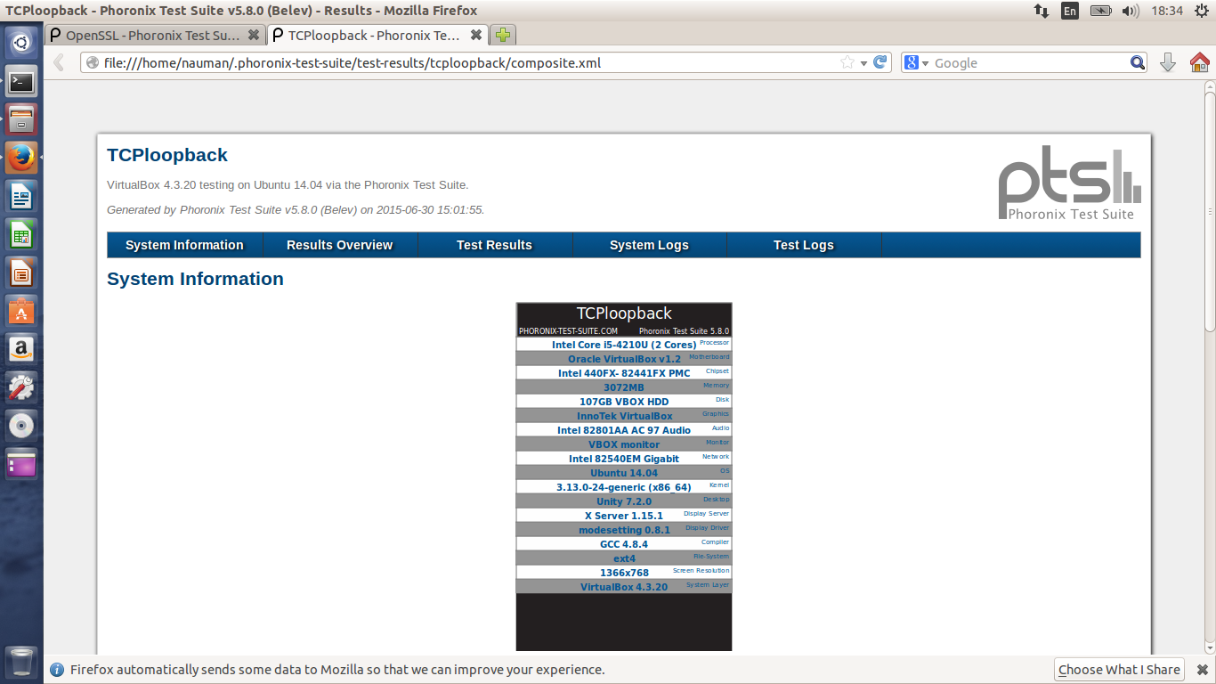
System Information

Slide 23
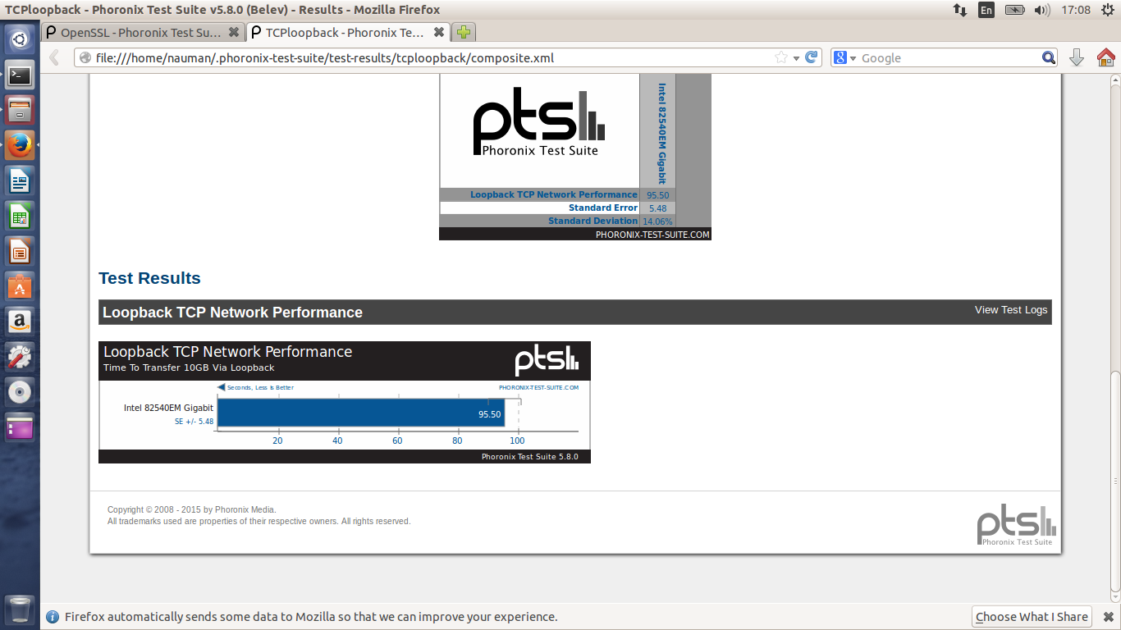
Test Results

