Slide 1
Simplified SFC with Switching-Based Configuration
Verbatim from email provided by Dave Dolson
(ddolson@sandvine.com)

Slide 2
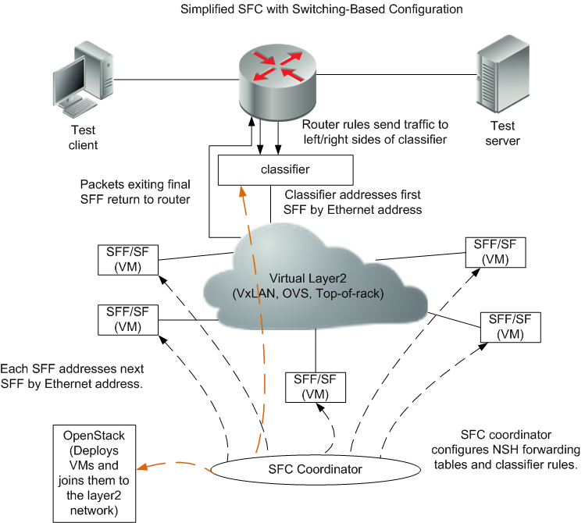
Picture Reference

